Slide 1


@SparkEBP #SparkAwards2023
Spark! Awards 2024 Sponsorship

Slide 2
About Spark!
We believe it’s possible for every young person to be ready, equipped, motivated and able to enter the world of work.
We support young people’s employability skills, knowledge, experience and access, so that they are better prepared for and able to effectively transition into the workplace, finding a job and a meaningful career.
We provide:
high quality work experience placements and internships
inspiring career mentoring relationships
a diverse range of employer engagement and skills development opportunities
A powerful online employability and careers platform
supported transitions into employment
You can read more about Spark! and our work at www.sparkcharity.org.uk.
Charity number: 1138697
Notes:
About Spark! – 1 min

Slide 3
Last year in numbers (2022/23)
3287
young people on our portfolio of activities
783
young people matched with a mentor or work experience placements
61
Schools and colleges participating in a Spark! programme
369
local business and employer partners
14,877
volunteer
hours generously given
84%
of young people stated they have improved employability skills
90%
of young people stated they feel better prepared for work after a Spark! opportunity
98%
of young people feel more equipped to achieve their
career goals
“My career mentor has helped me to find a structure to my life and also my future. I owe my current success to him and I will owe my future to him too. He is the best person I have ever met.” Mentee of the Year winner 2022
Notes:
MATT
Highlight:
PRU partnership
YEP
CONNECT growth

Slide 4































































Some of our employer partners
Notes:
MATT

Slide 5
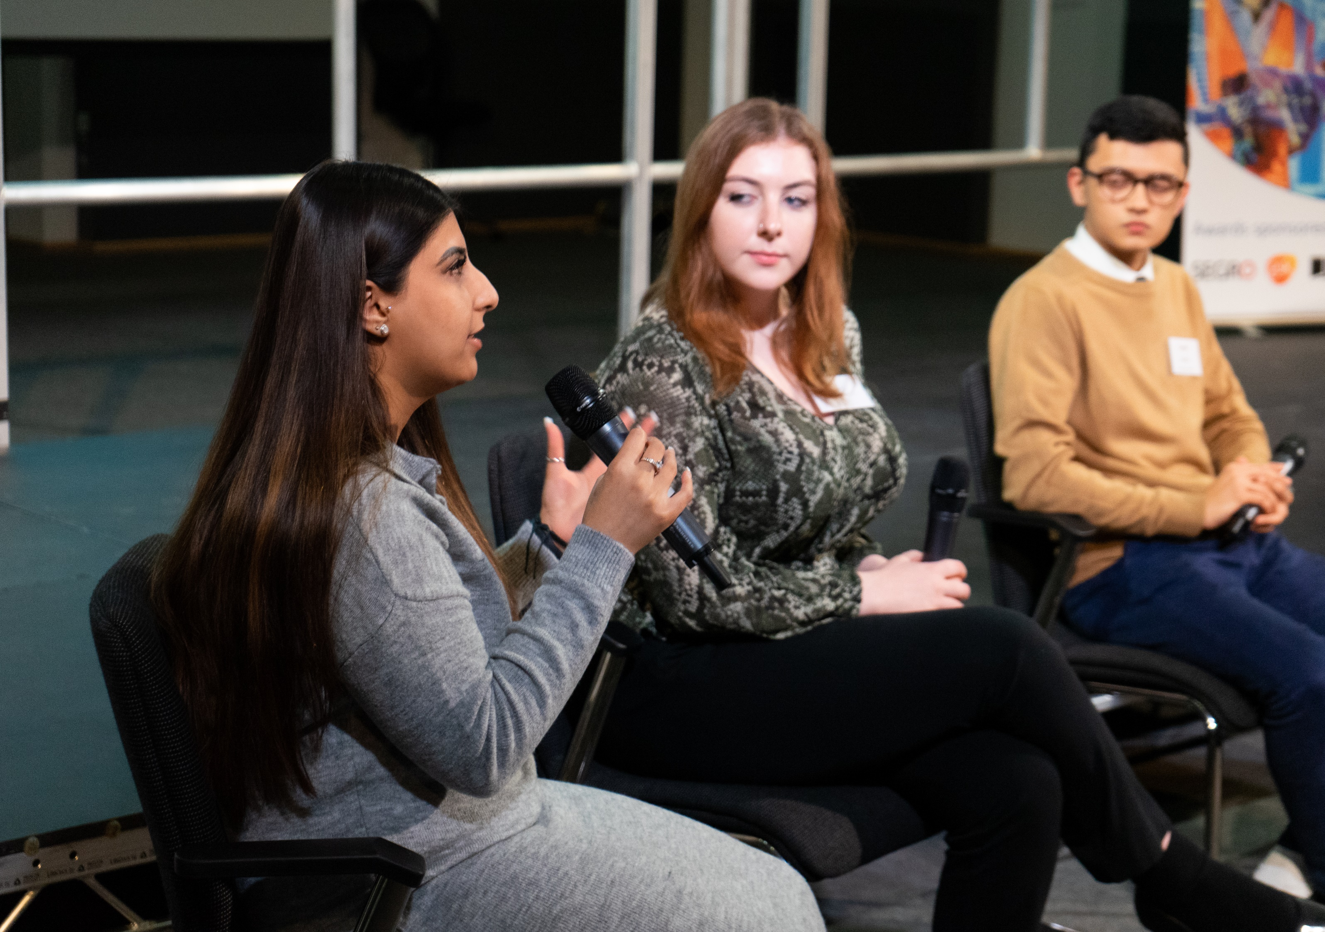
ABOUT THE AWARDS
Notes:
MATT

Slide 6
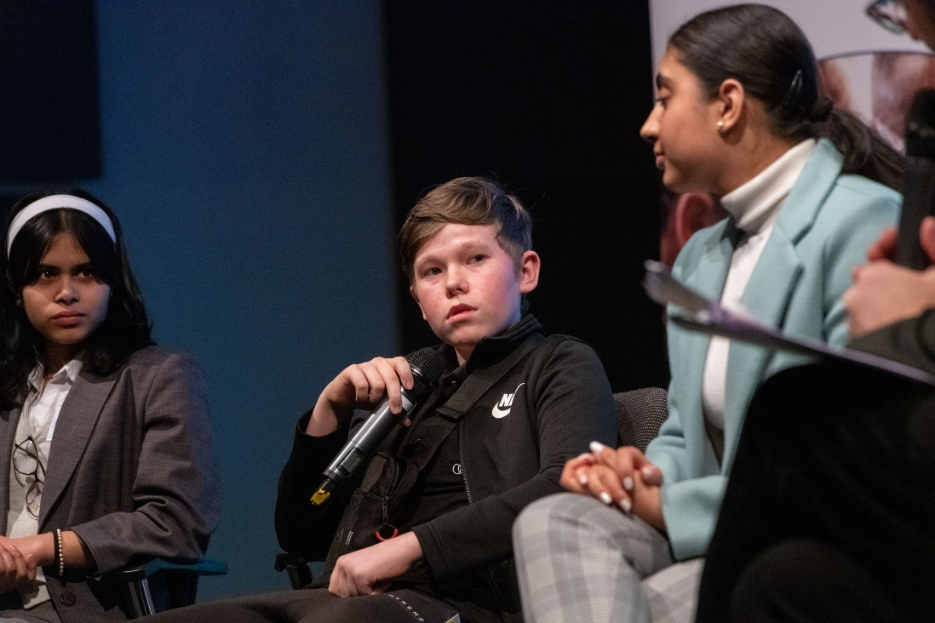
About the Awards
We will be holding our 36th Annual Awards on the 22nd February 2024, at the Clayton Hotel, Chiswick, With over 200 attendees, including local dignitaries and senior stakeholders from the world of business and education.
Sponsoring these brilliant Awards is a great way to support the local community and to acknowledge and celebrate the astounding achievements of young people, schools and businesses, across West London.
The Awards will include young people sharing their experiences of working with Spark! and their journey into employment, and we will also hear from teachers and a selection of our business partners.
Whether you choose the Gold, Silver or Bronze sponsorship package, this is an opportunity to heighten your brand, raise awareness and be recognised as a leading provider of community social value in West London.
See last year’s highlights and winners here.
Notes:
MATT
Housekeeping about toilets? And fire alarm

Slide 7
The Categories
CAREERS LEADER OF THE YEAR Recognising the vitally important role and impact of Careers Teachers and those who have excelled in the past year.
BUSINESS PARTNER OF THE YEAR
Celebrating Spark!'s most impactful and sustained business partners, without whom none of our work would be possible.
WORK EXPERIENCE PROVIDER OF THE YEAR Acknowledging an employers’ commitment towards excellence and the highest quality work experience placements.
WORK PLACEMENT YOUNG PERSON OF THE YEAR Recognising young people who have gone above and beyond during their placements, including work experience, internships, Apprenticeships and T Level placements.
SCHOOL / BUSINESS PARTNERSHIP OF THE YEAR Highlighting the amazing, productive and meaningful partnerships between schools and employers, upon which good careers guidance and services rely.
CROSS-SECTOR PARTNERSHIP INITIATIVE OF THE YEAR Showcasing the impactful cross-sector partnerships, reaching and benefitting young people most at risk of becoming 'Not in Employment, Education or Training'.
VOLUNTEER OF THE YEAR Celebrating our hundreds of employee volunteers' contribution and commitment to employability skills development for young people.
MENTOR AND MENTEE OF THE YEAR Recognising the powerful and impactful mentoring relationships at the heart of our CONNECT Programme.
YOUNG LEADER OF THE YEAR A new category in 2023 acknowledging and celebrating the commitment and hard work of our Young Ambassadors and Associates.
SPECIAL RECOGNITION AWARD Celebrating the long-term commitment and tireless determination of an individual supporting young people and their employment prospects.
Notes:
MATT
Housekeeping about toilets? And fire alarm

Slide 8
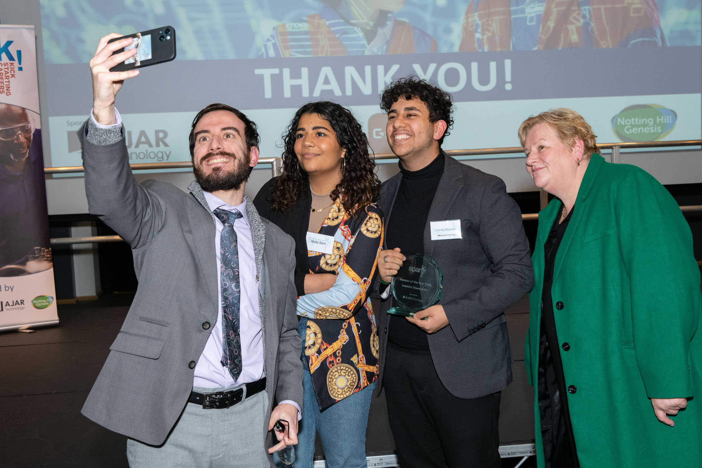
AWARD SPONSORSHIP
Notes:
MATT

Slide 9

GOLD HEADLINE SPONSOR
Prominent branding at the event, inc. podium, slides, printed materials and banners
Digital promotion across social media and the Spark! website
Co-branding of promotional materials
Keynote address (optional)
Two awards named after the company
Company name/logo engraved on awards
Presentation of company awards to the winners
Up to 10 guests
£5000

Slide 10

SILVER LEVEL SPONSOR
Prominent branding at the event, inc. slides and banners
Digital promotion across social media and the Spark! website
Co-branding of promotional materials
One award named after the company
Company name/logo engraved on award
Presentation of company award to the winners
Up to 5 guests
£3500

Slide 11

BRONZE LEVEL SPONSOR
Prominent branding at the event, inc. slides and banners
Digital promotion across social media and the Spark! website
Co-branding of promotional materials
Up to 3 guests
£2000

Slide 12
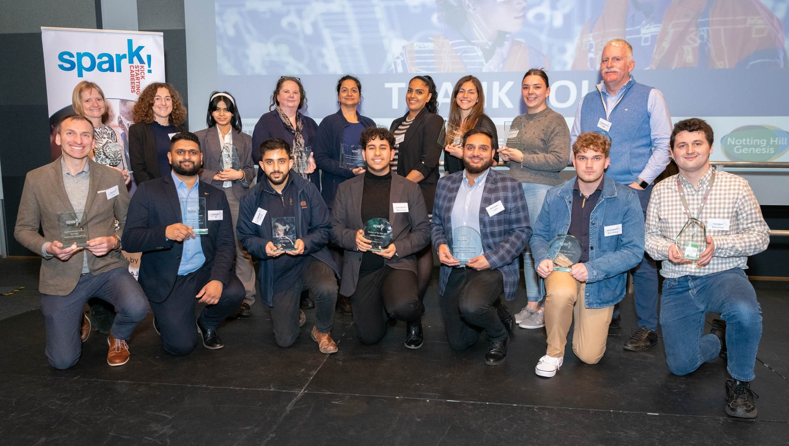

Contact Rachel McAdam
rachelmcadam@sparkcharity.org.uk
07753 745445
@SparkEBP #SparkAwards2023

