Slide 1
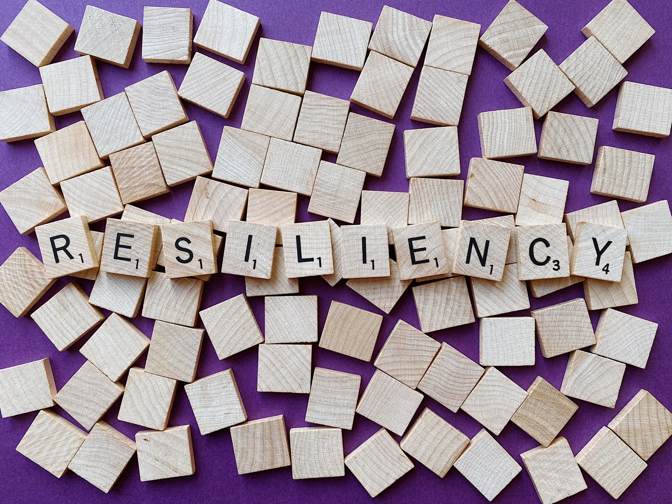

Mentor Toolkit

Slide 2


Using the Mentor Toolkit
  Please download a copy of this presentation onto your own computer
  Feel to free to edit and adapt these resources to suit your mentoring style
  You do not have to (and should not!) use all the activities in this pack, choose the resources that you think will work best for you and your mentee
  If using for an online session, screen share and complete the activities together
  The times given are an estimate - you may find they take less or more time, depending on you and your mentee.

Slide 3









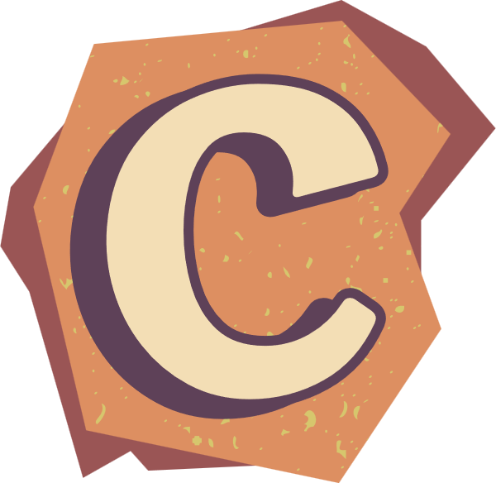

‘Bounce Back’ - an acronym for resilience
ad times don't last, things will get better
ther people can only help if you share with them
nhelpful thinking only makes you feel worse
obody is perfect!
oncentrate on the good things in life
verybody suffers and experiences setbacks – they are part of normal life!
lame fairly – negative events are often a combination of things you did, things others did, and sometimes just bad luck!
ccept what you can't change and change what you can
atastrophising only makes things worse
eep things in perspective – even the worst moment is but one moment
in life

Slide 4

Activity 1 - Exploring Reslience
Goal
Help your mentee to explore what resilience is, what it looks like, and why it's important.
Instructions
1.Discuss what resilience is. You may want to use the "Bounce Back" acronym as a starting point for your discussion
2.Brainstorm what it looks like, feels like and sounds like to be resilient, and fill your ideas into the resilience pie chart
3.Help your mentee to recognise their own levels of resilience by completing the ‘resilience scale’ quiz
Time: 15 mins

Slide 5

Activity 1 - Exploring Reslience
Sounds like...
Resilience...
Looks like...
Feels like...

Slide 6
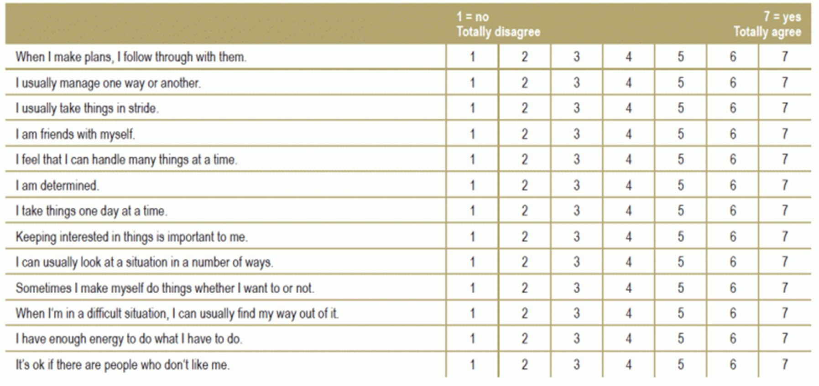
Resilience scale quiz
Scores: 71+ very high resilience, 70-56 High resilience, 55-40 Average resilience,
Less than 40 low resilience

Slide 7
Activity 2: Doors closed, doors open
Goal
Guide your mentee into understanding that the end of something can be the beginning of something new. The end of something is not only negative but can also create room for something positive again. This exercise can help them shift their perspective from focusing on what is not there, to seeing the potential of the future and develop a more optimistic outlook in the face of setbacks or failures.
Instructions
Think about a time in your life where you were rejected, you missed out on something important, or a big plan collapsed. These could be points in your life where a door has closed.
Now think about what happened after: what doors opened after? What doors opened after? What would never have happened if the first door didn't close?
Share your screen and write down your thoughts and experiences on the closed and open doors
Time - 10 mins
Mentor tip - Share your experiences too so your mentee can feel more confident to talk

Slide 8
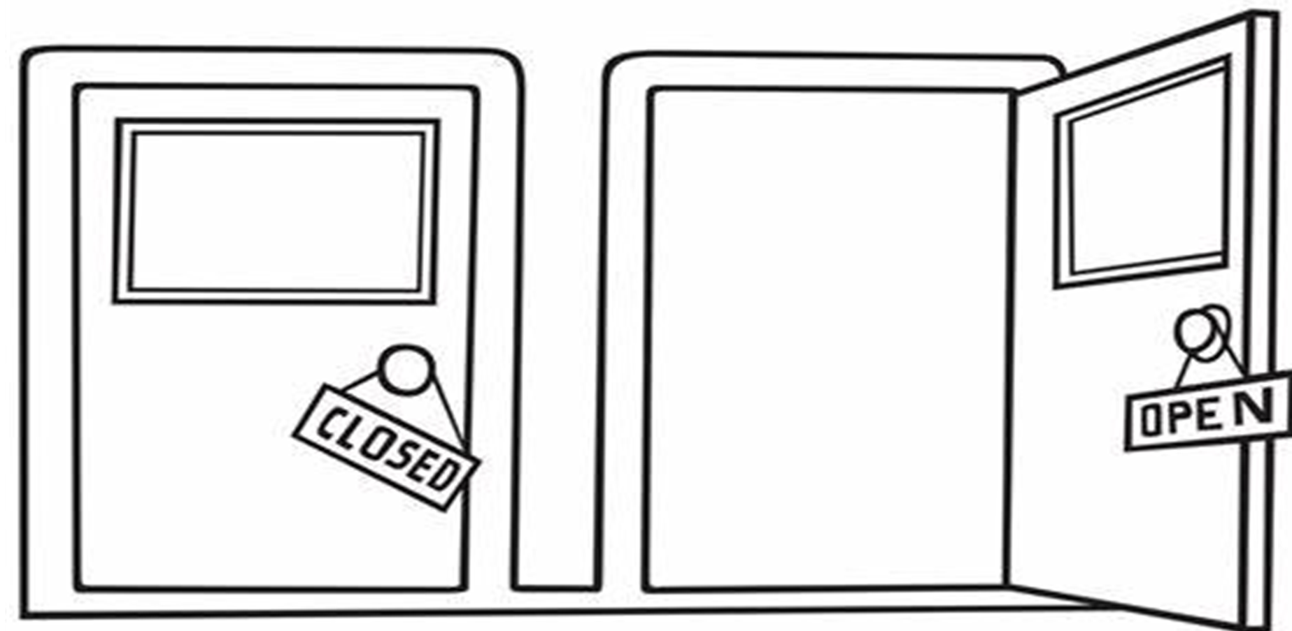
Activity 2: Doors closed, doors open
But a door opened for me when...
A door closed for me when....

Slide 9
Activity 2 follow up discussion
Now reflect upon your experiences and respond with some of the following questions:
•What led to the door closing? What helped you open the new door?
•What were the effects of the door closing on you? How long did they last?
•How long did it take you to realise that a new door was open?
•Was it easy or hard for you to see the new open door?
•What might have prevented you from seeing the new open door?
•What can you do next time to recognise new opportunities sooner?
•What character strengths did you use in this exercise?
•What will a closed door represent to you now?
•What did you learn from the door closing?

Slide 10
Activity 3 – Three good things
Goal
Guide your mentee to focus on the good things in their life, allowing them to develop a more optimistic, resilient attitude. This exercise will help to create a habit of positive thinking.
Instructions
1.Think of three good things that happened to you today and write them down on today's day on the 'Good Things Calendar'.
2.Continue to do this at the end of each day for a week.
3.Bring your 'Good Things Calendar' to your next mentor session and share your week of good things with your mentor
Time: 5 - 10 mins

Slide 11
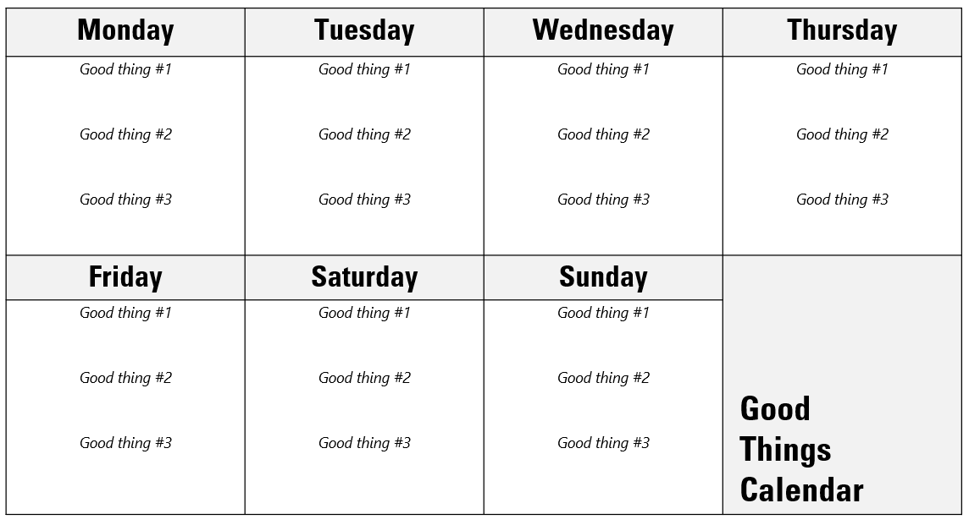
Activity 3 – Three good things

Slide 12
Activity 4: Resilience Plan - The Four S's
Introduction
Resilience is not a trait that people either have or do not have. It involves behaviours, thoughts, and actions that can be learned and developed in anyone. One way to develop resilience is to draw on your learnings from similar challenges in the past.
What helped you through a difficult situation? What supports did you call on, what strategies did you use, what sayings did you hold onto, and what solutions did you find? These resilience resources are also known as the 4 S’s. This tool helps people become more resilient by giving them a framework (The 4 S’s) to bring out what works for them.
Goal
The goal of this tool is to help mentees devise a personal resilience plan based on their existing resources (that is, what has helped them bounce back from difficulties in the past).
Time: 20 mins

Slide 13
Activity 4: Resilience Plan - The Four S's
Support Who helped you or made you feel better? | Strategies What activities or things kept you going?
Sayings What thoughts gave you comfort or hope? | Solutions What behaviours did you show to move on?

Slide 14
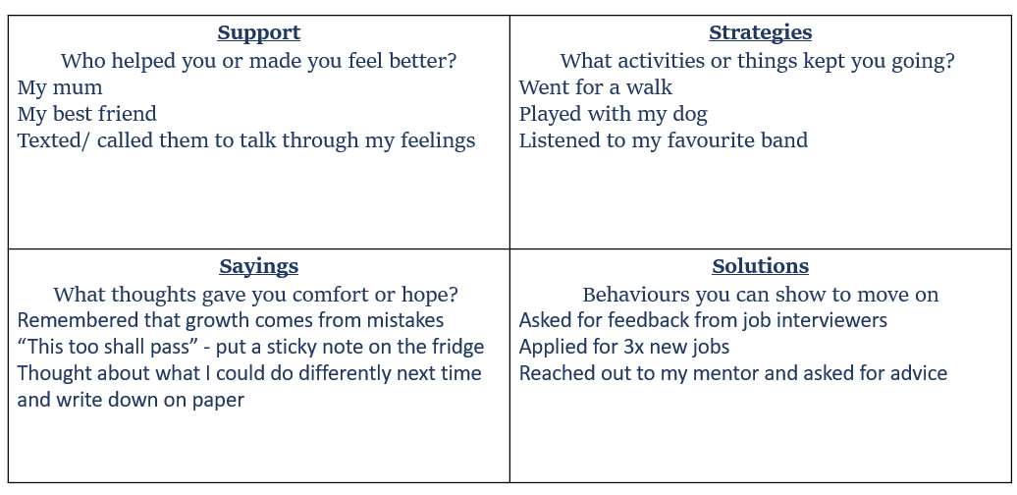

Activity 4: Resilience Plan - completed copy

Slide 15
Wrapping up the session
Reflect on your session by discussing the following questions:
1.Why do you think resilience is an important career skill?
2.What are the most important aspects of resilience?
3.How resilient do you think you have been in the past? Why?
4.What strategies will you use to be more resilient going forward?
5.How confident are you now in your resilience skills?

