Slide 1


Mentor Toolkit

Slide 2


Using the Mentor Toolkit
  Please download a copy of this presentation onto your own computer
  Feel to free to edit and adapt these resources to suit your mentoring style
  You do not have to (and should not!) use all the activities in this pack, choose the resources that you think will work best for you and your mentee
  If using for an online session, screen share and complete the activities together
  The times given are an estimate - you may find they take less or more time, depending on you and your mentee.

Slide 3

Activity 1: Good CV vs Bad CV
Instructions
Step 1: Check your mentees understanding of the purpose of a CV by asking the following questions:
  What do you think is the purpose of a CV?
  What do you think an employer is looking for in a CV?
  How long do you think it takes an employer to make a decision when first seeing a CV?
  How long do you think a CV should be?
Step 2: Share CV examples (next few pages, or find your own online), and discuss the prompt questions for each
Step 3: Based on the example CVs, discuss the 'Do's' and 'Do Nots' of CV writing. Encourage your mentee to write down their thoughts or fill in the table together
Time 15 – 20 mins

Slide 4
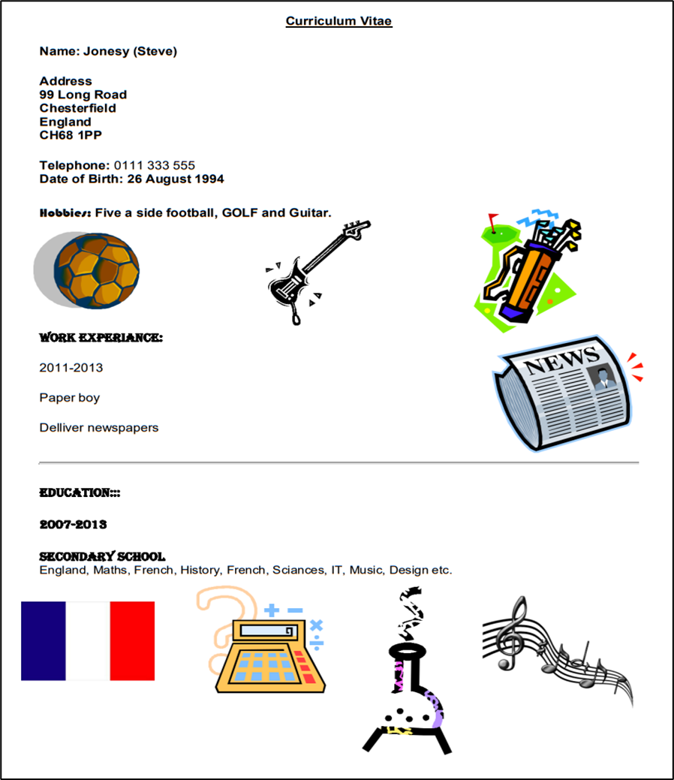

CV Example 1
  What do you think of this CV? Why?​
  If you were an employer, what impression do you get of this person? ​
  Would you hire them? Why/why not?

Slide 5
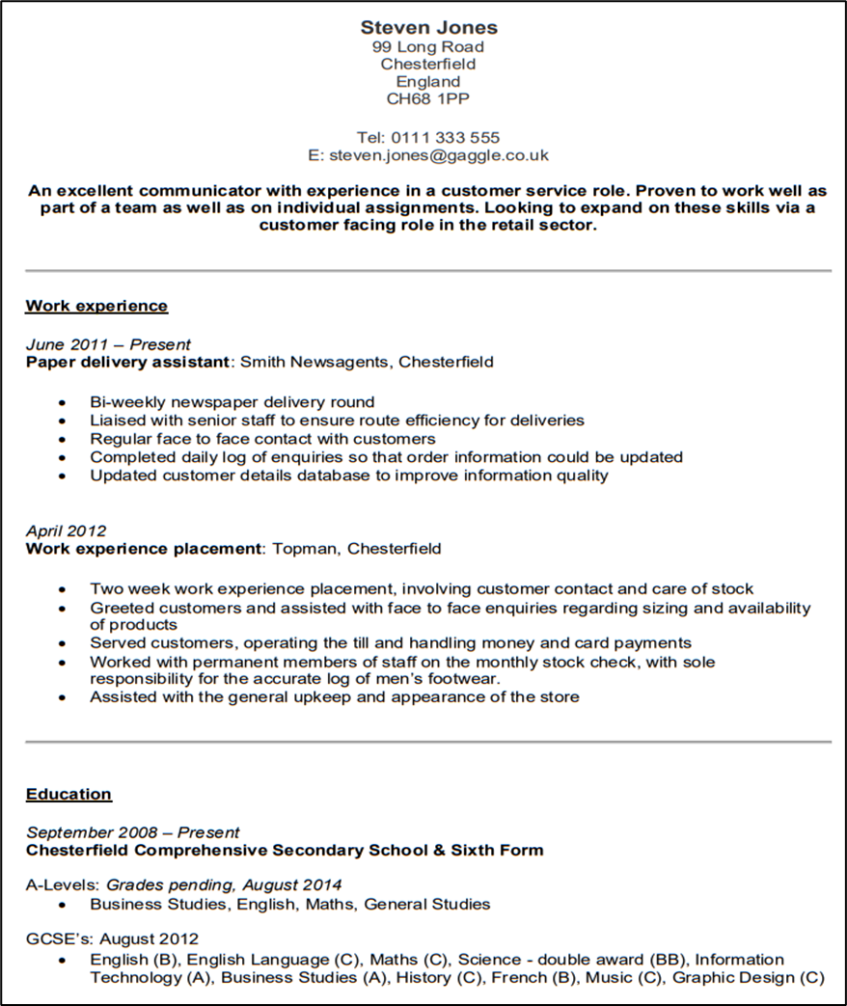
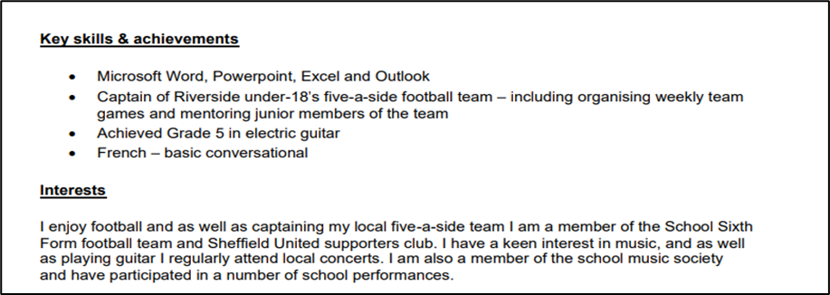
CV Example 2
  What do you think of this CV? Why?​
  If you were an employer, what impression do you get of this person? ​
  Would you hire them? Why/why not?

Slide 6
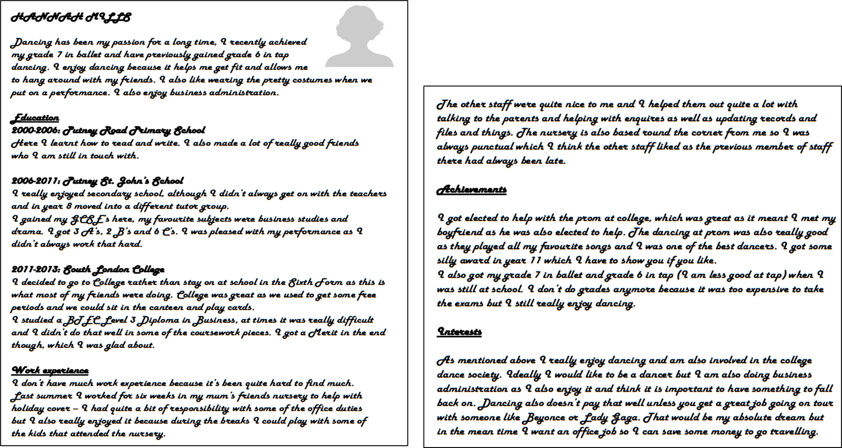
CV Example 3

Slide 7
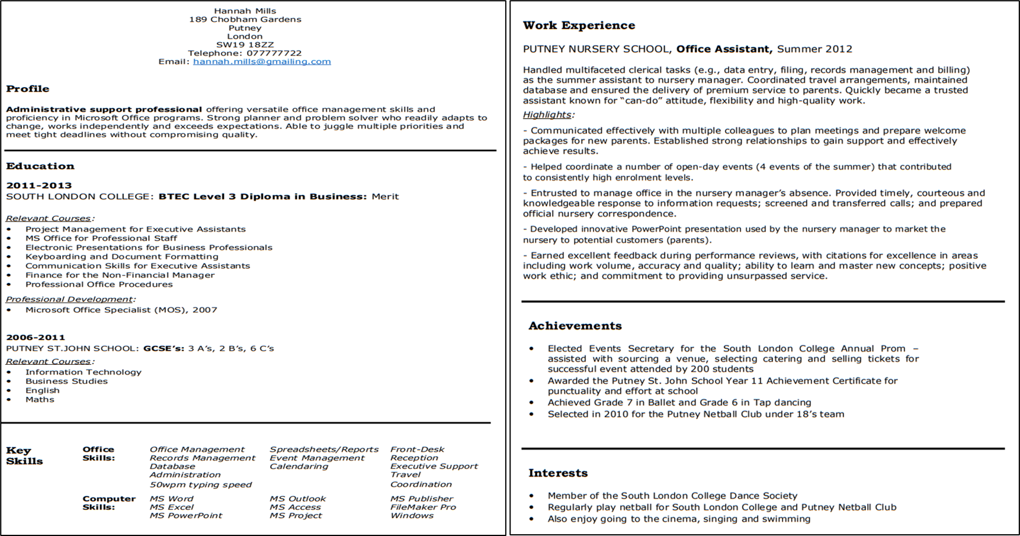
CV Example 3

Slide 8
Activity 1: Step 3 - CV do’s and don’ts
DO | DO NOT

Slide 9
Activity 1: Step 3 - CV do’s and don’ts
Completed example
DO | DO NOT
Research the company and the job before you start match the words you use to the keywords in the job description use a clear font, headings, bullet points and spacing to make it easier to read be clear and to the point and keep it to 2 sides of A4 Keep it concise and relevant Include dates for work experience and qualifications Sell yourself! get someone else to proofread it, and double check spelling and grammar | •Include irrelevant information or add too much information •Write anything negative about yourself •Write long paragraphs •Use informal language or slang •Include irrelevant personal details like nicknames or too much detail about hobbies and interests •Include graphics such as pictures •Use fonts and colours that are hard to read •Lie about your qualifications or experience

Slide 10
Activity 2 - Writing a CV
Goal
Help your mentee to write an effective CV
Instructions
Step 1: Open the CV template word document provided in the toolkit. You may want to share this document with your mentee, and/or share your screen so you work on it together
Step 2: Follow the ‘How to guide’ on the next pages, and support your mentee to fill in the template based on their own qualifications, experience, and industry they are hoping to apply for
Time 30+ mins

Slide 11
Activity 2 - Writing a CV, ‘How to Guide’
1. Contact details
You’ll need to provide details of how employers can get in touch with you if they want to offer you an interview.
You should only include your:
•name at the top of the page - no need to add 'CV' or 'curriculum vitae'
•phone number which employers can reach you on during the working day
•email address - always use a professional sounding email address
•You can also provide a link to your professional networking profile, like LinkedIn.
•Do not include your age, date of birth, marital status or nationality.
2. Personal Statement
This is a few short lines that sum up who you are and what you hope to do. It should go just under your name and contact details.
Think about the job you want and what the employer is looking for. Make your profile sound like you're the right person for the job. See the CV template for an example.

Slide 12
Activity 2 - Writing a CV, ‘How to Guide’
3. Key skills and achievements
Provide details of skills and achievements you have gained that will be relevant to the job you are applying for. Be sure to refer to the job description and match the words you use to the keywords included there.
Skills you could include here could be: IT skills such as Microsoft Office; 'soft' skills such as communication; and qualifications taken outside of school, such as First Aid.
4. Work history
Include placements, volunteering and any paid jobs you’ve had. You should list these with the most recent first, and include:
•the employer details
•the job title
•the dates you worked there
•what you did, usually 2 to 3 lines
If you’re applying for your first job, you can focus on skills you’ve learned through: projects; part-time work; work experience; internships and placements; or volunteering
Use active words to highlight your strengths and skills, to describe things you've done like organised, created, built, managed, planned.
Give positive examples of your achievements rather than just listing responsibilities. Use the STAR method to help (find more information on the STAR method in the Interview Skills resource)

Slide 13
Activity 2 - Writing a CV, ‘How to Guide’
5. Education
In chronological order, you’ll need to include the:
•names of your qualifications
•school, college or university where you studied
•dates you attended
6. Hobbies, interests or achievements
Try to show the skills you have through your hobbies and interests. Keep this section to short and to the point, focusing on examples that show you have relevant skills for the job.
7. References
You can leave out the details of your references at this point, or mention that 'references are available on request'.
The recruiter will ask for these when you get through to the next stage.

