Slide 1
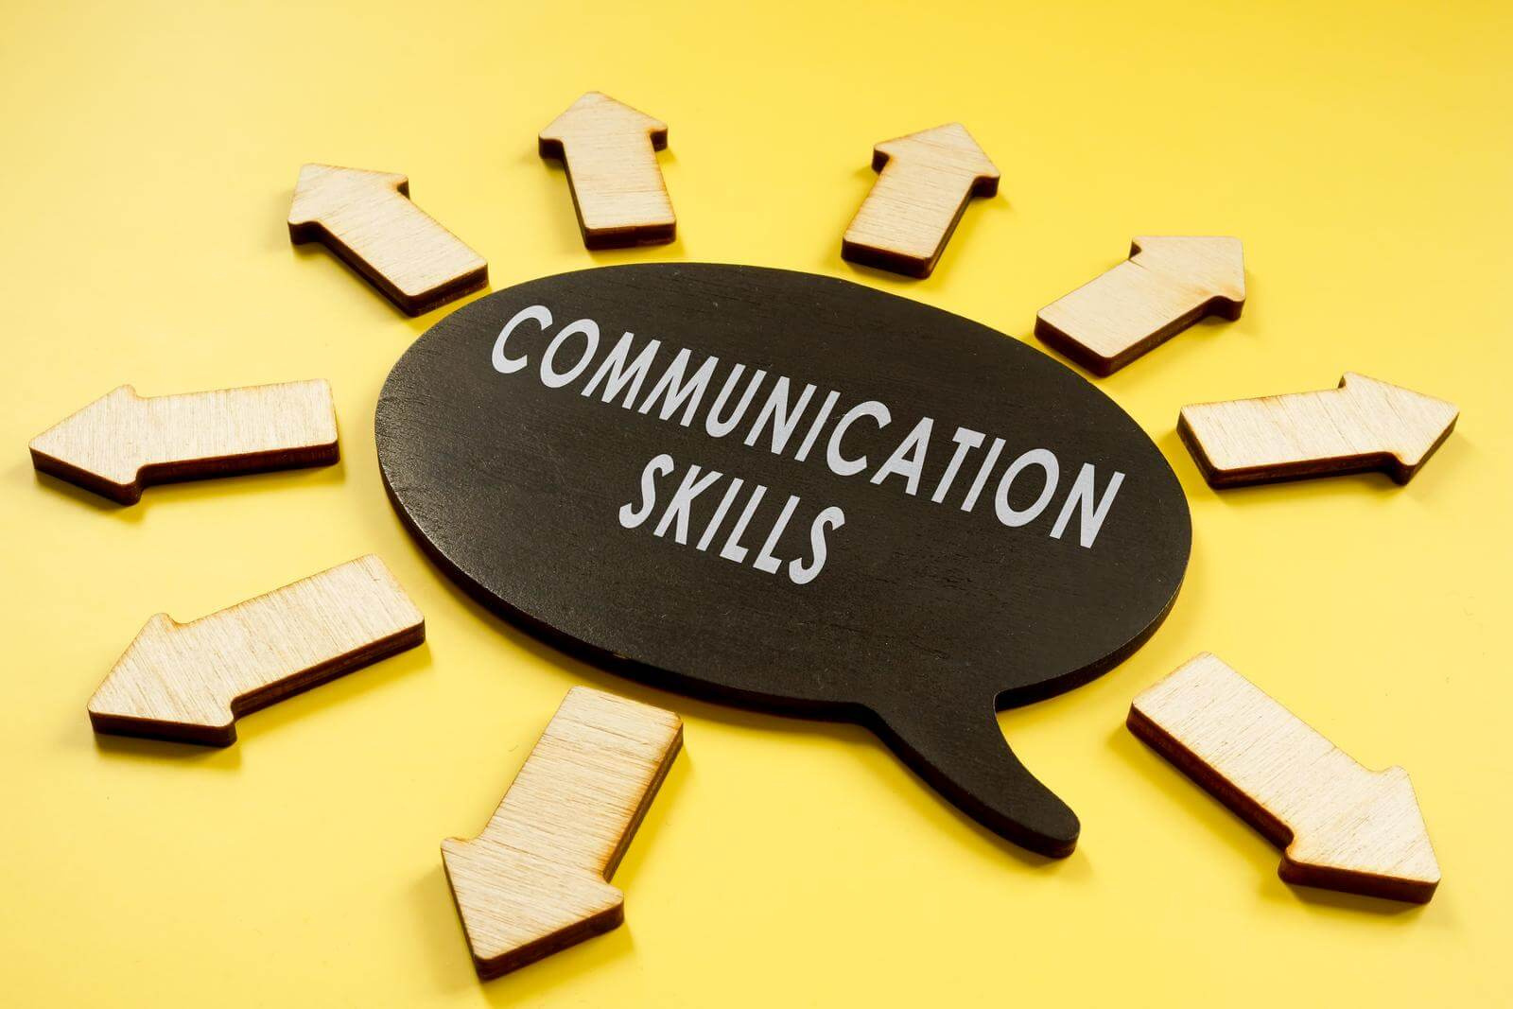

Mentor Toolkit

Slide 2


Using the Mentor Toolkit
  Please download a copy of this presentation onto your own computer
  Feel to free to edit and adapt these resources to suit your mentoring style
  You do not have to (and should not!) use all the activities in this pack, choose the resources that you think will work best for you and your mentee
  If using for an online session, screen share and complete the activities together
  The times given are an estimate - you may find they take less or more time, depending on you and your mentee.

Slide 3

Activity 1: Informal vs formal communication
Goal​
Guide your mentee to understand the importance of professional language skills and how they can benefit personal and professional growth. ​
​
Instructions​
Step 1: Discuss with your mentee the idea that you should change the way you say things to suit the situation - Sometimes it’s best to speak formally, at other times it’s more appropriate to speak in a more informal way. ​
Step 3: Brainstorm: What situations should you use formal language, and what situations can you use informal language? You may use the graphic on the next slide to guide you, or simply write your ideas down on a piece of paper. ​
Step 2: Go through the 'Ways of saying things' table together, discussing how to express yourself in each situation ​
Time: 15 mins

Slide 4



Activity 1: Informal vs formal communication
Situations to use
informal language
Situations to use formal language

Slide 5
Activity 1 - ways of saying things table
Informal | Formal
Coffee please | May I have a coffee, please?
What do you want?
That's a rip off!
 | I'd like to introduce my mother
Great hat!
Where's the way out?
 | May I speak to the headteacher, please?
 | I’m intending to visit my aunt in the near future
Why not?
 | I’m hoping to complete my course in the summer

Slide 6
Activity 2 - Active Listening (Part 1)
Introduction
Communication skills are not just about speaking, they are about listening too. However, there’s more to being a good listener than hearing the words another person says. For effective communicators, listening is an active process, rather than a passive one. An active listener is a participant in a conversation—not just an audience.
Goal​
Help your mentee to understand what active listening is and why it is important, and facilitate practice of key skills in active listening
Instructions (part 1)
Use the BUILD acronym to explore with your mentee the key components of active listening and then discuss with them the importance of active listening skills for the workplace.
Time: 5mins

Slide 7
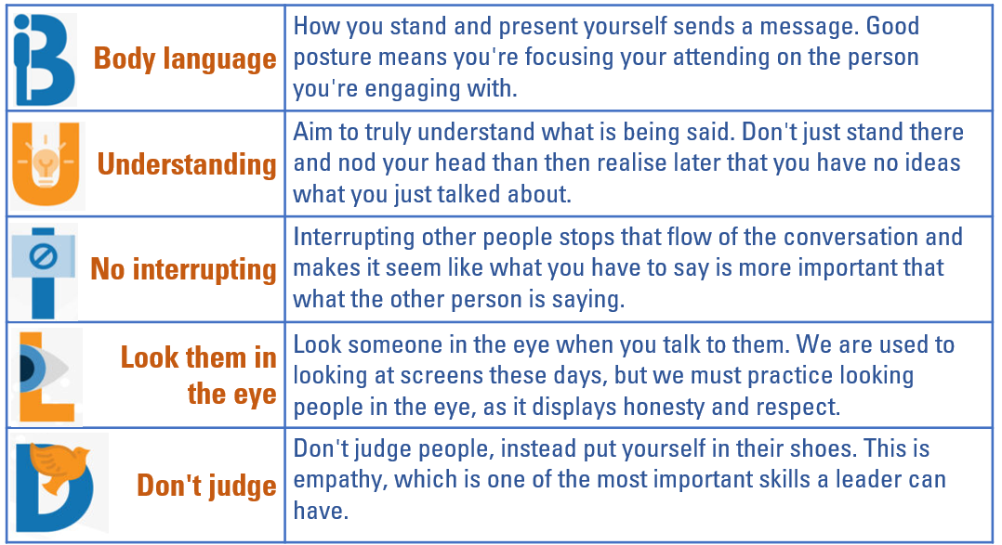
Activity 2 - Active Listening (Part 1)

Slide 8
Activity 2: Active listening (Part 2: Guided
Conversation)
Instructions
Step 1: Ask your mentee to choose a topic they are interested in or passionate about, and then get them to share their thoughts and ideas on the chosen topic for around 3 minutes, while you practice active listening techniques, such as maintaining eye contact, nodding, paraphrasing, and asking open-ended questions.
Step 2: After your mentee has finished sharing, ask them to take a moment to reflect on how they felt while speaking and whether they felt actively listened to.
Step 3: Now switch roles: It is your turn to talk for 3 mintues whilst the mentee practices active listening skills, encourage them to refer back to the BUILD acronym. You may also want to share with them the ‘Steps for Active Listening’ Guide
Step 4: Offer specific feedback on the mentee's active listening skills, highlighting strengths and suggesting areas for improvement, if applicable.
Time: 15mins

Slide 9
‘Steps of Active Listening’ Guide
Pay Attention | Give your full attention to the speaker and focus on what they are saying. Maintain eye contact.
2. Avoid Interruptions | Let the speaker express their thoughts without interrupting. Avoid finishing their sentences or jumping to conclusions.
3. Reflect Feelings | Recognise and acknowledge the speaker's emotions or feelings shown through their words or tone of voice. This shows empathy
4. Ask Clarifying Questions | Ask for clarification when you don't understand something. Ask open-ended questions to encourage the speaker to provide more details or elaborate on their thoughts. Can you give me an example or show me what you mean?; What exactly do you mean by that?; Can you tell me more?; Why do you think that?
5. . Reflect on the content | share your thoughts, insights, or relevant personal experiences if appropriate
6. Avoid Judgment | Listen with an open mind, allowing the speaker to express themselves freely without feeling judged.
7. Paraphrase | Summarise or restate their words to ensure understanding. This demonstrates that you are actively processing the information and helps clarify any misunderstandings

Slide 10
Activity 3 - Non-verbal communcation
Goal
Guide your mentee through the importance of non-verbal communication, and help them to understand how to adapt their body language for the workplace
Instructions
Step 1: Read and discuss the 'Decoding body language in the workplace' infographic
For each page, you may want to use the following prompt questions to stimulate discussion:
-Do you think you sometimes do this example of negative body language ?
-Why does this body language represent poor communication skills?
-In what way can we improve this negative body language?
Step 2: Review what you have discussed about non-verbal communication, and then assign your mentee to select three positive body language strategies to try and use over the next week. Next session, ask them about these behaviours:
-How regularly did you use your chosen strategies?
-Did you notice people reacting differently to you when you improved your body language?
-How did using these strategies make you feel?
Time: 15 mins

Slide 11
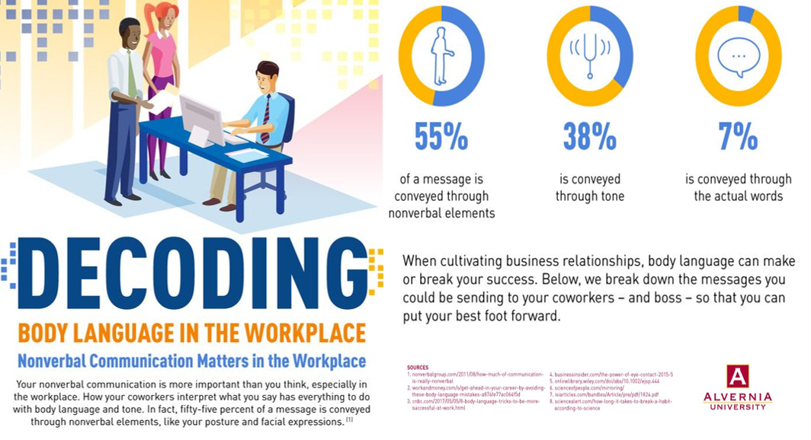

Slide 12
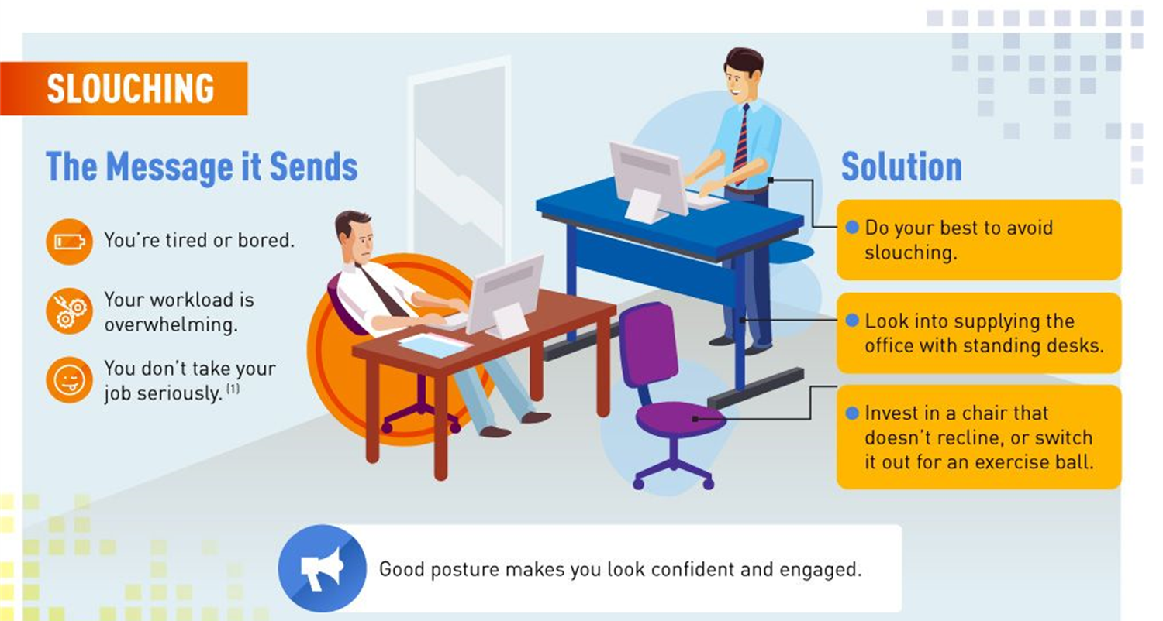

Slide 13
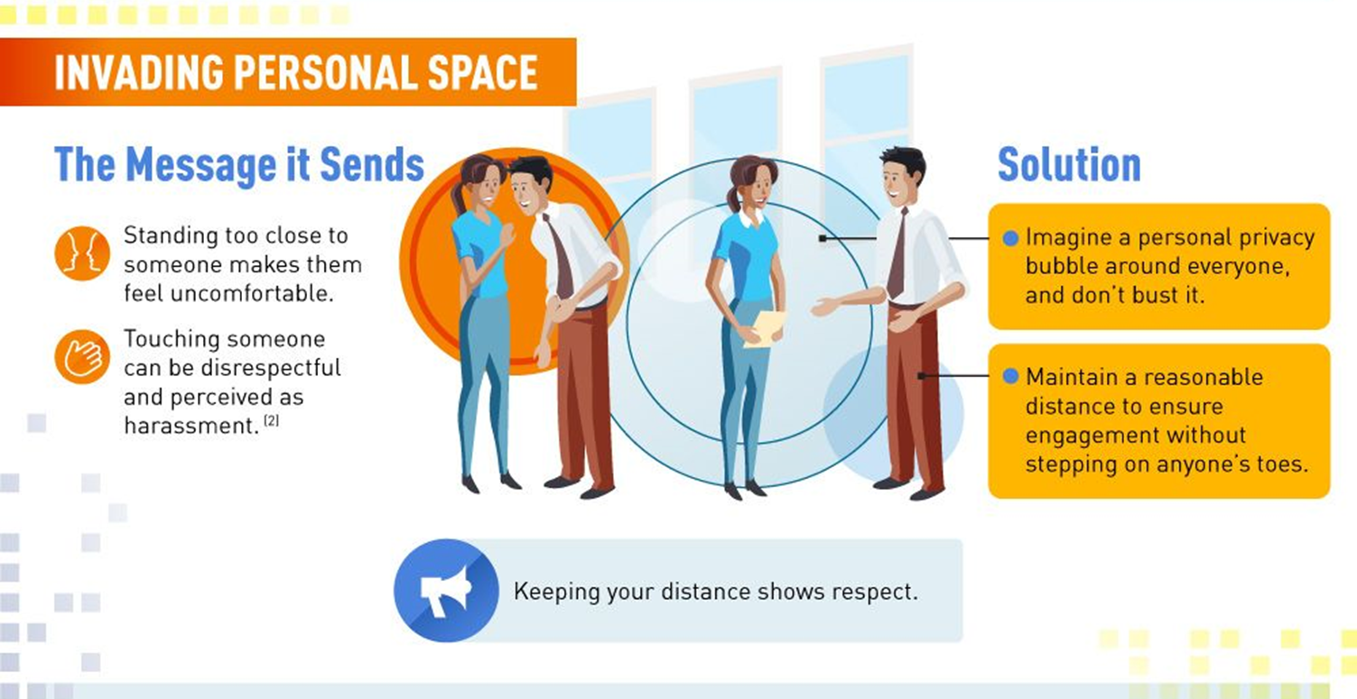

Slide 14
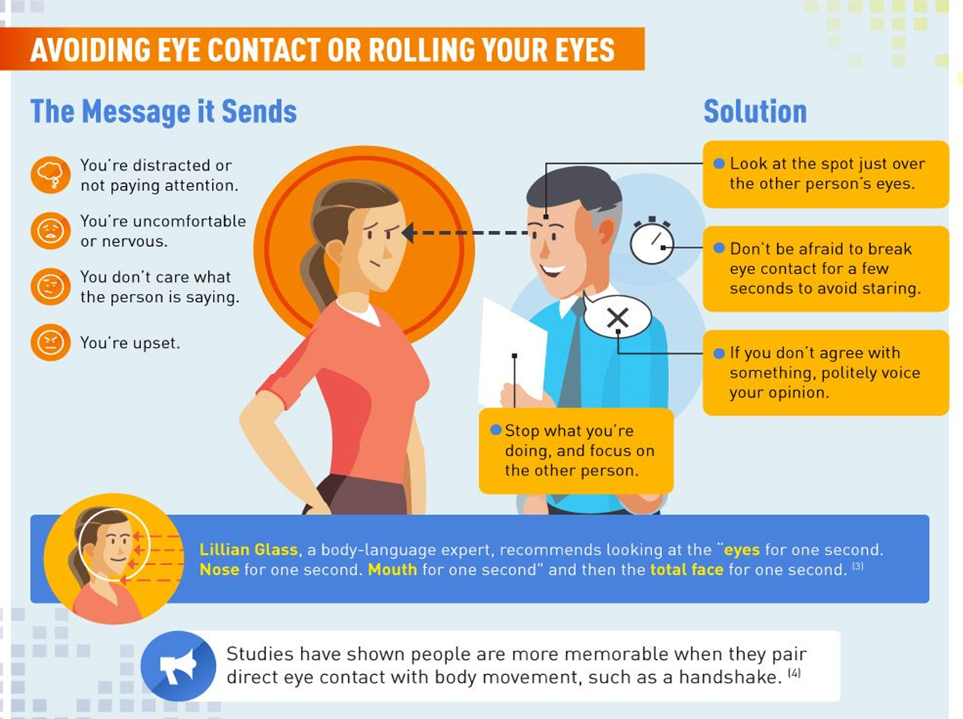

Slide 15
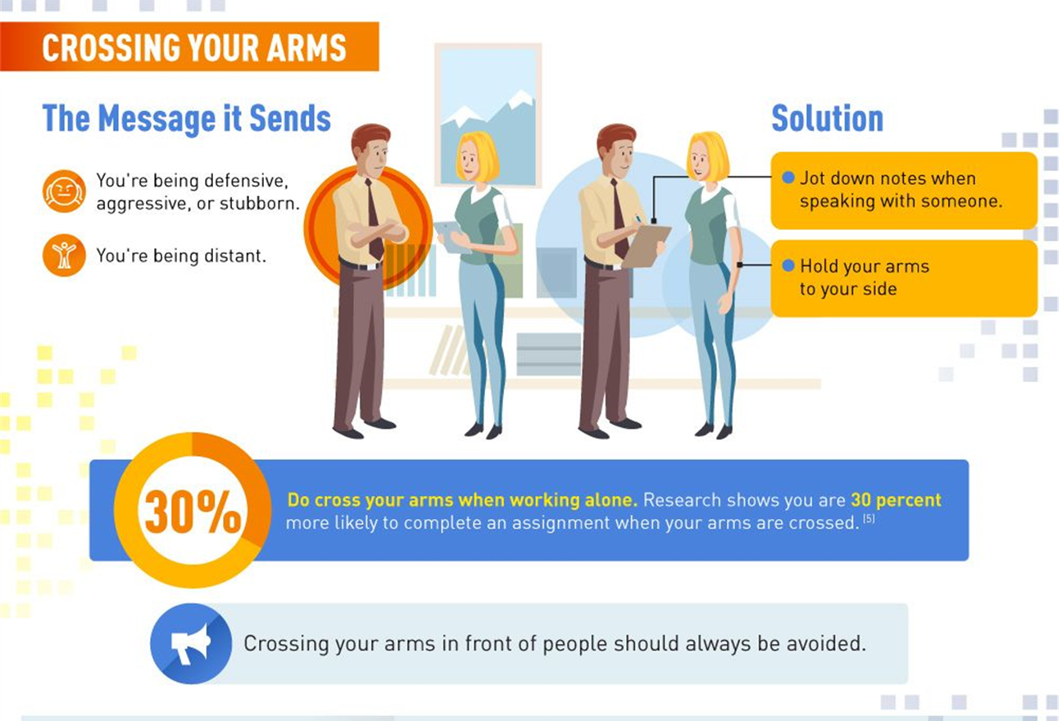

Slide 16
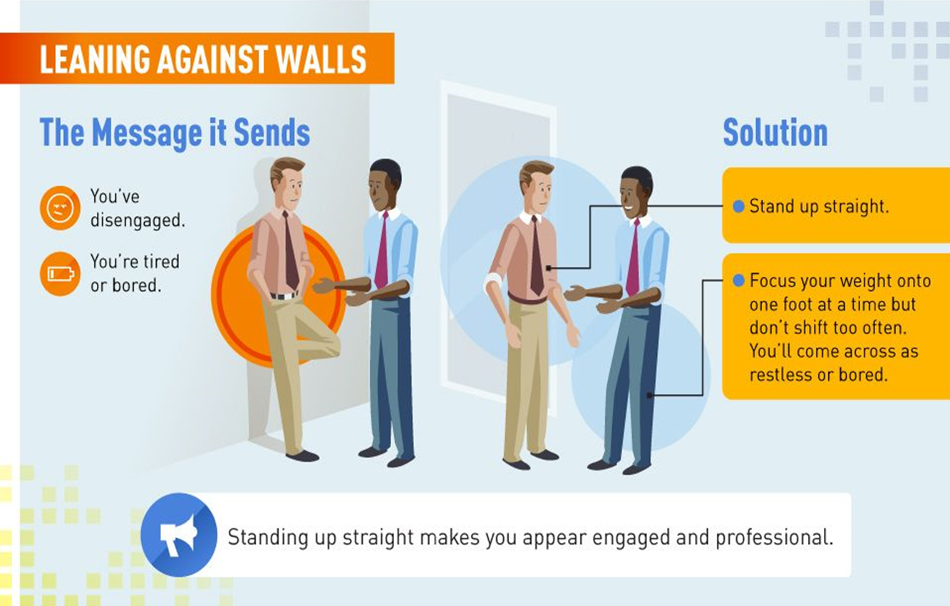

Slide 17
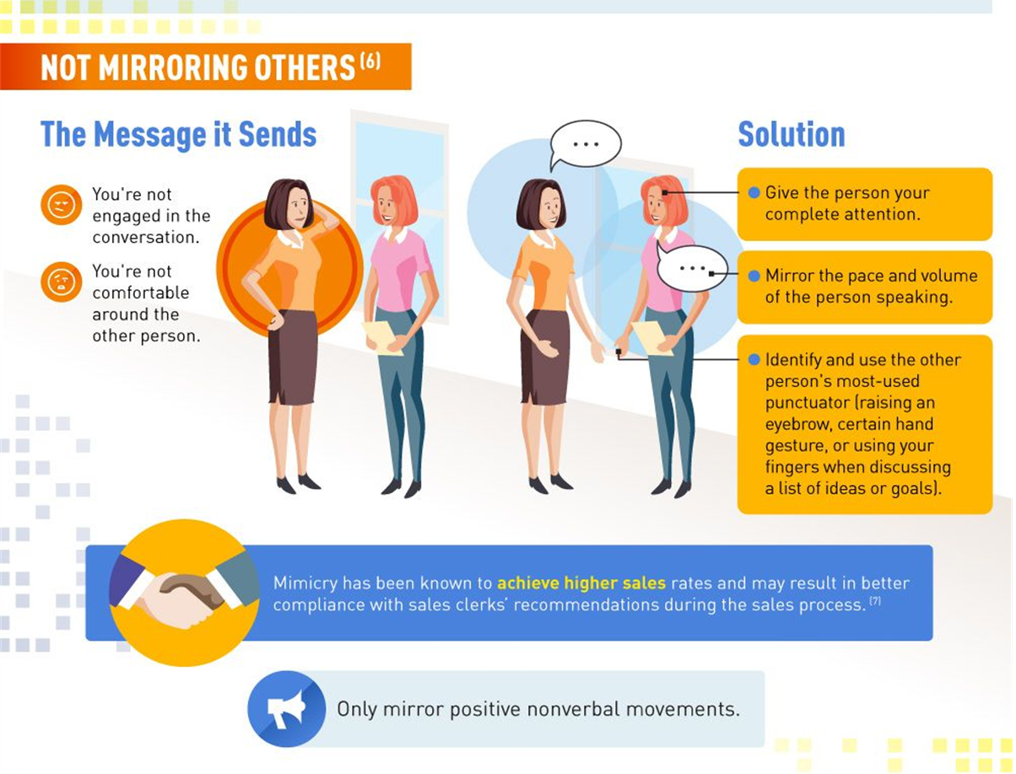

Slide 18
