Slide 1

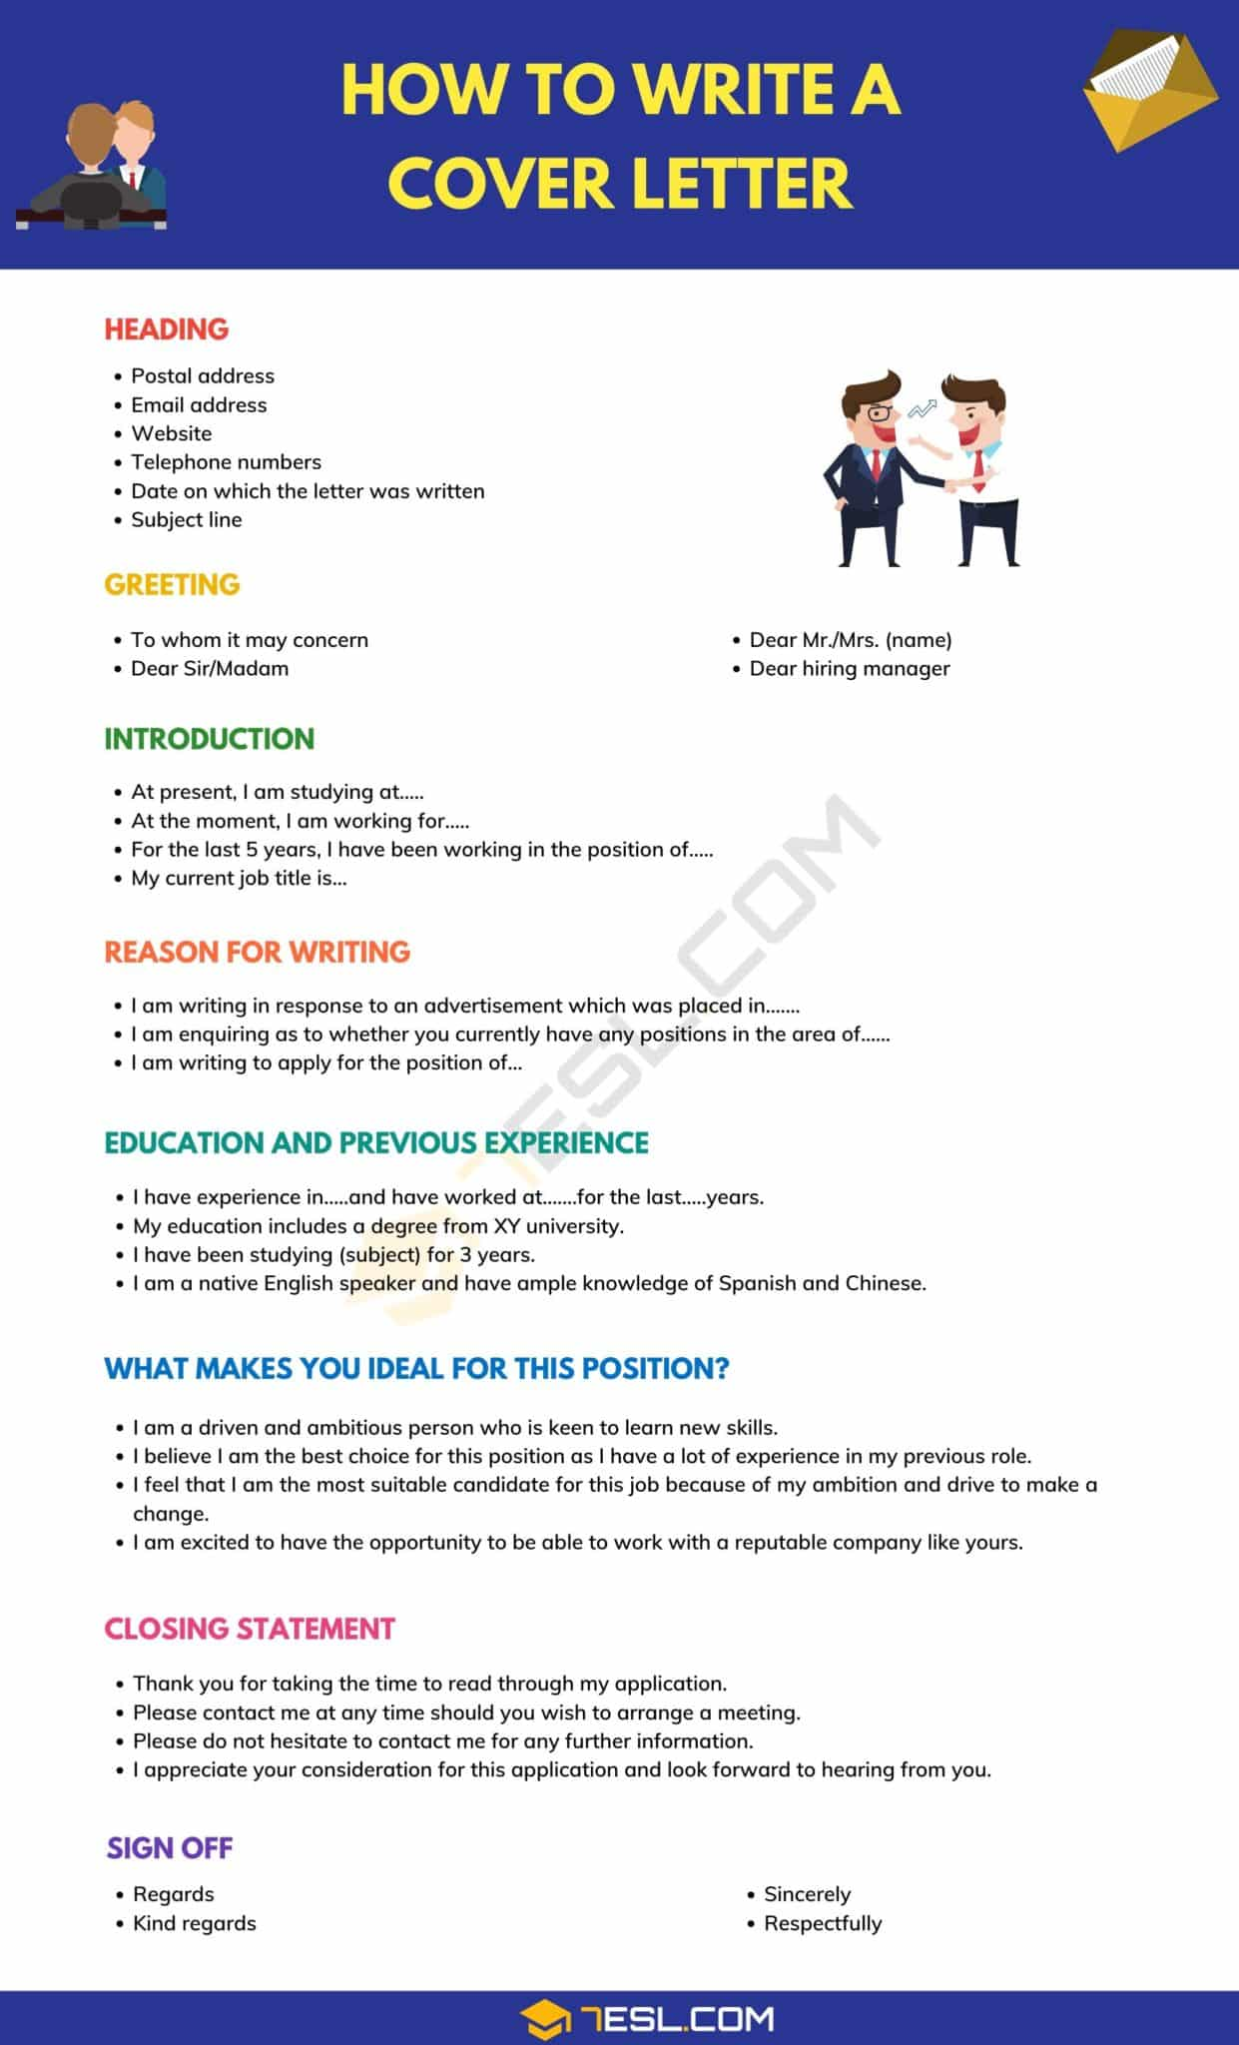
Mentor Toolkit

Slide 2


Using the Mentor Toolkit
  Please download a copy of this presentation onto your own computer
  Feel to free to edit and adapt these resources to suit your mentoring style
  You do not have to (and should not!) use all the activities in this pack, choose the resources that you think will work best for you and your mentee
  If using for an online session, screen share and complete the activities together
  The times given are an estimate - you may find they take less or more time, depending on you and your mentee.

Slide 3

What is a cover letter?
•A cover letter is a letter that you write about yourself and submit alongside your CV when applying for a job. Within it, you explain why you’re the right candidate for that role, based on your experience and skills.
•A potential employer might use a cover letter as an introduction to you before moving on to your CV, so it’s important to make a strong impression.
•Just like you would tailor your CV to the specific role you’re applying for, you should write a cover letter with a particular job in mind. The concise structure of a CV can make it hard to stand out. But the structure of a cover letter gives you more room to showcase your skills and personality.

Slide 4

When do you need a cover letter?
•The first thing an employer will see is your CV and cover letter so you want both to stand out.
•A job application will tell you whether you need to include a cover letter or not. Most applications do ask you to, or some may get you to fill out some online questions instead. You probably won’t need a cover letter for a part-time job as a student, for example.
•If a job description doesn’t say anything about a cover letter, play it safe and include one just in case. It’s a great opportunity to demonstrate your skills and show you’ve gone the extra mile.

Slide 5
How should you structure a cover letter?
•A cover letter should be roughly one side of A4 and broken up into short paragraphs (usually 3 to 5) so it’s easy to read. Just like your CV, stick to a sensible font type, size, and colour.
•Ideally, you should submit it as a PDF version with a clear filename, so it always looks the same regardless of the device it’s opened on.
•Do your research on the company! Learn more about what they do by looking on their website, recent news articles and connecting with people who work there.
•Keep it simple, neat and clean – you don’t need to overcomplicate it.

Slide 6
What should you include in a cover letter?
1)Contact details
2)Who to address your cover letter to
3)Clarify the role you’re applying to
4)Describe yourself and your experience
5)Why you’re looking for a new role?
6)Demonstrate your key achievements
7)Why that company/organisation/field?
8)Conclusion: reiterate with impact

Slide 7
Tips for writing a cover letter
When writing your cover letter, remember to:
•write a new one for every job you apply for and make sure it’s tailored to the company and the specific role
•use the same font and size as you do for your CV, so it looks consistent
•make sure the company name and recruiter’s details are correct
•use the right language and tone: keep it professional and match the keywords used by the employer in their job advert
•show you’ve done your research into the job and the company
•highlight your most relevant skills and experience to stand out from other applicants
•back up any statements you make with facts and use the STAR method
•double check spelling and grammar before you send it
•keep a copy of your cover letter as they may ask you about it in an interview

Slide 8
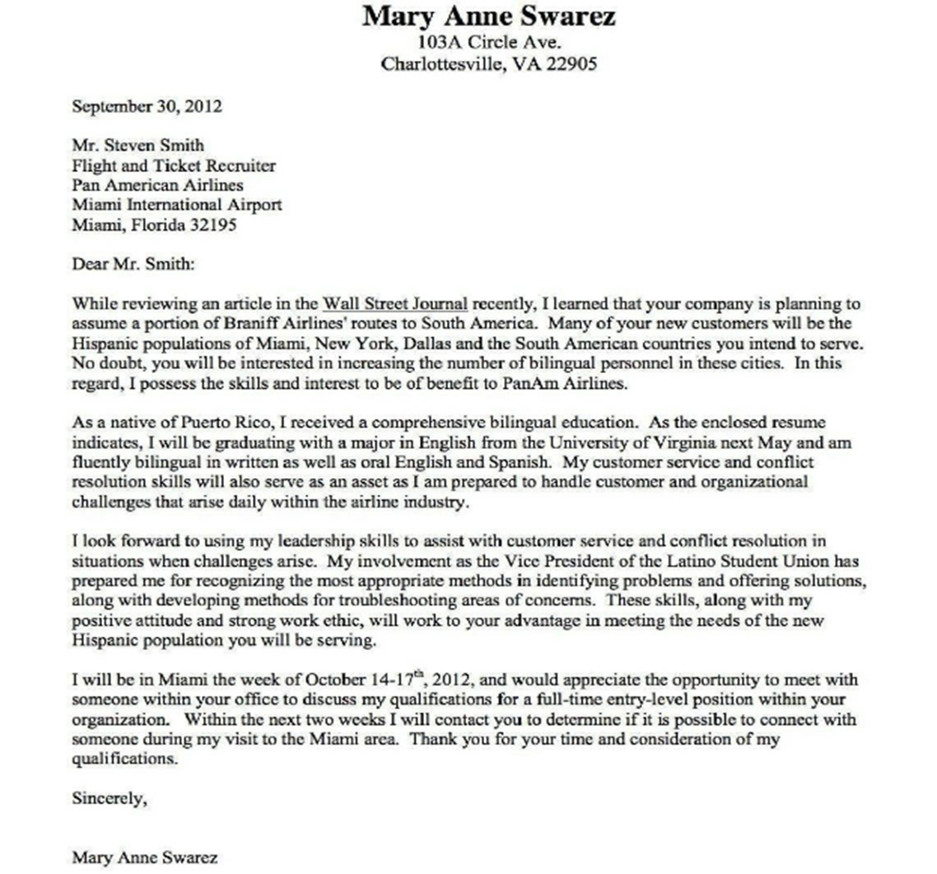
What is good about this cover letter?
What can be improved?

Slide 9
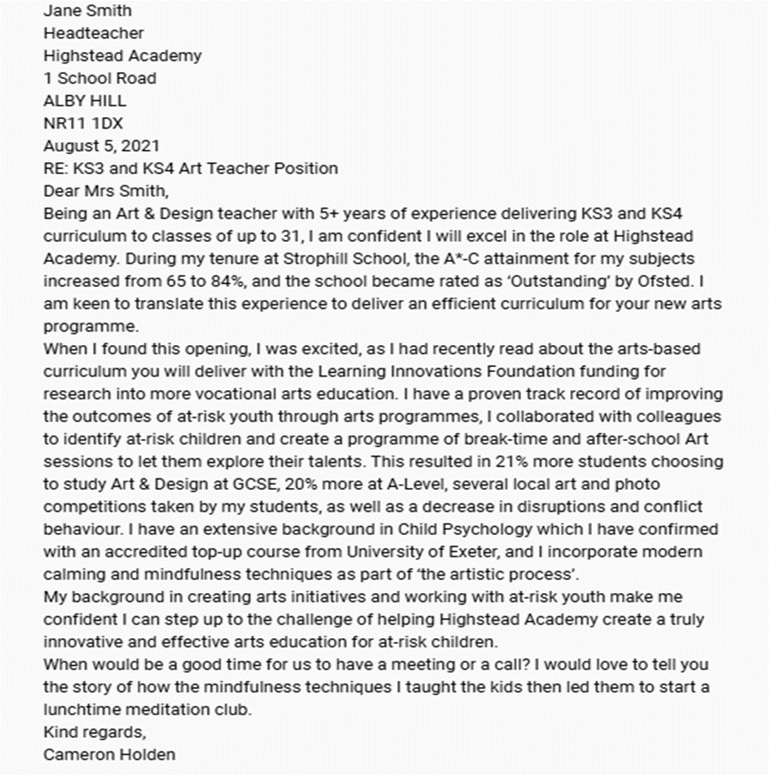
What is good about this cover letter?
What can be improved?

Slide 10
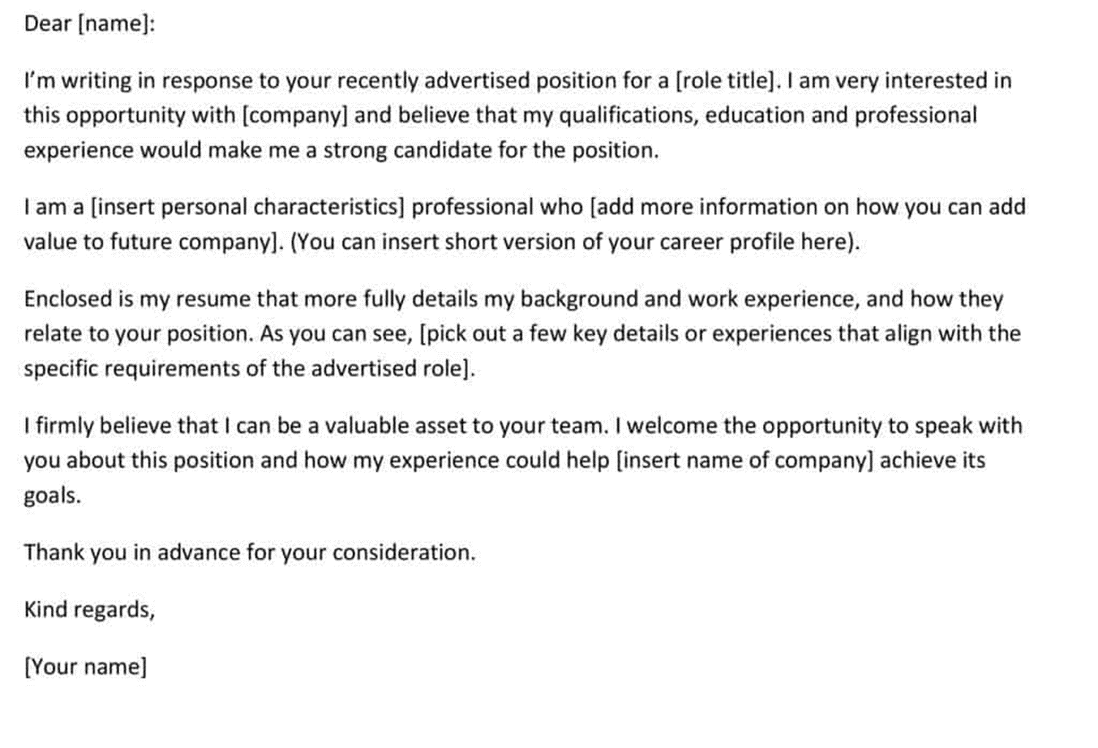
What is good about this cover letter?
What can be improved?

