Slide 1


End of Mentoring: Creating an after-mentoring action plan
Goal:
Aid your mentee in future thinking – help them to plan what steps will they take to further help them reach their goals
Instructions:
Part 1: Revisit your action plan from Session 1. Discuss with your mentee how far they have come to reaching their goals they set.
Any there any goals they feel they have achieved?
Which goals still need further work?
Part 2: Now help them with future thinking:
If there are goals that are not met yet, what can they do to help reach these after your mentorship is over? Do they have any new goals? If so, that steps can they take to work towards them?
Part 3: Structure your thinking with the ‘after mentoring’ action plan on the next page

Slide 2

Creating an after-mentoring action plan
1.Short term goal Something I can achieve in the coming weeks | Actions I can take to help achieve this goal: 1. 2. 3.
2. Middle term goal Something I can achieve over the next few months | Actions I can take to help achieve this goal: 1. 2. 3.
3. Long term goal Something I would like to achieve in the future | Actions I can take to help achieve this goal: 1. 2. 3.

Slide 3
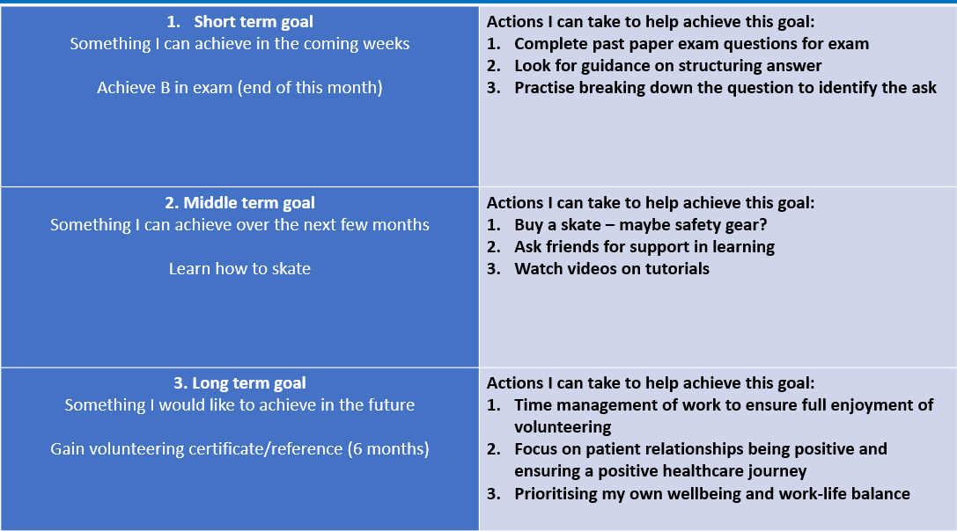

Action plan completed version

