Slide 1


Mentor Toolkit
EXPLORING CAREER
OPTIONS

Slide 2


Using the Mentor Toolkit
  Please download a copy of this presentation onto your own computer
  Feel to free to edit and adapt these resources to suit your mentoring style
  You do not have to (and should not!) use all the activities in this pack, choose the resources that you think will work best for you and your mentee
  If using for an online session, screen share and complete the activities together
  The times given are an estimate - you may find they take less or more time, depending on you and your mentee.

Slide 3

Activity 1: What do you want from a job?
Goal
Guide your mentee through an exploration about what is important for your mentee when considering jobs and a career, helping them to prioritize key career characteristics
Instructions
Step 1: Support your mentee to fill out the table by ranking which factors are the most to least important for them when considering their future career. You may need to explain the meaning of some factors, e.g. ‘organisational culture’
Step 2: Identify which of these factors are essential for your mentee, or simply nice to have. Are there any other factors that they would want to include?
Step 3: Use their answers to kick-off a discussion about what type of job/career they may wish to do and why. Discuss with them how their answers relate to your industry, and help them to identify careers that will fit in with their preferences.
This is an excellent time to give them more details about your industry/career. Use the prompt questions on the next page to guide your discussion.
Time 20 mins

Slide 4

Factor | Rank order 1 = most important, 13 = least important | Essential? Yes, no, maybe?
Hours of work
Salary
Organisational culture
Manager's leadership style
Working with people
Travel opportunities
Development opportunities
Industry/sector
Size of organisation
Level of responsibility
Alignment with my values
Location
Flexible hours

Slide 5
Activity 1 prompt questions
Questions to ask your mentee
  What would you say are your best skills?
  Have you done anything outside of your studies (e.g. volunteering, work experience) that you enjoyed and/or developed your skills?
  Do you know which sectors you're most interested in?
  Do you have any idea what jobs are available in these sectors?
  What interests you the most about these sectors/jobs?
  Do you know what qualifications you'll need for these jobs? Do you know how to get these qualifications?
  Do you know about the different training and education options for these jobs?
Questions for your mentee to ask you
  What education and/or training did you do to get your job/career?
  What jobs did you do before this one?
  What do you like most about your job?
  What does a normal day look like in your job?
  What career progression do you want to have?
  Are there any downsides to your job?
  What are the most important skills for your job?
  What job factors do you think are most important/least important?

Slide 6
Activity 2: Discover your skills and careers (DYSAC)
Goal
Help your mentee assess their skills and interests if your mentee is unsure about what career/job they would like, to better guide their career exploration based on their skills and interests.
Instructions
Step 1: Click the link to access the DYSAC assessment provided by the National Careers Service.
DYSAC Assessment | National Careers Service
Share your screen and ask your mentee the assessment questions
Step 2: Use the results of the assessment to look at some of the suggested careers together. You could talk about:
-the different careers and whether they have anything in common
-which careers they do and do not like and why
This should help them understand what interests them and become a starting point for exploring different careers.
Time 10-15mins

Slide 7
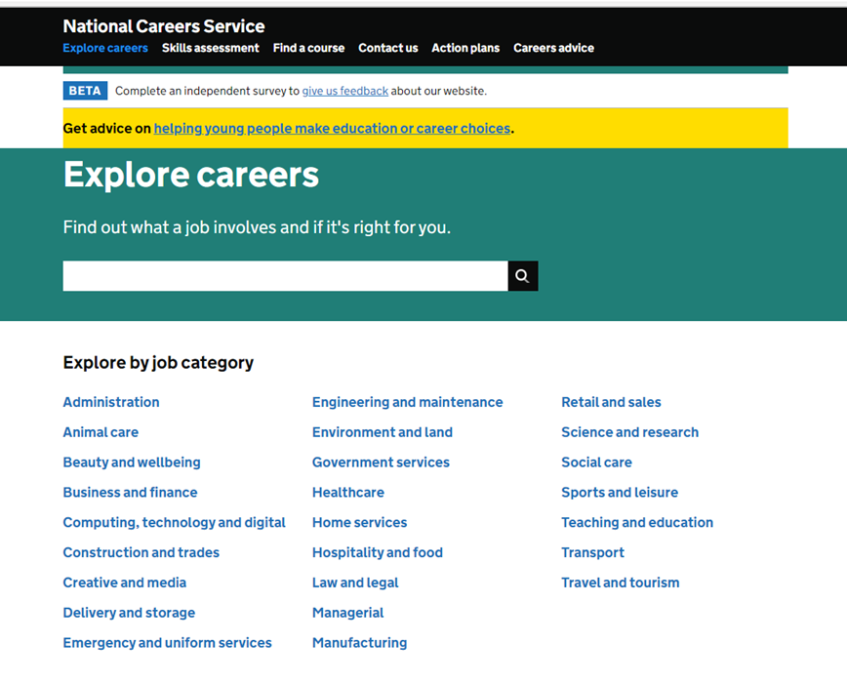
Activity 3 - Exploring more careers
Goal
Explore more career options with your mentee and help them find out what a job involves and if it's right for them.
Instructions
Use the National Careers Service page to explore careers with your mentee. Follow the link below and use the search function and, based on what you have learned from the previous activities and your mentees preferences, select career options to learn more about.
Share your screen and discuss the information shown by the careers service.
Explore careers | National Careers Service

Slide 8
Activity 4 - Apprenticeships
Goal
University isn’t for everyone - perhaps an apprenticeship is the right choice for your mentee. Help them to learn more by exploring the government apprenticeships website
Instructions
Step 1: Follow the link the apprenticeships.gov website, and share your screen. If your mentee isn’t sure what apprenticeships are, read the ‘About Apprenticeships’ page together
https://www.apprenticeships.gov.uk/apprentices/about-apprenticeships
You may want to develop this further by watching the ‘Apprentice Stories’ videos : https://www.apprenticeships.gov.uk/apprentices/real-stories
Step 2: Explore further by reading the ‘Is an Apprenticeship right for me’ page. This can go hand-in-hand with Activity 1, where your mentee can consider career priorities. If you have already completed this activity, refer back to your mentees answers, and see how an apprenticeship might fit.
https://www.apprenticeships.gov.uk/apprentices/benefits-apprenticeship
Step 3: If it seems that an apprenticeship might be a good fit, you can help your mentee to start browsing potential apprenticeship courses. Search by interest and location using the ‘Browse Apprenticeships’ page.
https://www.apprenticeships.gov.uk/apprentices/browse-by-interests

