Slide 1


Mentor Toolkit
Interview skills

Slide 2


Using the Mentor Toolkit
  Please download a copy of this presentation onto your own computer
  Feel to free to edit and adapt these resources to suit your mentoring style
  You do not have to (and should not!) use all the activities in this pack, choose the resources that you think will work best for you and your mentee
  If using for an online session, screen share and complete the activities together
  The times given are an estimate - you may find they take less or more time, depending on you and your mentee.

Slide 3
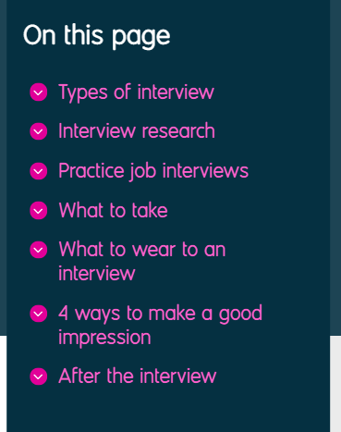

Activity 1: Preparing for an Interview
Goal
Instruct your mentee in how to best prepare for an interview
Instructions
Part 1: Follow the links, share your screen and talk through the 'How to prepare for an interview' resources from Prospects.ac.uk with your mentee.
How to prepare for an interview | Prospects.ac.uk
Top 5 job interview mistakes | Prospects.ac.uk

Slide 4

Activity 2: STAR Technique
Goal
Instruct your mentee on how to use the STAR interview technique
Instructions
Step 1: Show your mentee the main elements of the STAR technique and the examples of how it is used
Step 2: Practice using the STAR technique with competency-based questions.
First demonstrate how to use the technique by answering a question yourself, and model going through each element of STAR in your answer.
Then encourage your mentee to practice STAR by answering a question themselves. Allow the mentee to choose a question from the list so they feel more comfortable and confident in their answer.
Step 3: Provide constructive feedback of their technique. What did they do well? Which elements do they need to work on more and why?
Time 15 - 20 mins

Slide 5
Activity 2: STAR Technique
S SITUATION | T TASK | A ACTION | R RESULT
Introduce the situation to the employer and set out the context | Describe the task you had to complete, including the expectations and challenges it involved | Explain what you did and how you did it | Explain the results of your efforts, inc. what you accomplished, rewards and impact

Slide 6
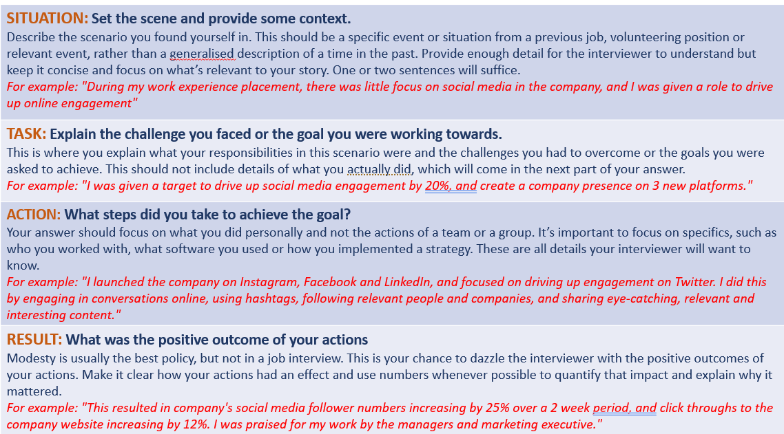

Slide 7
Activity 2: STAR Technique
Examples of STAR being used effectively:
Tell me about a time when you have shown leadership skills.
•Situation - in my previous digital marketing job, the company wanted to get more people to sign up to a newsletter which was not receiving a lot of attention.
•Task - my job was to find a way of getting more people to sign up.
•Action - I organised a meeting with other important members of the marketing team to come up with creative ideas, and I led the social media campaign to generate interest in the revamped newsletter.
•Result - over a period of 3 months, there was an 25% increase in sign-ups to the newsletter and the approach I took was used by the management team in other departments.

Slide 8
Activity 2: STAR Technique
Examples of STAR being used effectively:
Give me an example of when you faced a problem at work. How did you handle it?
•Situation - I was working in a florist shop with the manager and we were arranging an order of flowers for 2 weddings. The manager, who had taken the order, had mixed up the customers’ addresses and the flowers were delivered to the wrong venues.
•Task - I had to get the flowers to the right place and apologise to the customers.
•Action - I told my boss that I would deal with the mistake, leaving her to take care of the shop. I spoke to both customers on the telephone to explain, and reassured them that we would put things right straight away. I drove to both venues, swapped the flowers in time and apologised in person. I gave both customers a voucher for a bouquet as compensation.
•Result - the customers were grateful that we had acted quickly. Later on, they both came back to the shop to spend their vouchers and have since recommended us to their friends.

Slide 9
Activity 2: STAR Technique
Practice the STAR technique with these competency-based questions
1.Give an example of a time where you handled conflict
2.How do you maintain good working relationships?
3.Tell me about a big decision you've made recently. How did you go about it?
4.What has been your biggest achievement to date?
5.Describe a time where you had to use different leadership styles to reach your goal.
6.Tell me about a time when your communication skills improved a situation.
7.How do you cope in adversity?
8.Give me an example of a challenge you faced and tell me how you overcame it.
9.Tell me about a time when you showed integrity and professionalism.
10.Give an example of a situation where you solved a problem in a creative way.
11.Describe a situation where you were asked to do something that you'd never attempted previously.
12.Tell me about a time when you achieved success

Slide 10
Activity 3: Common Interview Questions
Goal
Help your mentee be interview-ready by familiarising them with common interview questions
Instructions
Share your screen and go through the 'Common Interview Questions' with your mentee.
Encourage them to practice answering these questions with the STAR technique and to write their answers down so they can remember them for future interviews
Time 15 – 20 mins

Slide 11
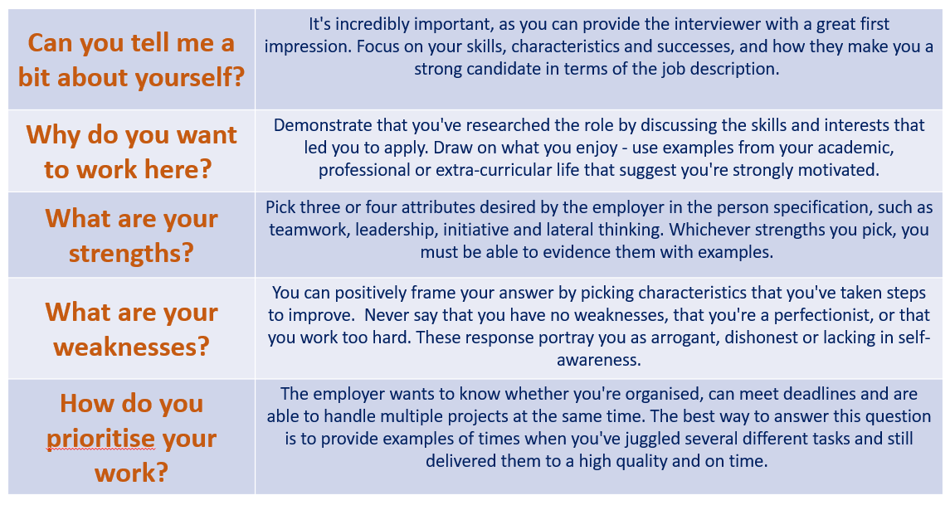

Slide 12
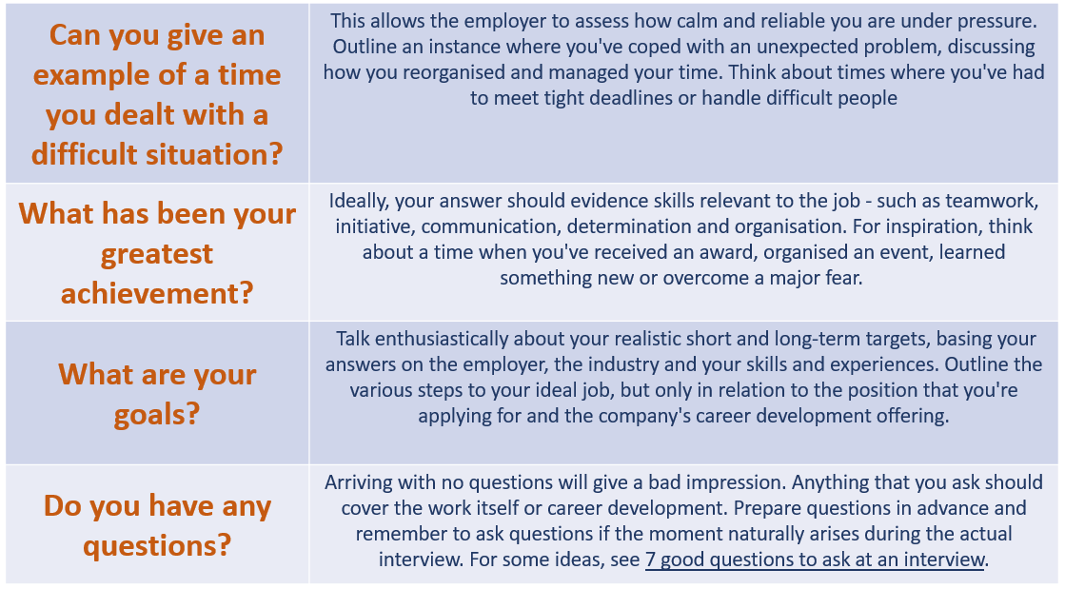

Slide 13
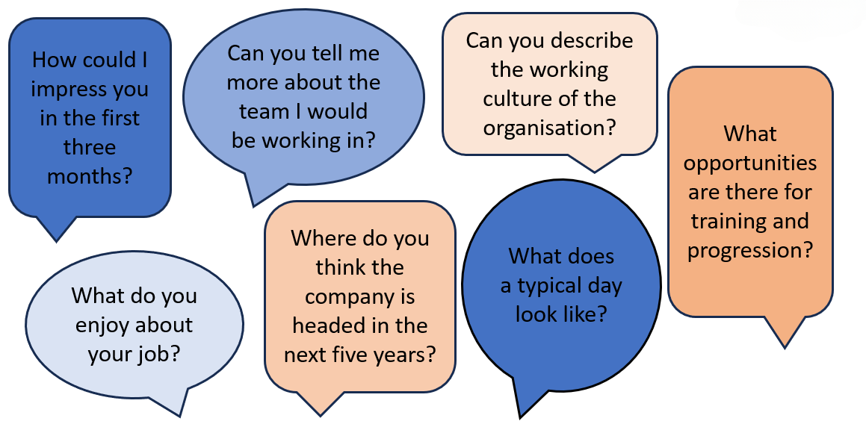
7 good questions for you to ask at interview

