Slide 1


Mentor Toolkit

Slide 2


Using the Mentor Toolkit
  Please download a copy of this presentation onto your own computer
  Feel to free to edit and adapt these resources to suit your mentoring style
  You do not have to (and should not!) use all the activities in this pack, choose the resources that you think will work best for you and your mentee
  If using for an online session, screen share and complete the activities together
  The times given are an estimate - you may find they take less or more time, depending on you and your mentee.

Slide 3

Activity 1: What does a leader look like?
Goal​
Discuss with your mentee what it means to be a leader and explore qualities of leaders in their life.
Instructions
Step 1: Ask you mentee to write down the names of three leaders in their life (e.g. teacher, parent etc.) who they admire or look up too. You can use the diagram on the next page if preferred.
Step 2: Ask your mentee: What qualities or characteristics do you admire most about each of them? (e.g. caring, funny). Write down two qualities for each person.
Step 3: Discuss: Why do you think you admire the 2 characteristics mentioned above? Why are you drawn to these qualities?
Step 4: Discuss: Do you think these qualities make them a good leader? Why?
Time: 10 mins

Slide 4

Activity 1: What does a leader look like?
Leader 1
Name:
Quality #1:
Quality #2:
Leader 2
Name:
Quality #1:
Quality #2:
Leader 3
Name:
Quality #1:
Quality #2:

Slide 5
Activity 2: How to be an effective leader
Goal​
Support your mentee in exploring what it qualities and characteristics make an effective leader.
Instructions
Step 1: Brainstorm with your mentee key characteristics of an effective leader. This could be qualities, abilities or beliefs e.g., being supportive, having creative ideas etc.
Encourage your mentee to write down their ideas. Use the template or copy onto a shared word document.
Step 2: Review your finished chart and reflect on the following questions:
-Which of the characteristics you have discussed are the most important?
-Are there any characteristics here that you think you already have?
-Which characteristics would you like to improve on for yourself?
You may want to use the example finished chart to aid your reflection.
Time 10 – 15 mins

Slide 6
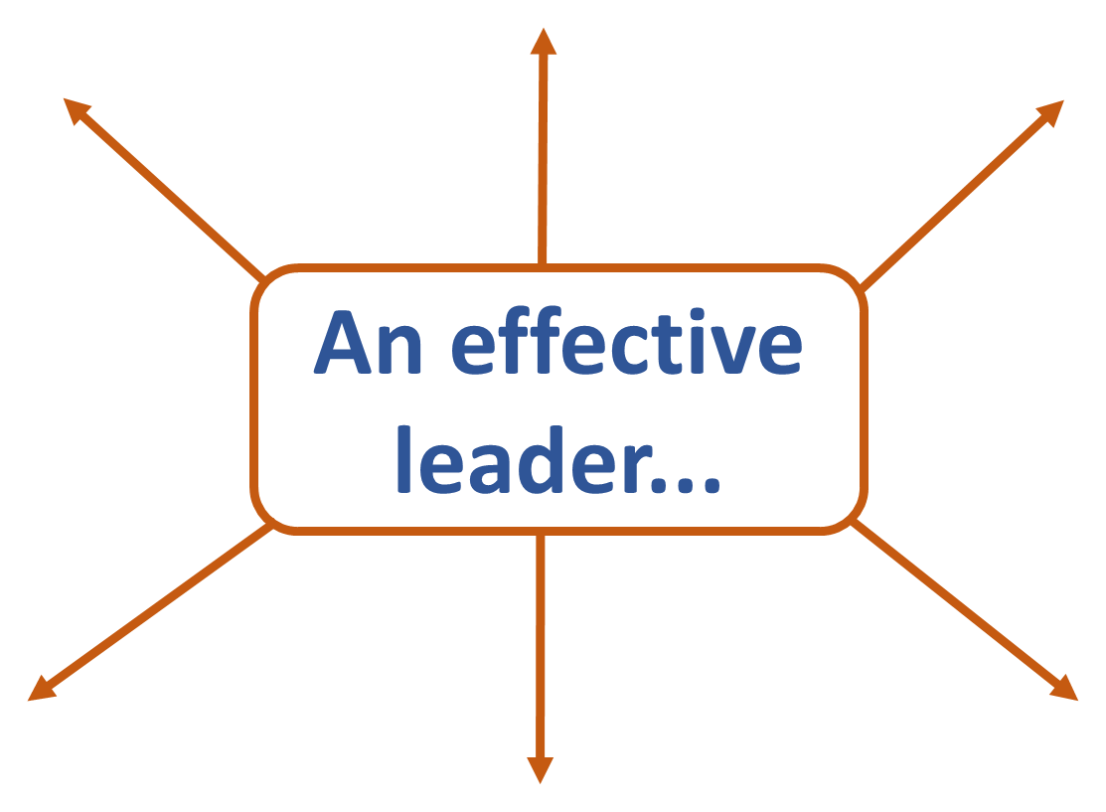
Activity 2: How to be an effective leader
is supportive

Slide 7
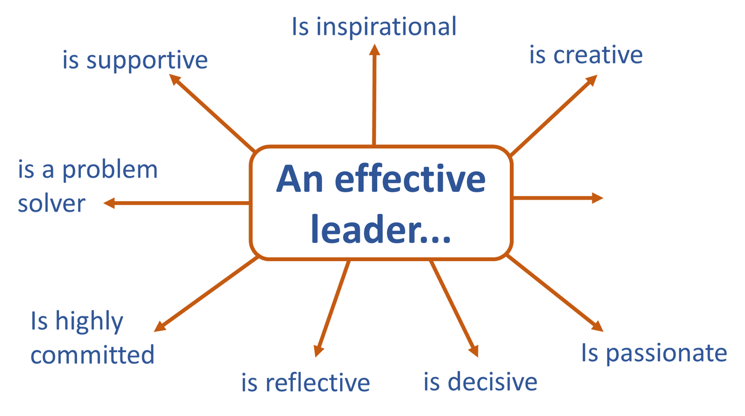
Activity 2: How to be an effective leader
COMPLETED EXAMPLE

Slide 8
Activity 3: Differing Leadership Styles
Goal​
Support your mentee in exploring differing leadership styles and reflecting on which one are the most effective.
Instructions
Step 1: Together, read the 7 most common leadership styles, shown on the page below. (Share your screen)
Step 2: Discuss:
  Do you think all of these are positive leadership styles?
  Are there any you think are bad? If so, which ones, and why?
  Which of these leadership style do you think would be the most effective? Why?
Step 3: Go through the hypothetical scenarios together and discuss which leadership styles would be most effective in these situations
Step 4: Review and reflect: Ask the mentee to reflect on their own leadership tendencies or preferences. Encourage them to think about the style(s) they feel most comfortable with and which ones they may want to develop further.
Time: 15 mins

Slide 9
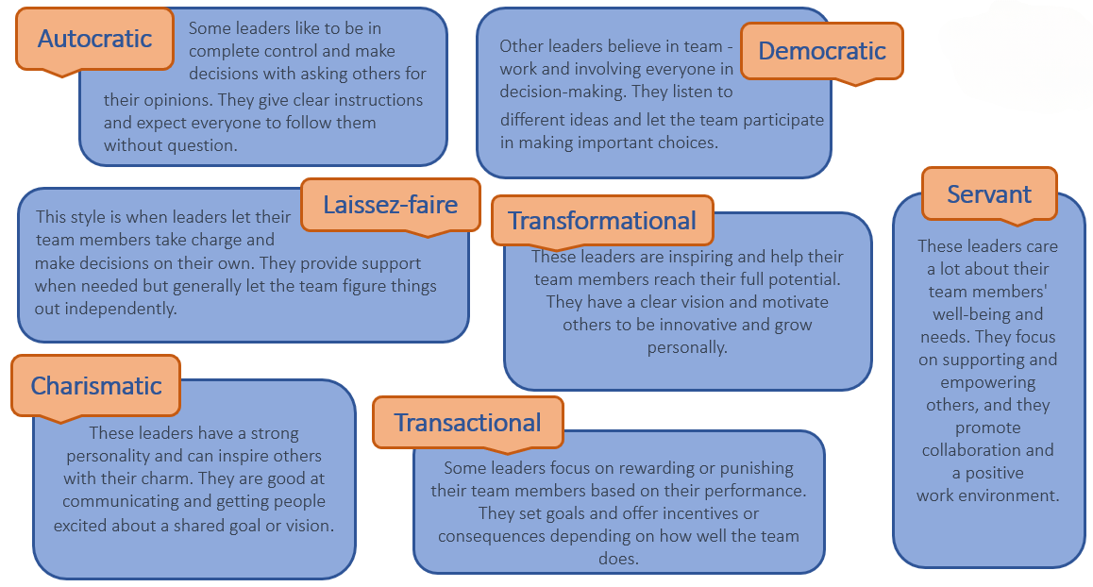
Leadership styles

Slide 10
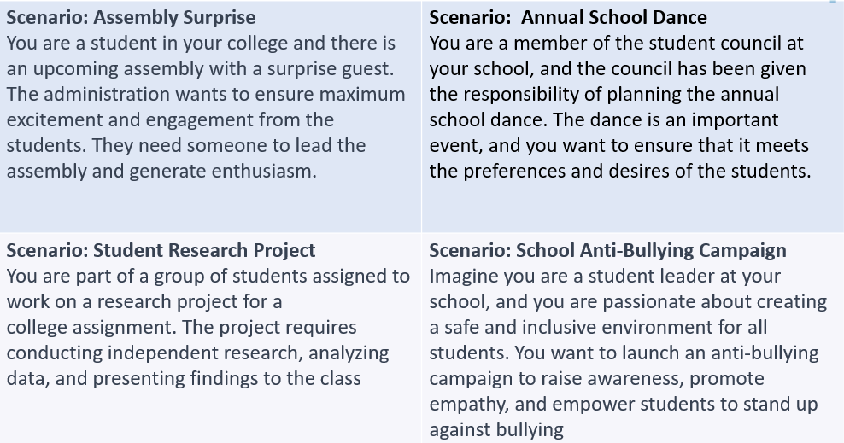
Hypothetical scenarios

Slide 11
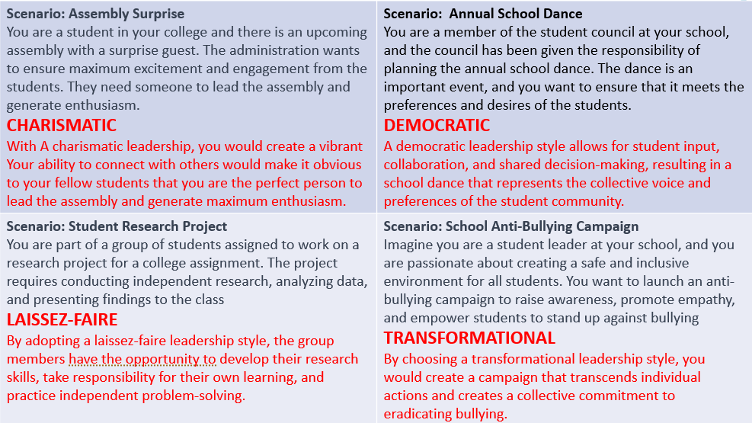
Hypothetical scenarios - suggested answers

