Slide 1
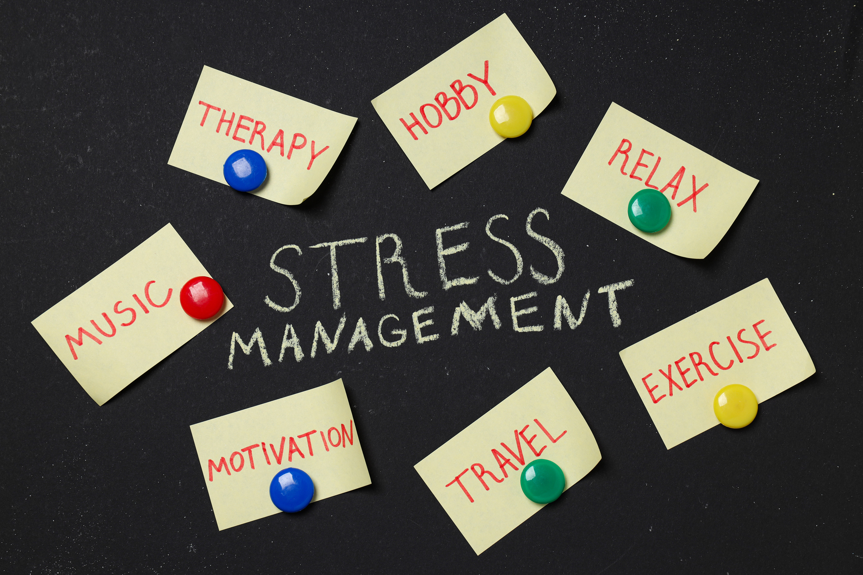

Mentor Toolkit

Slide 2


Using the Mentor Toolkit
  Please download a copy of this presentation onto your own computer
  Feel to free to edit and adapt these resources to suit your mentoring style
  You do not have to (and should not!) use all the activities in this pack, choose the resources that you think will work best for you and your mentee
  If using for an online session, screen share and complete the activities together
  The times given are an estimate - you may find they take less or more time, depending on you and your mentee.

Slide 3

Activity 1: Intro to stress management
Introduction
Stress is how we react when we feel under pressure or threatened. Sometimes, a small amount of stress can help us to complete tasks and feel more energised. But stress can become a problem when it lasts for a long time or is very intense. In some cases, stress can affect our physical and mental health.
Being prepared for periods of stress can make it easier to get through them. And knowing how to manage our wellbeing can help us recover after a stressful event. Therefore, it is important to practice recognising when we are stressed, as well as effective management tools.
Goal
Guide your mentee through recognising stress, as well as introducing management tools, before exploring some of these tools further in the next activities
Instructions
Share your screen and read through the resources with your mentee, and discuss the prompt questions
Time 15 - 20 mins

Slide 4
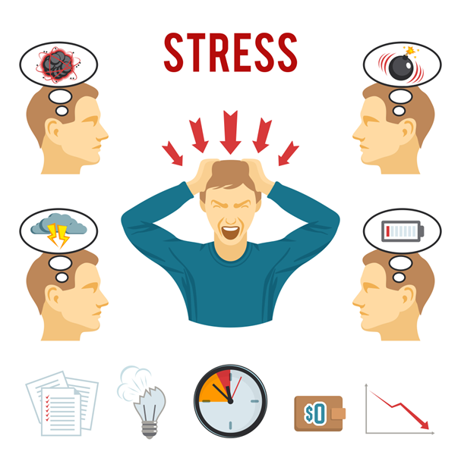

What causes stress?
Many things can cause stress. You might feel stressed because of one big event or situation in your life. Or it might be a build-up of lots of smaller things. This might make it harder for you to identify what's making you feel stressed, or to explain it to other people.
You may experience stress if you:
•Feel under lots of pressure
•Face big changes in your life
•Are worried about something
•Don't have much or any control over the outcome of a situation
•Have responsibilities that you find overwhelming
•Don't have enough work, activities or change in your life
•Experience discrimination, hate or abuse
•Are going through a period of uncertainty
Prompt questions:
•Have you ever experienced stress?
•If so, when and why?
•How did the stress affect you and your daily life?

Slide 5
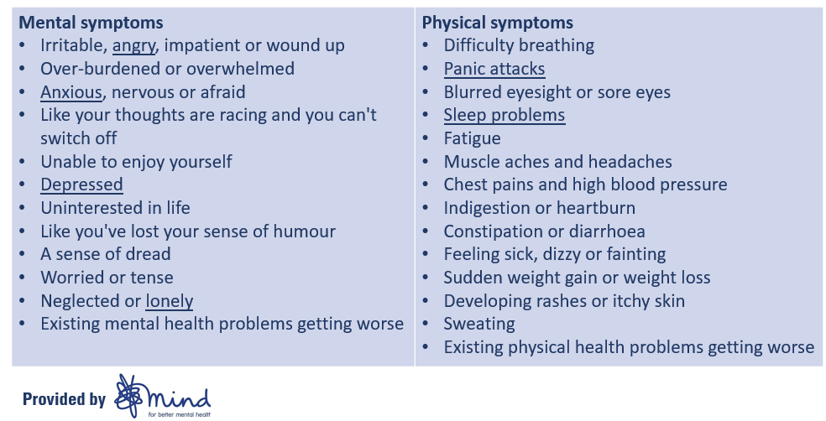
Signs and symptoms of stress

Slide 6
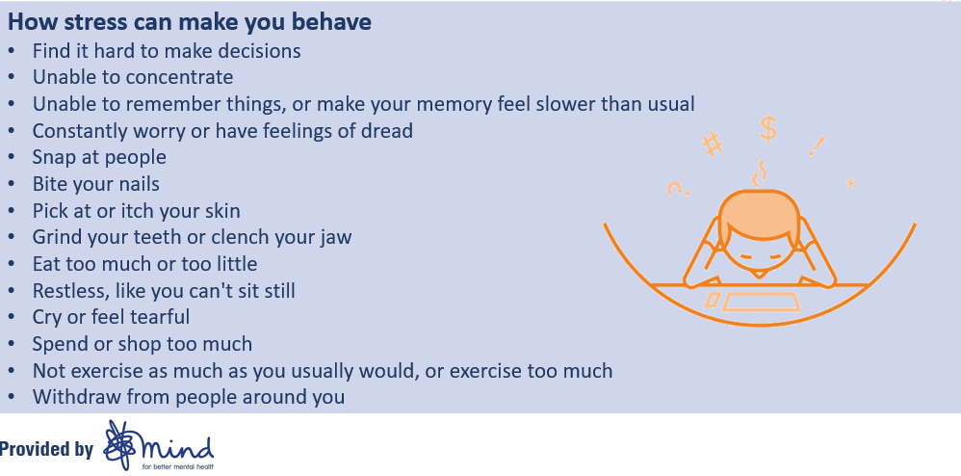
Signs and symptoms of stress

Slide 7
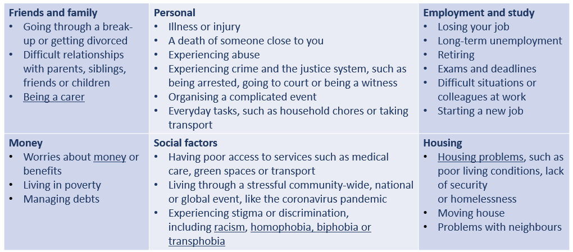
What kinds of situations cause stress?

Slide 8
Activity 1 - prompt questions part 2
•Based on the signs and symptoms, how do you think stress would affect a person at work?
•How do you think it would affect their lives overall?
•Are there any signs and symptoms that you recognise in yourself?
•Start thinking about stress management tools – What are some things you could do to help with stress?

Slide 9
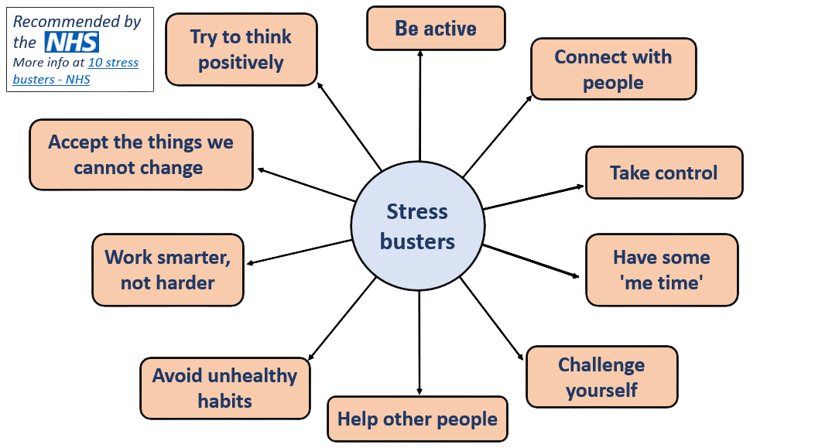

Slide 10
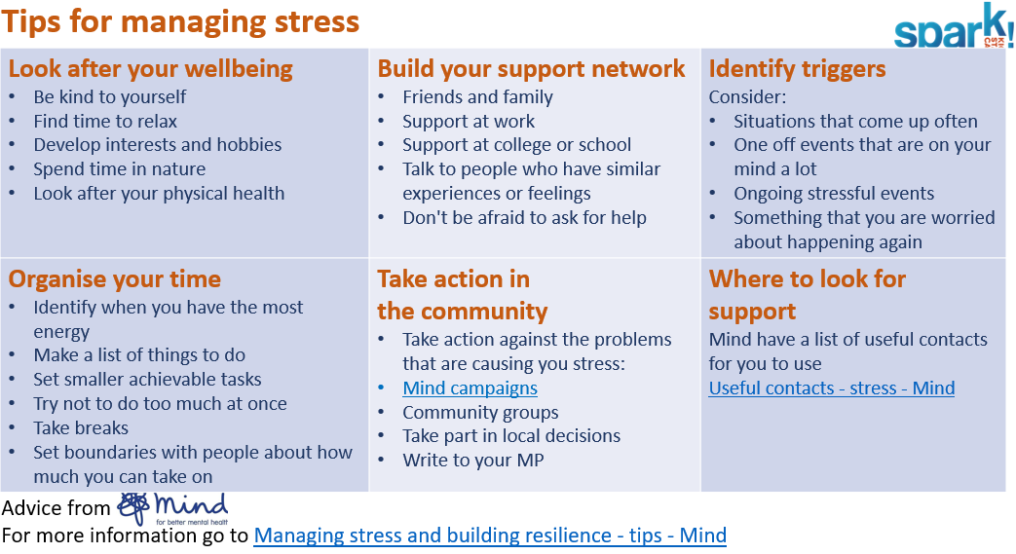
Tips for managing stress

Slide 11
Activity 1: Prompt questions part 3
•Which of these stress management tools do you think would be the most effective?
•Are there any barriers to using these tools effectively?
•How do you manage stress? Is it included in the advice here?
•Are there any tips here that you find particularly useful?

Slide 12
Activity 2: Practicing mindfulness
Introduction
What is mindfulness?
Mindfulness is a technique you can learn which involves noticing what's happening in the present moment, without judgement. You might take notice and be aware of your mind, body or surroundings. The technique has roots in Buddhism and meditation, but you don't have to be spiritual, or have any particular beliefs, to try it.
Mindfulness aims to help you:
•become more self-aware
•feel calmer and less stressed
•feel more able to choose how to respond to your thoughts and feelings
•cope with difficult or unhelpful thoughts
•be kinder towards yourself.
Many people find practising mindfulness helps them manage their day-to-day wellbeing, but it doesn't always work for everyone. Have a go at some of these activities to see if
Goal
Help your mentee is explore the practice of mindfulness by guiding them through these activities

Slide 13
How does mindfulness work?
Mindfulness works by taking your focus to the present moment and away from other thoughts.
The way we think, and what we think about, can affect how we feel and act. For example, if you think or worry a lot about upsetting past or future events, you might often feel sad or anxious.
It is understandable to want to stop thinking about difficult things. But trying to get rid of upsetting thoughts can often make us think about them even more.
The theory behind mindfulness is that by using various techniques to bring your attention to the present, you can:
•Notice how thoughts come and go in your mind. You may learn that they don't have to define who you are, or your experience of the world, and that you can let go of them.
•Notice what your body is telling you. For example, you might feel tension or anxiety in your body, such as a fast heartbeat, tense muscles or shallow breathing.
•Create space between you and your thoughts. With this space, you can reflect on the situation and react more calmly.

Slide 14
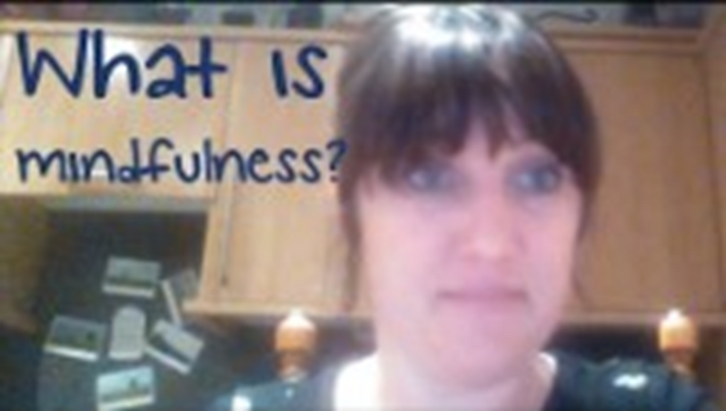
Practicing mindfulness
Instructions
In this video, Rebecca, a mindfulness teacher from the charity Mind, explains her understanding of mindfulness. If you wish to explore about what mindfulness is, share your screen and watch the video with your mentee. To avoid an echo, be sure to turn your microphone off for the duration of the video and have share audio selected when sharing your screen.
The video is 5 minutes long
https://youtu.be/VAl7jnV5FiY

Slide 15
Mindfulness activity 1 - meditation
What is meditation
Meditation is the practice of intentionally spending time with our mind. We take time out of our busy days to sit, breathe, and try to remain focused on our breath. Doing this helps us become more aware of our thoughts, act more compassionately toward ourselves and others, and connect with the present moment. It is not necessarily a practice that works for everyone, but many people find it incredibly effective for stress relief when done regularly.
The benefits of meditation
There are many types of meditation but the thing they all have in common is that, over time, they can help lower stress levels.
By releasing physical tension held in the body, meditation can help us release worries buried in the mind, easing anxiety, stress and low mood, and even helping you get deeper, more restful sleep.
Meditation can also bring a sense of calm that enables us to respond to life events in a measured way, rather than reacting with our emotions.
For the best results, try to build regular meditation into your daily routine.
Instructions
Follow the steps and practice meditation with your mentee (or guide your mentee to practice). You do not have to meditate for 20 minutes, but just long enough so that your mentee understands the key steps and feels comfortable to try it at home
Time: up to 20 mins

Slide 16
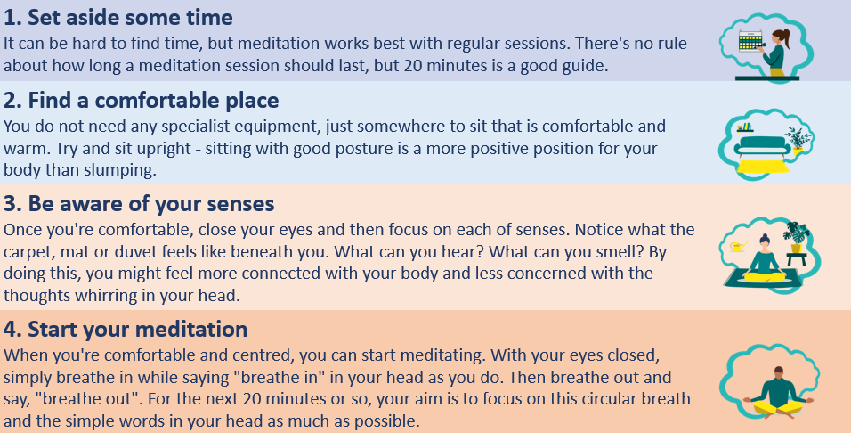
How to meditate in 7 steps

Slide 17
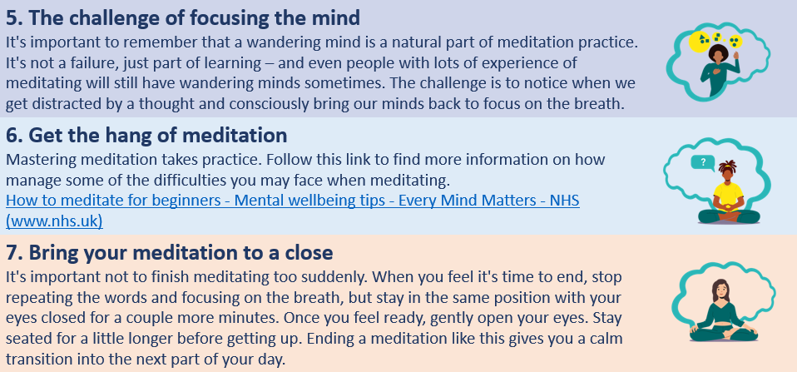
How to meditate in 7 steps

Slide 18
Mindfulness activity 2 - breathing exercises
Introduction
Oftentimes, you might experience moments with high levels of stress, but you do not have the time, space or resources to take part in more in-depth mindfulness practices such as meditation. In these moments, breathing exercises can be very effective for instant stress relief. These exercises can help to calm and focus your mind to deal with feelings of stress, anxiety and panic.
You will get the most benefit if you do it regularly, as part of your daily routine. It takes just a few minutes and can be done anywhere.
Goal
Guide your mentee to practice breathing exercises, and if they struggle with stress management, encourage them to incorporate the exercises into their daily routine
Time 5-10 mins

Slide 19
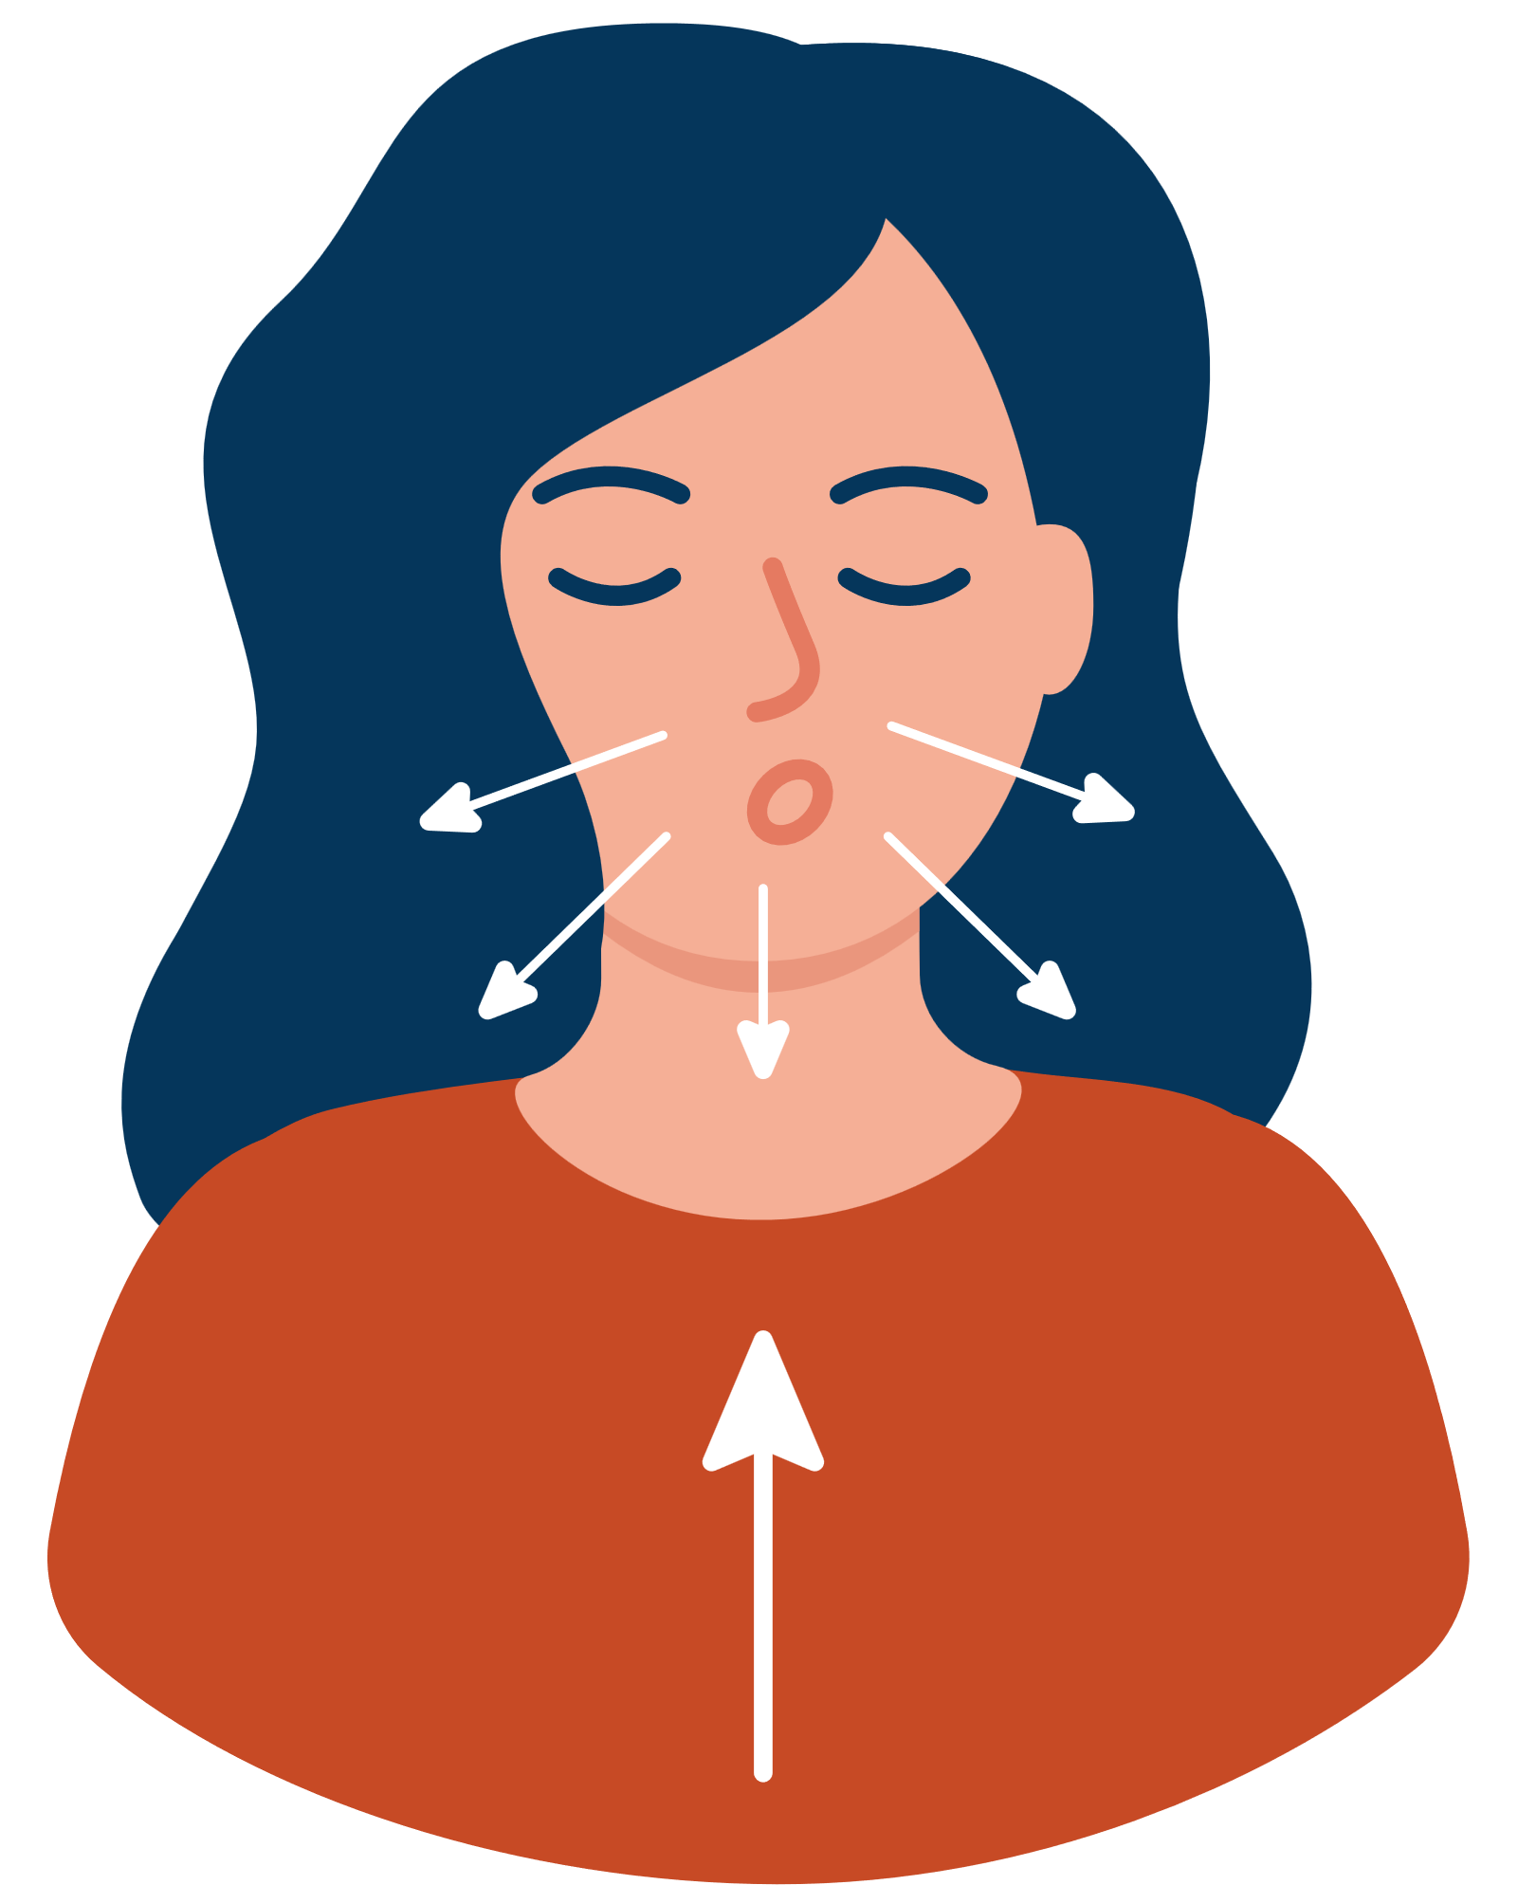
Mindfulness activity 2 - breathing exercises
Instructions
  Make yourself as comfortable as you can. If you can, loosen any clothes that restrict your breathing. You can do it standing up, sitting in a chair that supports your back, or lying on a bed or yoga mat on the floor.
  Let your breath flow as deep down into your belly as is comfortable, without forcing it.
  Try breathing in through your nose and out through your mouth.
  Breathe in gently and regularly. Some people find it helpful to count steadily from 1 to 5. You may not be able to reach 5 at first.
  Then let it flow out gently, counting from 1 to 5 again, if you find this helpful.
  Keep doing this for at least 5 minutes.

Slide 20

Mindfulness activity 3 - colouring
Mindful colouring asks us to focus on how we choose and apply colour in a design to bring our awareness to the present moment. Colouring may seem trivial, but the process is similar to meditation, where we let go of any stressful thoughts that we are having at the time. Mandalas –such as this image here – are often a good choice to colour. The intricate but repetitive pattern helps us to focus on mindfulness thoughts.
If you would like to try some colouring to calm you during stressful moments, there are many resources online available for free download. Here are some suggested ones:
Link 1
Link 2

Slide 21
Activity 3 - The importance of a good night
Introduction
Not getting enough sleep can be a major contributor to high levels of stress. It diminishes our cognitive function, which can lead to heightened anxiety, irritability, and difficulty coping with everyday challenges, ultimately increasing our overall stress levels. Therefore, it is important to follow proper bedtime habits to ensure a good night’s sleep.
Goal
Guide your mentee through the tips to aid a guide nights sleep
Instructions
Share your screen and discuss the tips together
Time 5 mins

Slide 22
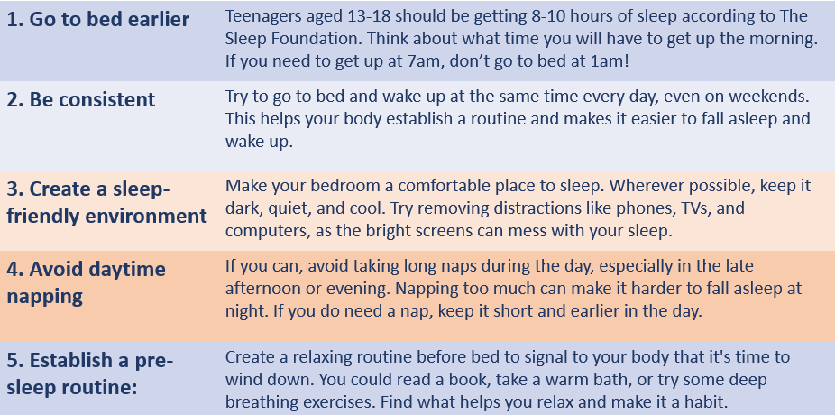
Activity 3 - The importance of a good night

Slide 23
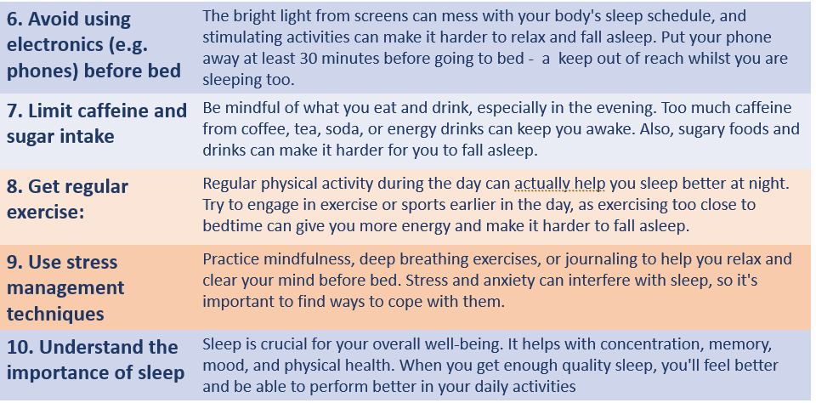
Activity 3 - The importance of a good night

