Slide 1


Mentor Toolkit

Slide 2


Using the Mentor Toolkit
  Please download a copy of this presentation onto your own computer
  Feel to free to edit and adapt these resources to suit your mentoring style
  You do not have to (and should not!) use all the activities in this pack, choose the resources that you think will work best for you and your mentee
  If using for an online session, screen share and complete the activities together
  The times given are an estimate - you may find they take less or more time, depending on you and your mentee.

Slide 3

Activity 1: Wants vs Needs – Making wise money decisions
Introduction
Whether it’s longing for the new mobile phone or a designer jacket; young people often have a difficult time distinguishing between their wants and needs. In order to make good financial decisions, it’s important to know how to differentiate between wants and needs.
Goal
Guide your mentee to assess their personal spending behaviour and evaluate their spending choices when it comes to personal wants versus needs
Instructions
Step 1: Discuss with your mentee what the difference is between a want and a need. Encourage them to think about needs being items we must have to survive (food, shelter, clothing), while wants are nice to have, but not necessary e.g., clothes are a need, but designer clothes are a want.
Step 2: Share your screen, go through each case study with your mentee, and encourage them to determine the wants and needs in each scenario and justify their reasoning
Step 3: Reflect on the activity by considering how this can apply to their own lives. You may want to ask:
•What needs to do you have in your life? What wants do you have?
•Do you think we should never buy things that we want? Why?

Slide 4
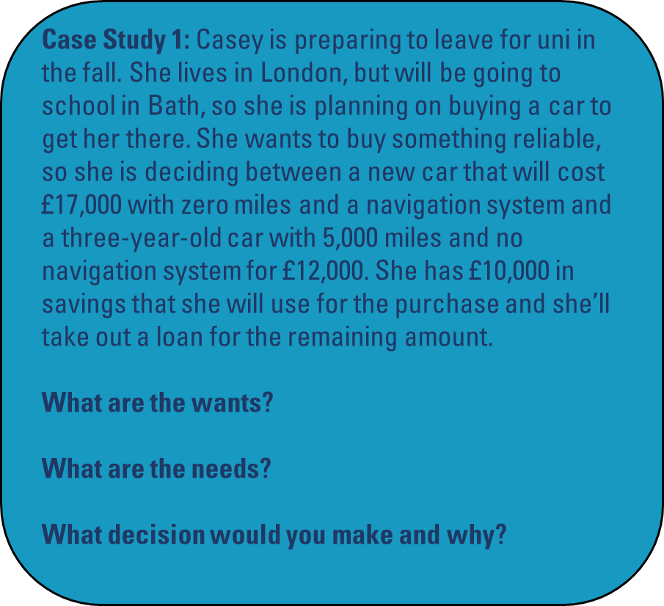
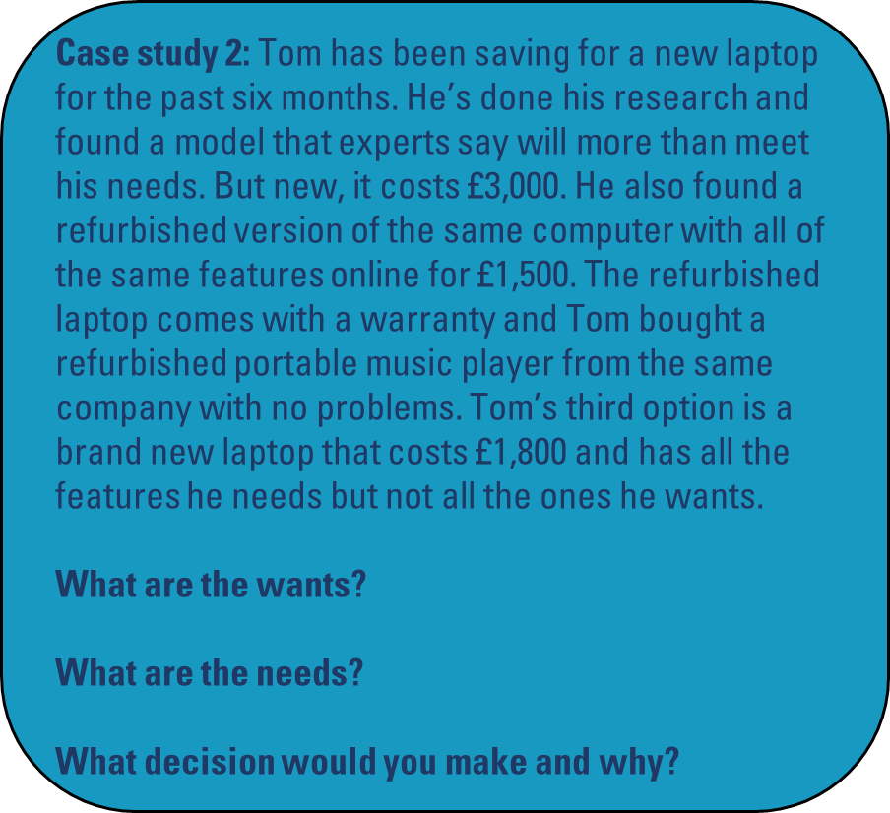

Wants vs Needs: Case studies

Slide 5
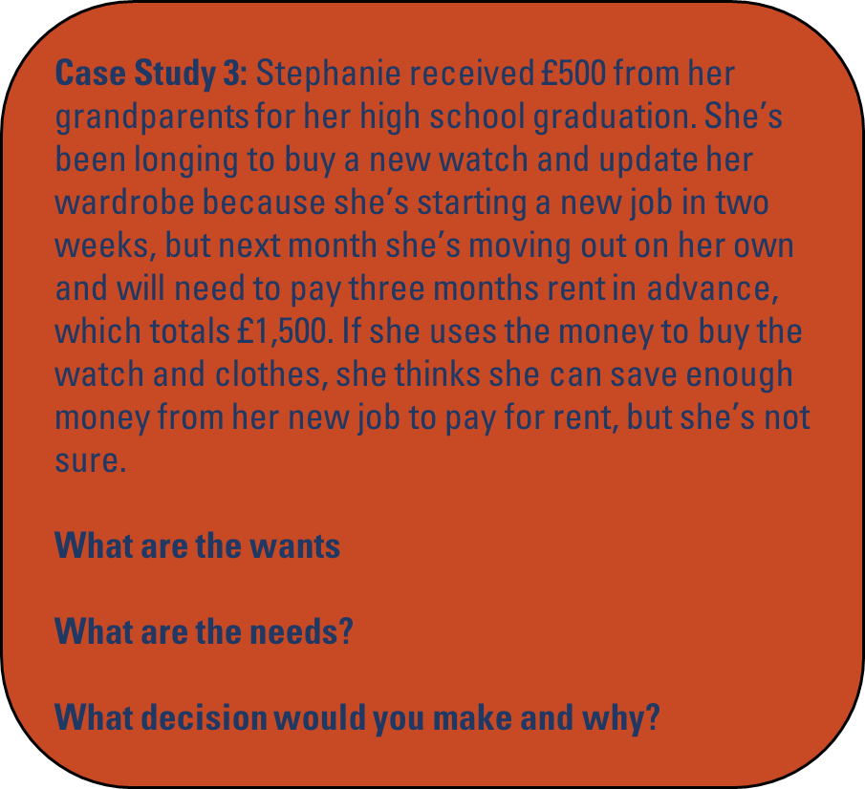
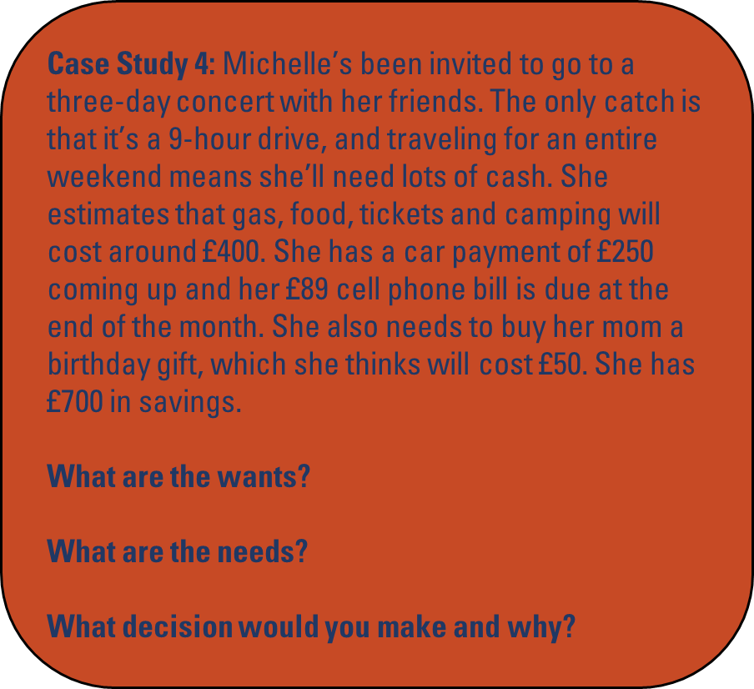
Wants vs Needs: Case studies

Slide 6
Wants vs Needs suggested answers
1. Casey needs a car to move her belongings across the country, but a brand-new car that will put her £7,000 in debt is a want. The best decision in this case is to select the used model. Even though it may not have all the bells and whistles of a new car, it is still reliable with low miles and it meets Casey’s needs.
2. Tom has done a good job of researching all his options. He needs a new laptop, but the expensive model is a want. He’s discovered that he can meet both his needs and his wants by purchasing a refurbished version. Since the refurbished model carries a warranty and Tom has had a good experience with the company in the past, he should go ahead and buy the refurbished computer.
3. Rent money is the primary need, while the new watch and clothes are wants. While Stephanie may want to buy a new watch and clothes, she needs to pay rent first before making other purchases.
4. Michelle should take care of her bills first, and then decide if she wants to spend less on her mother’s gift in order to afford the concert, or skip the concert and put the money into her savings account. Help your mentee see that our values are closely linked to the decisions we make about money. If Michelle values giving her mother a gift, she may want to sacrifice the concert to be able to afford a nice gift.

Slide 7
Activity 2: Setting a budget
No matter what we call it, we all make, spend and save money. While young people may recognize the concepts of working, earning and spending; trying to understand variable expenses, cash flow and net income can feel like learning a foreign language. This activity breaks down key terms in budgeting and introduces them to the process of creating their own plans for spending and saving.
Instructions
Step 1: Discuss with your mentee the importance of setting a budget
Step 2: Share your screen and go through the budget case studies with your mentee, helping them to identify a good budget and a bad budget
Step 3: Guide your mentee to set their own budget either, based on the scenario given, or based on real life (if they have an income and expenses). Encourage them to copy down the budget table and then follow the four steps on the next page. Explain to them key terms if necessary, such as gross income, net income, fixed vs variable expenses etc.
Step 4: Reflect on the activity – you might want to use these prompt questions:
What is the most important thing to consider when setting a budget?
Did you find setting a budget challenging? Why/why not?
How will you take these skills and use them in your daily life?

Slide 8
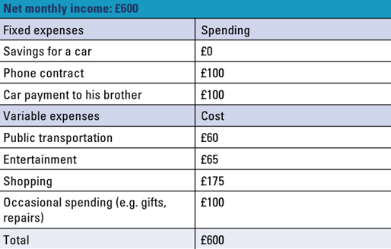
Budget case studies
Case study 1:
Nate is in Year 13. He works 15 hours a week at a shoe shop, and his net income after taxes is £600 a month. He lives with his parents, so he doesn’t have rent, utility or food expenses. His older brother owns a car and lets him borrow it to drive to work for £50 a week; otherwise Nate takes the bus. He really wants to buy a car, so he puts any leftover money toward savings. Nate also pays for his phone contract and personal expenses, such as going to the cinema, buying video games and purchasing gifts. Below is what Nate spent in one month.
Analyse Nate’s spending to determine whether his budget is effective and if he needs to make any changes

Slide 9
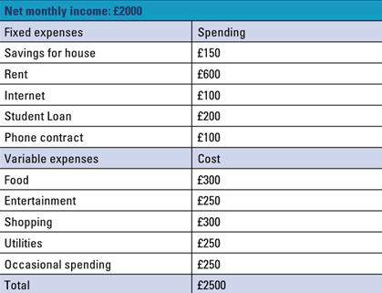
Budget case studies
Case study 2:
Maria just graduated from Uni and accepted her first job as a social media manager for a real estate company. Her monthly net income is £2,000. She just moved into a flat share, so she is responsible for her part of the rent, utilities, food and other household expenses. She is paying off a student loan and she wants to save as much money as she can to buy a house someday. She enjoys going out with friends on the weekend and buying new clothes.
Analyse Maria’s spending to determine whether her budget is effective and if she needs to make any changes

Slide 10
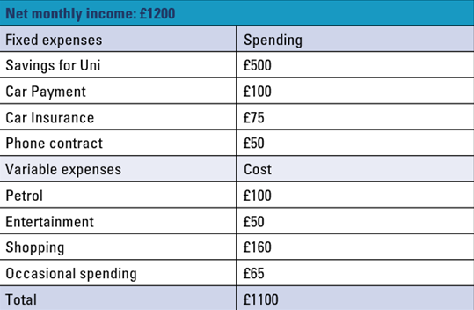
Budget case studies
Case study 3:
Jamal has just finished college and works 30 hours per week at a coffee shop. His net income is £1,200 and he is saving up for Uni. He owns a car and makes payments toward it each month, but he lives with his parents so he saves on rent, utilities and food costs. He occasionally goes out with friends and buys things for himself, but he tries to hold back on these things so he can save more for Uni next year.
Analyse Jamal’s spending to determine whether his budget is effective and if he needs to make any changes

Slide 11

Activity 3: Setting a budget
You just accepted your first job and you’ll be earning a gross income of £20,000 a year. You are responsible for all your own expenses, including rent, car, insurance, phone contract, utilities, entertainment, food, savings and miscellaneous expenses. At £20,000, you must pay 12% of your gross income in taxes (National Insurance and PAYE)
1. Calculate Your Take-Home Pay:
With a gross income of £20,000 and a 12% tax deduction, your yearly net income will be £17,6000. What is your monthly net income? (Remember this is what you get after taxes.) Use this number to start your budget.
2. Categorise Expenses:
Determine if your expenses are fixed or variable, and write them in the appropriate sections of the table on the next page.
Remember your expenses include: rent, car, car insurance, cell phone, utilities, entertainment, food, savings and
occasional expenses
3. Divide Your Expenses:
Determine the cost for each category and record the prices in your budget. How much of your income you spend is up to you, but below are some suggested percentages to divide your monthly net pay:

Slide 12
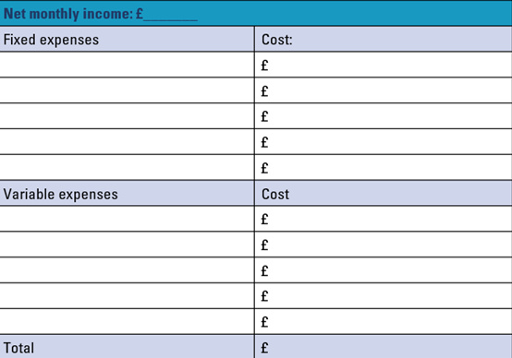
Activity 3: Setting a budget
4. Assess Your Budget:
Compare your expenses to your monthly income. Have you spent everything you’ve earned? Do you have money left over for savings? What expenses could you lower to increase your savings?

