Slide 1


Mentor Toolkit

Slide 2


Using the Mentor Toolkit
  Please download a copy of this presentation onto your own computer
  Feel to free to edit and adapt these resources to suit your mentoring style
  You do not have to (and should not!) use all the activities in this pack, choose the resources that you think will work best for you and your mentee
  If using for an online session, screen share and complete the activities together
  The times given are an estimate - you may find they take less or more time, depending on you and your mentee.

Slide 3

Activity 1: How motivated are you?
Goal​
Allow your mentee to reflect on their current levels of motivation and identify areas for improvement
​
Instructions​
Step 1: Share your screen and guide your mentee through completing the motivation statement quiz. Read each statement and ask them to rank it 1 through 5 based on how much they agree.
Step 2: When they have completed the quiz, review each statement and their answers, discussing the following prompt questions:
-Why did you give it this score?
-What do you think this shows you about your motivation?
-How do you think you could improve this?
​
Time: 10 mins

Slide 4

Rank how much you agree with the statement. 1 = strongly disagree, 5 = strongly agree | 1 | 2 | 3 | 4 | 5
I'm unsure of my ability to achieve the goals I set for myself.
I put in maximum effort and work even harder if I've suffered a setback.
I regularly set goals and objectives to achieve my vision for my life.
I think positively about setting goals and making sure my needs are met.
I use rewards (and consequences) to keep myself focused. For example, if I finish my homework on time, I allow myself to take a TV break.
I believe that if I work hard and apply my abilities and talents, I will be successful.
I worry about deadlines and getting things done, which causes stress and anxiety.
When an unexpected event threatens my goal, I tend to panic and walk away from the goal
I tend to do the minimum amount of work necessary to keep my boss or teachers satisfied.
I tend to worry about why I won't reach my goals, and I often focus on why something probably won't work.

Slide 5
Activity 2: Fixed vs Growth Mindset
Goal
Introduce your mentee to the concept of fixed vs growth mindset, and guide them to adjusting their own mindset.
Instructions
Step 1: Discuss with your mentee the meaning of fixed vs growth mindset using the information slides on the next page. Then ask your mentee: Why is a growth mindset important to help us stay motivated?
Step 2: Ask your mentee to reflect on an experience when they faced a challenge or encountered failure. Encourage them to reflect on their thoughts and emotions related to that experience, and whether they had a fixed or growth mindset during the challenge.
You may want to use the 'encouraging growth mindset' worksheet as a guide. Share your screen or ask your mentee to note their ideas down on a piece of paper
Step 3: Now encourage them to shift their perspective and think of how they could have responded to the challenge with more of a growth mindset e.g., from "I'm not good enough" to "I can learn from this and improve". Guide them in identifying potential lessons or insights they gained from that experience.
Time 15 mins

Slide 6
Activity 2: What is a growth mindset
Psychologist Professor Carol Dweck coined the term 'growth mindset' when she researched how people's underlying beliefs about themselves and their abilities can affect their lives.
People with a growth mindset believe that if they’re not as good as they’d like to be at something, they can work at it and improve. Set-backs are re-framed as new challenges to overcome, and failure can be used as a springboard to bigger and better things. Whereas people with a fixed mindset believe that their intelligence and abilities are fixed, something that you are either born with or without.
A growth mindset is the belief that your skills and abilities are not set in stone. Just as mighty oaks grow from tiny acorns, our talents might start small, but they have the potential to grow huge. The opposite of this is the fixed mindset. People with a fixed mindset are more likely to believe that their ability and intelligence can’t be changed; that they're either good at something or not. They’re usually easily discouraged and might avoid taking risks or trying new things because they’re fearful of failure.
For example, imagine you’re learning to play an instrument. By the end of your first lesson you can play a few notes, but you’re no Mozart. If you have a fixed mindset you might think “I’m no good at this, so why bother?” and give up straight away. You’ll stop taking lessons and – surprise, surprise – you’ll never get any better. If you have a growth mindset, you’ll still recognise that you’re no virtuoso (it’s not about being in denial) but instead of giving up you’ll recognise that with more lessons, practice and effort, you’ll improve. And, guess what? You will!

Slide 7
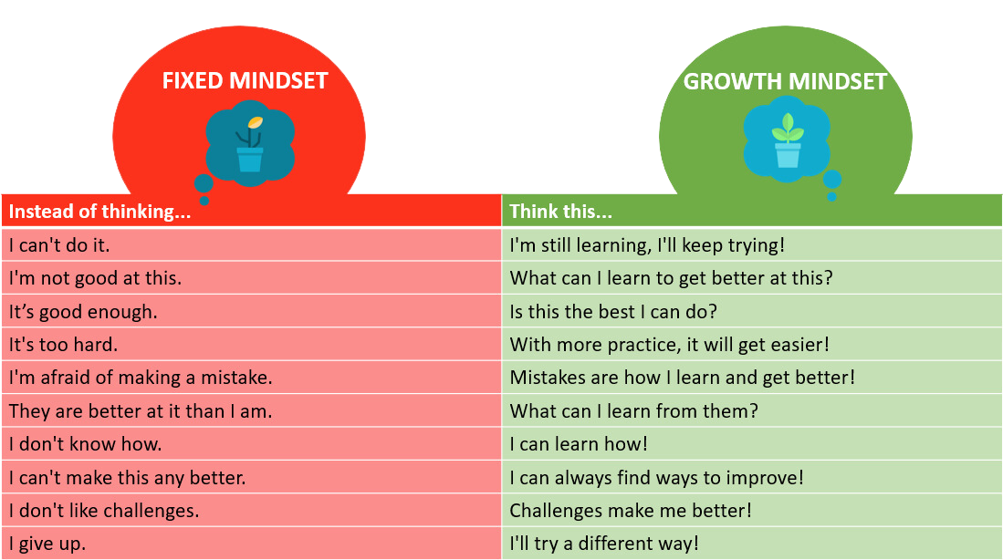

Slide 8
Encouraging growth mindset worksheet
What is a past experience where you faced a challenge or encountered failure?
How did you feel and/or respond to this experience at the time?
Did you have a fixed mindset or a growth mindset?
How could you have changed your response to follow more of a growth mindset?

Slide 9
Activity 3: Motivation action plan
Goal​
Help your mentee keep themselves accountable for their motivation and sticking to their goals by guiding them to create a motivation action plan
Instructions
Encourage your mentee to complete the action plan template. Copy the questions into a shared word document or ask your mentee to write them down on a piece of paper or notebook.
Time 10 – 15 mins

Slide 10
Motivation action plan
What is a goal you feel unmotivated about? | Why do you feel unmotivated?
What were to happen if you stopped working towards this goal? How would your future look different? | What were to happen if you stopped working towards this goal? How would your future look different?
What are three things you can do to keep yourself motivated to reach your goal? 1. 2. 3. | What are three things you can do to keep yourself motivated to reach your goal? 1. 2. 3.
What can you start doing right now? | What can you start doing right now?

