Slide 1
Mentor toolkit
Preparing for Mentoring
Charity number: 1138697

Slide 2
Your Mentoring Journey
Prepare
Resources: Safeguarding, Coaching models, Skillsbuilder Framework, How To Be An Effective Mentor, Communicating With Your Mentee
Session 1
Session 2 to 5
Choose a minimum of 4 focus areas from the toolkit based on the goals set in session 1
Session 6
Reflect and feedback, complete final survey
Get to know your mentee and goal setting, create an action plan of the topics chosen for your mentoring sessions

Slide 3
Safeguarding
Our number one concern on any Spark! programme is the safety and well-being of the young people we are supporting.
As a mentor for a young person, you are taking on a responsibility for their safeguarding during the time you are working with them. Below are some simple do and don'ts you should follow to keep you and your mentee safe.
DO
When online, ask permission to have cameras on during one-to-one sessions
When online, locate yourself in a private space where your conversation cannot be overheard
When in-person, locate yourself in a public space, but seated where your conversation cannot be overheard
Use language appropriate for under 18-year-olds
Let Spark! know immediately if you have any concerns about your mentee's physical, emotional or mental safety, or anyone else's safety
Speak to Spark! staff if you are uncertain on the right or wrong thing to do regarding safeguarding
DON'T
Record or take screen shots of your sessions
Contact students outside of your one-to-one, except to arrange your next mentoring sessions
Share personal information, such as where you live, date of birth, etc.
Request any personal information about your mentee, such as where they live, date of birth, etc.
Share weblinks in the chat unless approved by a member of the Spark! team
Promise to keep secrets, that may be related to the harm of your mentee or anyone else
Notes:
Introduce the volunteers

Slide 4
The many roles of a mentor
Being a mentor isn't easy. It takes patience, empathy and generosity. There are many hats that a mentor needs to wear, and you will need to judge which one to 'put on' at different times, as your relationship with your mentee develops and grows.
An active listener
Take the time to listen, understand and interpret what the young person is saying. Suspend your own frame of reference and judgement and remove distractions.
A critical friend ​
Help the young person work through difficult decisions and weigh up alternatives. Be there to listen and offer encouragement, providing critical feedback which may be difficult for them to receive from a less trusted source
A role model
Share your own experiences; be positive, confident and ambitious. Show them you believe in them.
A Challenger​
Ask difficult questions; ask them to explore their decisions and the consequences of their decisions

Slide 5
The many roles of a mentor
An advisor
Help the young person to build and implement their goals and support them to plan how to achieve them
A network facilitator
Help the young person develop their own resources, open doors to networks of useful people, and where they can gain knowledge and expertise
A truth teller
Be upfront and clear about what you can give and ask the young person what they expect of you. Be straight-talking, don't over-promise, and never lie
Open minded​
It is likely to be a learning experience for you too. Be open to learning as much from your mentee as they do from you
BE RELIABLE | Keep appointments, say what you'll do and do what you say you’re going to do. Don’t make any promises or assurances you may not be able to keep

Slide 6
Coaching models
Coaching models provide structure, clarity, and focus to coaching or mentoring interactions. They can help mentors and mentees communicate effectively, set goals, plan actions, and track progress. Using coaching models enhances accountability, tailors approaches to individual needs, boosts confidence, ensures consistency, and promotes continuous improvement in coaching.
GROW Coaching Model
The GROW (Goal, Reality, Options, Will) model is used as a common mentoring and coaching tool. It enables the mentor to structure an effective conversation and get to a meaningful result in a short amount of time.
The objective is to help your mentee to identify and define their specific goals, and then organise themselves to attain these goals. An effective mentor can do this by becoming skilled at asking questions and guiding towards solutions.
GOAL
What do you want?
Goals, objectives and aspirations
REALITY
Where are you now?
Current situation, obstacles to overcome
OPTIONS
What could you do?
Possibilities, strengths, and resources
WILL
What will you do?
Actions to take and accountability

Slide 7
Communication is key

Slide 8
Barriers to building a rapport
Communication and rapport can breakdown quickly, and your language can make all the difference. Try to avoid the below

Slide 9
Active Listening
How well you listen has a major impact on the quality of your relationship. To improve your listening skills, practise active listening - making a conscious effort to hear the words and understand the meaning behind them.
Pay careful attention. Try not to become distracted, bored or lose focus. It can be challenging to stay focused. You may be thinking ahead to your next question or topic of discussion for example. If you’re finding it difficult to focus or concentrate, try repeating the words mentally – this will reinforce their message and help you stay focused.
L | Listen to what is being said and how - tone, volume, speed
I | Interpret non-verbal messages – body languages, facial expressions etc.
S | Show you are being attentive – affirming gestures such as nodding, smiling – and short words or noises ‘um’, ‘yes’, ‘go on.’ Avoid interrupting
T | Try to understand the meaning, not just hear the words – listen and ask questions
E | Evaluate and summarise/paraphrase the words of your mentor or mentee back to them to clarify you have understood
N | Neutralise your feelings – try not to show negative emotions, e.g. shock, disapproval, as this may affect your mentee or mentor’s willingness to be open with you in the future

Slide 10
Questioning skills – The funnel technique
Asking the right questions is another critical skill in the mentoring process. The funnel technique involves starting with general questions, and then drilling down, asking for more detail each time
Open
----------------------------------------------------
Probe
---------------------------------
Closed (to clarify)
--------------------
Reflective and Comparative
Question | Description and examples
Open | Framed to encourage a detailed response and prompt thought and reflection How have things been since we last met?
Probe | Help to get under the surface of the initial answer and bring out more detail What was that life for you?
Closed | Elicit a yet or no answer – used to clarify or check understanding My understand is… is that right?
Reflective | Repeat something the mentee has said or implied, enabling that to reflect and provide new insights So you’ve told me that… It sounds like from what you’ve said that…
Comparative | A form of closed question, giving the mentee options to decide the most suitable way forward Which would you say is more difficult to achieve?

Slide 11
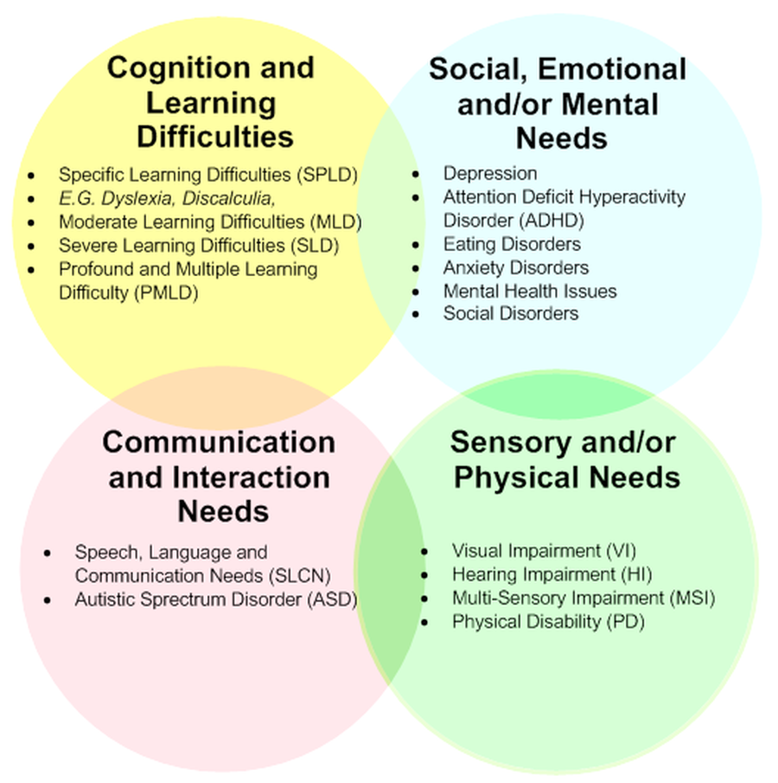
Students with special education needs and disabilities (SEND)
It is possible that you may be matched with a student who has a SEND. A young person has SEND if they have a learn difficulty or disabilities which requires them to have a special education provision. On average, 12.5% of students in England will require some kind of SEN support.
This is a very broad term for a wide range of educational needs and disabilities, may look different for every student, and will have varying levels of challenges involved.
The Four Needs
These are the four broad areas of need that may lead to a student requiring a special education provision

Slide 12
Challenges SEND students may face
Social Communication
We can break social skills down into four main areas; listening, expressive language, turn-taking and self-esteem or confidence. Students may struggle on one or more of these areas, so it is important to model them as much as we can and as clearly as possible whilst also encouraging them to practise in these areas.
Top Tip – use visual supports e.g. pictures, symbols, photos, signs and gestures to aid understanding
Verbal Memory
Verbal memory is a type of long-term memory involved in remembering and recalling spoken or written information. Difficulties with verbal memory can cause noticeable behaviours, like:
Having to ask someone to do something more than once.
Losing concentration during tasks or forgetting what we should be doing.
Difficulty memorising information or revising.
Missing appointments or deadlines.
Finding it hard to answer questions on the spot.
Feeling easily overwhelmed with too much information.
Top tips: 1) Break down tasks and present information in small chunks; 2) repeat information and summarise content for each topic or skill; 3) provide supporting visual cues, directions or instructions

Slide 13
Challenges SEND students may face
Non-verbal memory
Non-verbal memory is ability to remember visual information. For example, recognising body language, facial expressions, recall of events and sense of direction. Difficulties with non-verbal memory can cause noticeable behaviours, like:
• Finding it hard to understand and visualise abstract concepts.
• Being less likely to remember how to do tasks we’ve already completed once.
• Navigating new situations, especially with unfamiliar people, can be distressing or cause anxiety.
• If a meeting or lesson location is changed, we may have difficulty finding the new location or may not turn up.
Top tips to help: 1) simplify abstract concepts and relate them to real-world scenarios; 2) Use a consistent visual structure when giving presentations, making worksheets etc; 3) Clearly outline learning objectives or aims
Verbal reasoning
Verbal reasoning is about taking the information we learn to form conclusions or ideas Difficulties with verbal reasoning can cause noticeable behaviours, like:
• Difficulty applying skills that we have learned to situations in a different context.
• Being slower to use our knowledge to solve new problems.
• Feeling unsure how to apply and use new information.
• Being less able to predict future consequences of our current actions.
Top tips to help: 1) Connect new topics to prior learning; 2) Repeating information but rephrasing it slightly differently each time; 3) Discuss similarities and differences between concepts

Slide 14
Challenges SEND students may challenge
Executive functioning
Executive function covers a range of processes that allow us to perform some of our more complex cognitive tasks, like maintaining concentration. Difficulties with executive function can cause noticeable behaviours, like:
• Consistent trouble focusing attention.
• Difficulty identifying and communicating exactly what it is about a subject or learning in general that we struggle with.
• Being easily distracted.
• Problems with prioritising or working to multiple deadlines.
Top tips: 1) Make a checklist; 2) Set realistic goals that are clear and achievable; 3) Practice ways of focusing attention
Low confidence and self esteem
We know that neurodiverse young people can experience difficulties around low self-esteem and confidence. This can make social situations painful and manifests in many ways. They may in the first instance appear to be rude, offensive or even aggressive.
We can help them to build their self-esteem by; celebrating effort rather than outcome, encouraging them to voice their own opinions, supporting them to step slightly out of their comfort zone by trying new things, acknowledging their opinions, challenging any negative perceptions they may have of themselves and helping them to discover hidden personal skills or talents.
Top tip: Check in “How are you feeling” activity

Slide 15
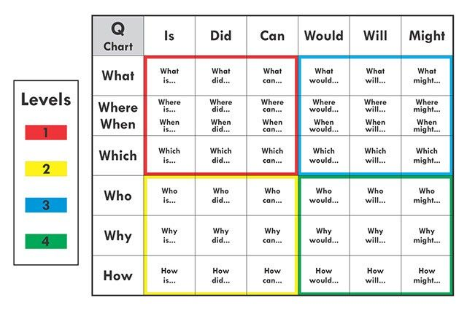
Questioning build social communication

Slide 16
How to deal with mentorship challenges
We hope that your mentorship will run smoothly, however sometimes challenges do occur, so it is important that you are properly equipped to deal with them.
Personal connection issues
If you have followed our advice on communicating and building a rapport but your relationship with your mentee still isn't gelling, try these strategies:
Tailor your approach: People respond differently to various communication styles and mentoring methods. Adapt your approach based on your mentee's preferences and personality. Experiment with different methods to find what works best for your mentee.
Organise an in-person session: We understand this may not always be possible, however it can be harder to form a connection via video call.
Form a connection outside of your careers and employability focus: What are their interests? Do you have anything in common? Take a moment to talk about something they enjoy#
Do not hesitate to contact the Spark! Team if connection issues continue to occur. We will offer advice and support for mentorship sessions, as well as reach out to your mentee where necessary.

Slide 17
How to deal with mentorship challenges
Lack of engagement/commitment
You might find that your mentee is not responding to your emails, or in your sessions they are non-committal. Try these strategies:
Assess the situation: Try to understand the possible reasons behind your mentee's lack of response or non-committal behavior. It could be due to personal issues, lack of interest, feeling overwhelmed, or misunderstanding your expectations. Take a moment to reflect on the situation and gather any relevant information.
Communicate openly: Reach out to your mentee and express your concerns about the lack of response or non-committal behaviour. Share your observations in a non-confrontational manner and emphasize your willingness to support them. Encourage open and honest communication, allowing them to express any challenges or concerns they may be facing.
Clarify expectations: Make sure that your mentee understands your expectations regarding communication and participation. Clearly outline the frequency and preferred methods of communication, as well as the importance of active engagement in mentoring sessions.
Break tasks into smaller steps: If your mentee seems overwhelmed or non-committal, break down tasks or goals into smaller, more manageable steps. This can make the overall process less daunting and increase the likelihood of engagement.
Remember, each mentee is unique, and there may be underlying factors that contribute to their lack of response or non-committal behaviour. Patience, understanding, and adaptability are key when addressing these challenges.
If your mentee is not responding to any communication, please contact the Spark! Team and we will reach out to the mentee or their school contact.

