Slide 1


Mentor Toolkit
Professional writing skills

Slide 2


Using the Mentor Toolkit
  Please download a copy of this presentation onto your own computer
  Feel to free to edit and adapt these resources to suit your mentoring style
  You do not have to (and should not!) use all the activities in this pack, choose the resources that you think will work best for you and your mentee
  If using for an online session, screen share and complete the activities together
  The times given are an estimate - you may find they take less or more time, depending on you and your mentee.

Slide 3

Why are professional writing skills important?
Professional writing skills are important to learn because they help you communicate effectively, be seen as professional and credible, advance in your career, build relationships, pay attention to detail, and adapt to different writing situations. Developing these skills can benefit you in various professional settings and increase your chances of success.
Some key components of professional writing skills include:
Clarity: Professional writing should be clear and easy to understand. It should convey ideas and information in a concise and straightforward manner.
Grammar and Punctuation: Strong writing skills involve proper grammar usage and punctuation.
Organisation: Professional writing should be well-organized and structured logically. It should have a clear introduction, body, and conclusion, with ideas presented in a coherent way
Tone and Style: Choosing an appropriate tone and style is essential in professional writing. Depending on the context and audience, the tone can be formal, informal, persuasive, or informative.
Audience Awareness: Effective professional writing considers the needs and expectations of the intended audience
Editing and Proofreading: Thoroughly editing and proofreading your writing is crucial to eliminate errors, improve clarity, and enhance overall quality.
Conciseness: It is important to communicate ideas concisely, avoiding unnecessary repetition or excessive wordiness.

Slide 4

Activity 1: Editing and proofreading
Goal
Engage in joint editing and proofreading sessions with the young person. Review their written work together, focusing on grammar, punctuation, clarity, and overall coherence. Teach them editing techniques and strategies to refine their writing.
Instructions
Go through each example with the mentee and guide them to proofread and edit to improve the grammar, clarity, structure and typos. Ask the mentee to rewrite the examples on a piece of paper or in a shared word document.
Time 15 mins

Slide 5
Grammar and Punctuation | Clarity and Conciseness
Identify and correct any grammar and punctuation errors in the following passage | Rewrite the following sentences to make them clearer and more concise
I enjoy going too the movies with my friends!!!! Their always, a lot of fun? We watch comedies, action films and, sometimes even horror movies!! My friends and Is favourite genre, are science fiction! | a) Because I really like science, and I'm really good and it, I thought it might be a good idea to try and get a job or a career as like doctor or something. b) Before you choose a Uni to apply to, it's really important to go and visit all the campuses first and see it all and the town and places. c) I'm writing this letter just to let you know that, you know, I really appreciate the opportunity you gave me and everything you do and stuff, it was really great
Sentence Structure and Word Choice | Proofreading for Spelling and Typos
Rewrite the following sentences to improve sentence structure and word choice | Identify and correct any spelling or typing errors in the following sentences.
a) The park, it's like, big, green, and cool. My family and I, we go there sometimes for like picnics and stuff, especially in the summer b) So, this book, right? It's written by this really famous author, and it's like, really, really interesting and got loads of information in it. You should totally read it. c) When it comes to math, I'm like, seriously, like, very, very good at it, you know? It's something I totally do so good in, for sure. | a) I am intersted in learnig new things and expandig my knowledge. b) My carrear goal is to become a sucessful entreprenuer in the future. c) I have a pasion for wrinting and hope to be a publised author one day.

Slide 6
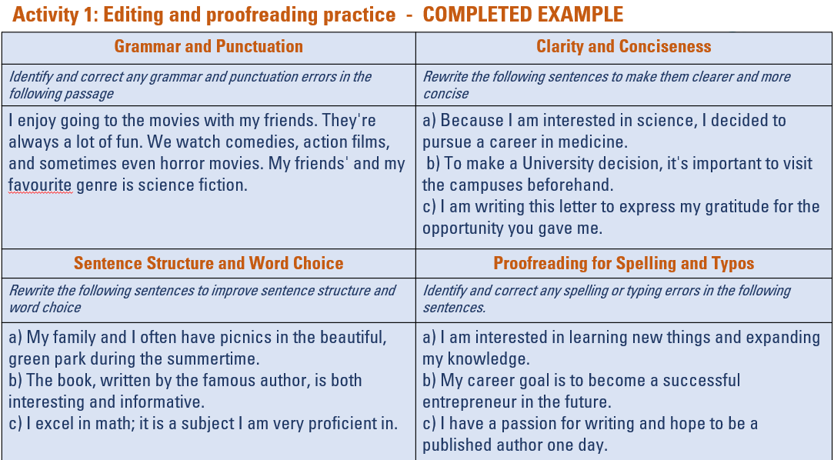

Slide 7
Activity 2: How to write an email
Instructions
Step 1: Show them the example of an email from a student in Finland and ask:
1.What do you think of it? Why?
2.How do you think a professional would respond to this email?
3.Can you pick out three things wrong with the email?
Step 2: Now show them the revised version and ask these questions again but instead of asking what is wrong, discuss with them what is better.
Step 3: Assign the mentee the task of drafting an email to a potential employer in your field, enquiring about a job. Share a blank word doc, or a blank email draft.
Guide them through the process, refer to the do's and don'ts table. and discuss with them the important elements of a professional email including structure, tone, word choice, and grammar.
Time 10-15mins

Slide 8
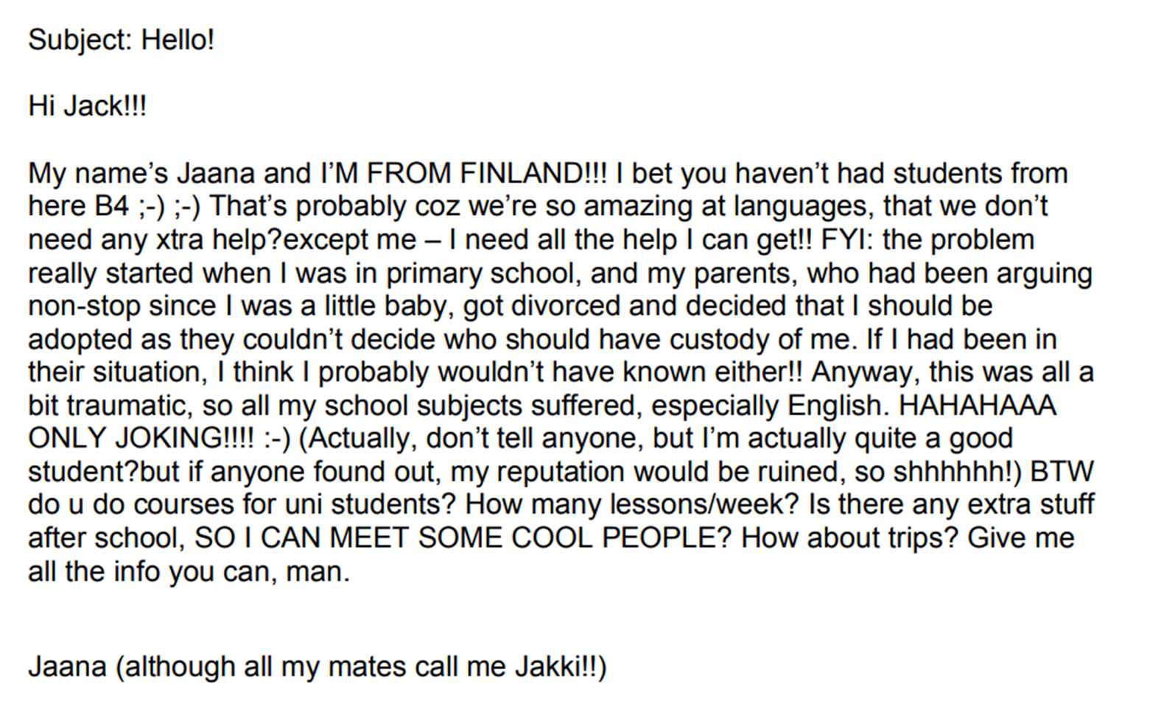
Example email 1

Slide 9
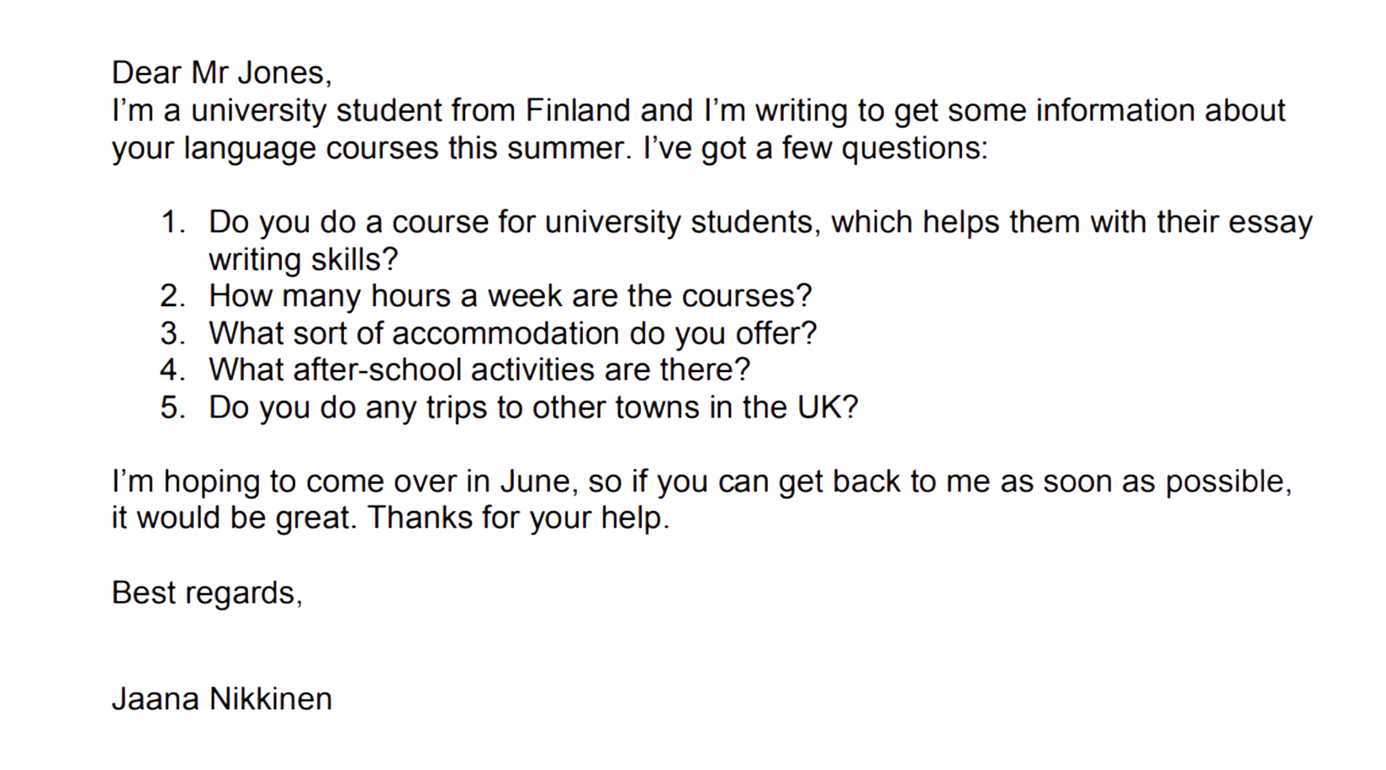
Exampe email 2

Slide 10
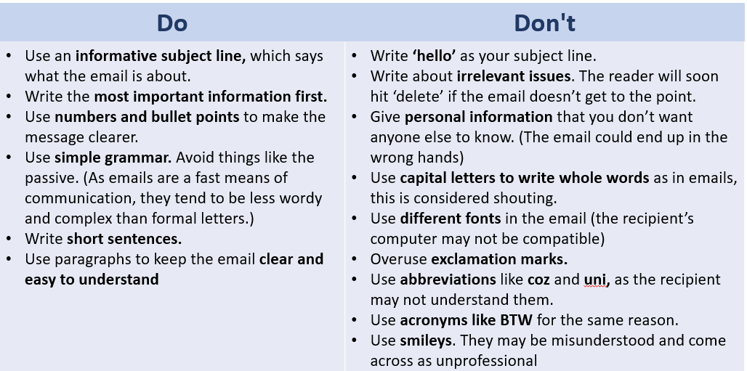
Email writing dos and don’ts

Slide 11
Activity 2: Writing a formal letter
Introduction
Formal letters are letters to people who we don’t know on a personal level. We may need to write formal letters or emails for many different reasons. For example, we may write to find out information, to apply for a job or a course, to make a complaint, to give information or to send thanks.
If you’re writing a formal letter, you must ask yourself:
  Who am I writing to?
  Why am I writing?
  What do I need to tell them?
  What do I want them to do?
Goal
To guide your mentee in writing formal letters and show them the appropriate structure, tone, and etiquette for professional correspondence. By the end of the activity, together you will have written an example formal letter.
Mentor tip - Consider your understanding of your mentee and their skill level before choosing this activity, some young people might find it challenging or overwhelming.
Time 20mins

Slide 12
Activity 3: writing a formal letter
Step 1: Understanding Structure and Format
Using the sample formal letter as a reference (share your screen), explain the basic structure of a formal letter: date, recipient's name and address, salutation, body paragraphs, closing, and signature.
Emphasize the importance of clear and organized content.
Step 2: Identifying Tone and Etiquette
Discuss the appropriate tone for formal letters: polite, respectful, and professional.
Highlight the importance of using appropriate language and avoiding slang or informal expressions.
Step 3: Writing Practice
Guide your mentee to write a thank-you letter. This can be to a person of their choice, but must be appropriate for a formal letter (e.g. teacher, mentor, work experience manager etc.)
Use the template and refer to the sample letter help them structure their own letter.
Step 4: Feedback and Revision
Briefly review their letter and provide constructive feedback.
Offer suggestions for improvement in terms of structure, tone, and clarity.
Encourage them to revise and make necessary edits.
For further advice and guidelines, including a simple video, head to this website
How to write a formal letter - BBC Bitesize

Slide 13
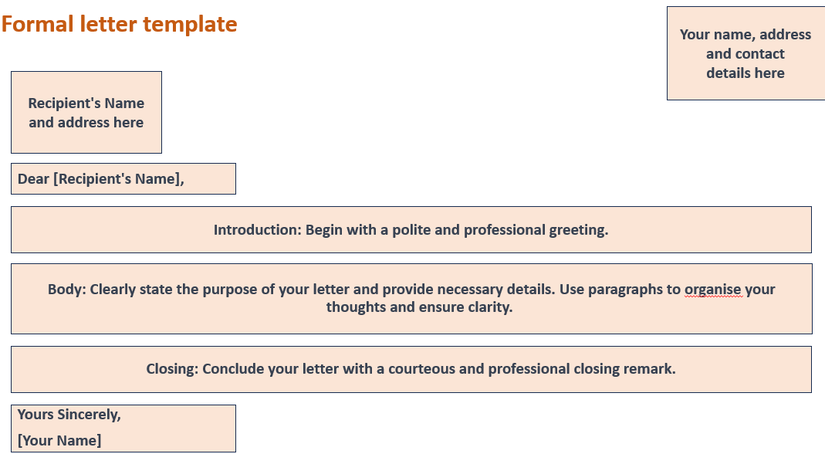

Slide 14
