Slide 1


Mentor Toolkit

Slide 2


Using the Mentor Toolkit
  Please download a copy of this presentation onto your own computer
  Feel to free to edit and adapt these resources to suit your mentoring style
  You do not have to (and should not!) use all the activities in this pack, choose the resources that you think will work best for you and your mentee
  If using for an online session, screen share and complete the activities together
  The times given are an estimate - you may find they take less or more time, depending on you and your mentee.

Slide 3

Tips for revision
There are a lot of excellent resources online to help young people with revision, one of the best being BBC Bitesize. There are many well thought out tips and advice videos on this website, and you may find it useful to share this page with your mentee, and go through relevant articles together ​
https://www.bbc.co.uk/bitesize/groups/cd5exmm663et​
​
Here are some of our top tips: ​
  Personalise your revision techniques – Everyone learns differently, and there are many ways to study. Try lots of methods to find what works best for you. ​
  Find the right space – Environment is so important for effective studying. If your home is too noisy, try a library. Work near a window for natural light and fresh air circulation. Organise your notes neatly and ensure you have water, snacks, and anything else to avoid interrupting your study flow. Avoid busy areas where noise can break your concentration.​
  Work with music – Music can improve your mood, help to motivate and relax, and increase your concentration. Studies also suggest it can improve your memory as well. However, be sure to select the proper music for this – perhaps heavy metal isn’t the best choice! ​
  Don’t forget about your wellbeing - Exam stress can really impact your mental health. Try to avoid energy drinks and aim for 8 hours of sleep per night. Exercise like yoga or walking to destress. Remember to schedule regular breaks, and don’t revise past a set time so you can unwind before bed.​
  Studying with friends - Group study can inspire you to work harder, as you can teach and test each other. But set ground rules like putting phones away to maintain concentration.

Slide 4
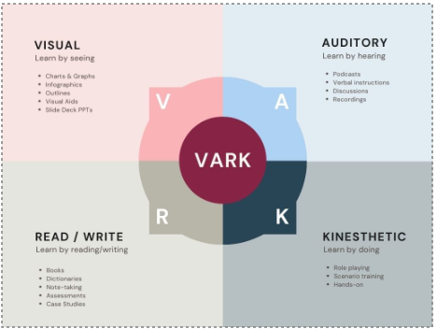

Differing learning styles or ‘Dual Coding’?
You may have heard about different learning styles before. They are intended to identify how different people learn best. The four most common types of learners are: visual, auditory, reading/writing, and kinaesthetic.​
Some say it can be useful to identify which one you are, to help you decide which revision techniques to use. ​
​
However, new research actually suggests that identifying your learning style is NOT as helpful as we might think , and that the most effective way to learn is use a variety of methods. This is called dual coding. ​
​
Learn more about dual coding here: ​
https://www.bbc.co.uk/bitesize/articles/z8vhfdm​
​
Instructions – share the webpage above, play the video about ‘dual coding’ and discuss the information together

Slide 5
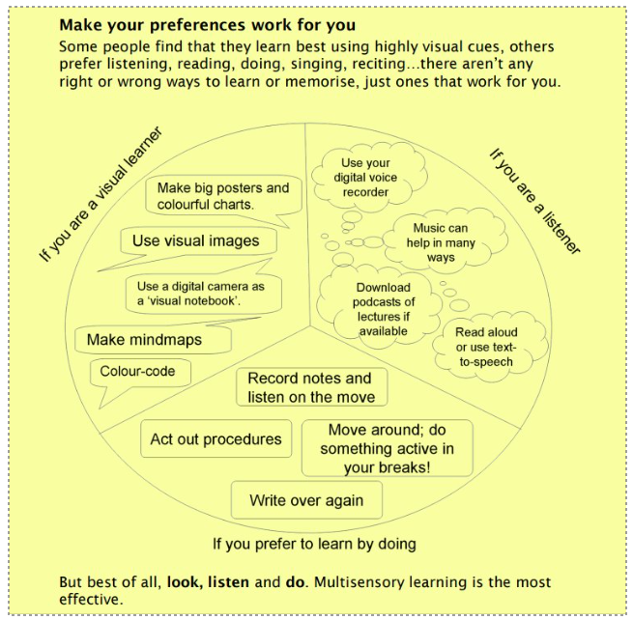

Slide 6
Revision techniques
There are many techniques for studying and memorising information. Everyone is different, and you may find some more useful than others. However, research suggests that the most effective way to revise is multi modal or ‘dual coding’ – these means using multiple different techniques for the same information, so that you process the information in different ways. ​
Here are recommended techniques that you could try: ​
​
  Flashcards​
  Youtube tutorials​
  The pomodoro technique​
  Mind maps​
  Past papers​
  Teach someone else​
  The SQ3R Technique​
Activity – go through the details on these techniques together. Discuss which ones might work best. ​
Tip – Assign your mentee a homework task of trying out a few of these techniques and then ask them to feedback next session on which ones they found effective and why

Slide 7
  Flashcards
Flashcards are the staple revision technique of any student. The reason they work so well is because they cut out all the useless bits of information that you don’t need to know. Short flashes of important facts and figures stick in your memory, meaning you’ll be able to use the information in your exams.​
How to make effective flashcards​
When making flashcards, using the specification for your particular exam is essential. The specification will breakdown your course into many smaller and easier-to-digest topics. Each of these topics are then further broken down into “Learning Objectives”. Every time you make a flashcard, make sure that it is actually testing a “Learning Objective” that is stated in your specific subject specification. ​
​
EXAMPLE: from the GCSE Physics Specification, Learning Objective 2.15 is – “Recall and use Newton’s second law as F = m x a”. ​
It is a good idea to phrase your flashcards as questions. Therefore, one side of your flashcard should read “What Is Newton’s Second Law Equation?”, and the other side should read ‘F = m x a’ ​
​
By phrasing as questions, it's easier for you to test yourself, and it will also be easier for you to recall previously revised information when you are in your actual exam. If you are comfortable answering questions, as opposed to just associating words with a particular definition, you will do much, much better in your exams.

Slide 8
  Flashcards
Now this is a ‘killer’ strategy for how you should use your flashcards:​
​
  Get someone else to read the question on each flashcard.​
  For every flashcard you get 100% correct, put it in a pile to your right. However, for every flash card you don’t get exactly right put it in a separate pile (to your left).​
  Once you have sorted your initial pile of flashcards into the two piles, you pick up the pile of flashcards that you got wrong and then you sort this pile out into their right-wrong respective piles (ask all the flashcards again).​
  You keep repeating this, until you have no flashcards left in a “wrong” pile.​
  Repeat steps 1-4 until you can go through the first pile of flashcards and have no wrong ones.

Slide 9
2. Youtube tutorials
Videos are great way of revising, as long as you’re watching videos on your course content. YouTube has hundreds of GCSE and A-Level revision videos for almost every course. There are so many fantastic YouTube channels that will take you all the way through the specification with a playlist including every topic. ​
It can be helpful to hear something explained in a different way - this could be the difference between you not understanding a topic and you being the master of that topic.​
To find videos, just search your course on YouTube – but be sure to check it is the correct exam board with the same specifications as your exam. ​
Tip – This is a great technique to use as part of ‘Dual coding’, as you’ll be taking in information differently to flashcards, mindmaps etc (auditory vs written or visual).
Here are some well-reviewed channels:​
  A-Level Physics – Science Shorts​
  A-Level Biology – Ryan Toal​
  A-Level Chemistry – Allery Chemistry​
  A-Level Maths – Exam Solutions & Yacine Koucha​
  A-Level Further Maths – Exam Solutions​
  A-Level Computer Science – Craigndave & Computer Science Tutour​
  A-Level English Language – Mr Bruff​
  A-Level English Literature – Mr Bruff

Slide 10
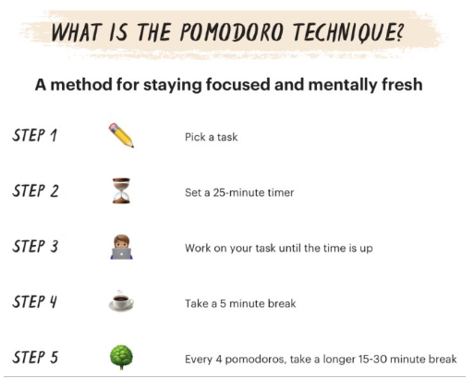
3. Pomodoro technique
The Pomodoro Technique means taking breaks after short periods of revising. This method of revision supposedly is the best for saving information in your head, 'better than any other method'. The short breaks allow your brain to rest and absorb what you’ve just revised, and so your revision ends up being more efficient. The technique was invented in the 1980’s, and it’s traditionally broken down into 25 minute periods of revision followed by 5 minute breaks.​
Try the Pomodoro Technique if you...​
  Find you are easily distracted​
  Consistently work past the point of optimal productivity​
  Are overly optimistic when it comes to how much you can get done in a day ​
  Enjoy gamified goal-setting

Slide 11
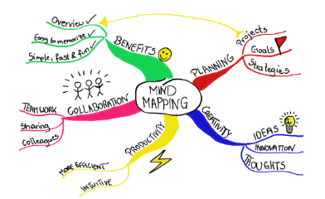
4. Mind maps
​
Therefore, you should make a mind map, revise what you didn’t know (using other techniques like flashcards or YouTube videos), and then make another one. Carry on making mind maps until you’re confident you’ve written down everything you need to know from memory.
Once you’ve done that, you should have a piece of paper with everything you need to know on it, which you can revise from in future. ​
Mind maps, also known as spider diagrams, are very effective for learning, and they can help you to understand what your strengths and weaknesses are. They consist of writing down all that you can remember, and then you can work out the gaps in your knowledge. Mind maps work so well because the fact that you make them yourself means you’re more likely to remember them. A mind map is essentially a visual representation of the knowledge that is contained inside your head. ​
The secret key to effective mind maps is visual memorability. To make an effective mind map, you’ll want to add colour, shapes and drawings – and lots of it. These helps your brain remember what you’re doing, as it makes it seem more fun and enjoyable. More enjoyment = better retention of information = better exam results.
How Do You Use Mind Maps (So They Actually Work)? ​
Mind maps are best used at the start of a revision session so that you can identify all of your knowledge gaps for a particular subject. Whenever you make a mind map, it highlights the areas that you know a lot about, and also shows you the areas that you don’t.​

Slide 12
5. Past Papers
Past papers are an essential part of revision. They not only improve your knowledge of the content, but they also boost your exam technique, too. Exam technique is vital for any student, as without it you could lose a lot of marks.​
There are lots of ways you can ‘go through’ a past paper, but only a few are effective. Possibly the most common (and most simple) way of going through past papers is to do all the questions in the allotted time, and then check your answers after. This way is great for preparing you for exams, as it is pretty much what will happen on the day. However, it isn’t entirely effective, as there’s less room to learn.​
A better way for learning is to take as much time as you need to do the questions. Just work on getting them right with full marks, and then move onto full exam style revision later. You can even check the answers every once in a while, if you need help. This repeated exam technique practice combined with constant revision is a sure-fire way of exam success. Just make sure you’re not constantly looking at the answers
If this happens, you won’t remember any of your revision – you’ll just rely on the answers being there, which they won’t be during an exam.​
Tip - Save your past papers until just a few weeks before your exam. Doing this will ensure you’re in the exam-mood as you progress smoothly from revision to the real thing. In the meantime, use other revision techniques on this list. The more you switch up your revision techniques, the more likely you are to remember what you revised.
​
Where to find past papers ​
Your teachers should have many past papers available for you, however you can can also find them all online:​
  AQA Past Papers​
  Edexcel Past Papers​
  OCR Past Papers
​

Slide 13
6. Teach someone else
Teaching other people is a great way of improving your own understanding of a subject or topic. Relaying your knowledge and helping someone else to understand helps both parties involved, so it’s a win-win.​
When you are teaching someone, they will ask a lot of questions. Each of these questions you will have to explain in detail. Therefore, it is very likely that they will ask a few questions you won’t know the answer to. You also might be on the receiving end of some tutoring. This can be just as effective as being the tutor, because better understanding and concepts are being shared with you.​
How Does Teaching Someone Else Actually Help You?​
Teaching someone else allows you to go over your previous understanding of things, something that you wouldn’t normally do.
It’s important to question your knowledge, as otherwise you may have hidden gaps. Hidden gaps in your knowledge can expose themselves in exams when you least expect it – this leads to loss of marks. Similar to mind maps, teaching someone else reveals those hidden gaps before you reach your exam. ​
​
Who should you teach? ​
When finding someone to teach, just make sure:​
  You at least know the basics on what you’re teaching ​
  You’re teaching someone who isn’t as good as you are​
  The person will be able to ask questions about the topic​
Tip – got time in your mentoring session today? Teach your mentor a topic!

Slide 14
7. SQ3R Method
This is a really simple yet effective revision technique that supports active recall. Active recall studying is when you actively stimulate your memory for a piece of information, and is a much more powerful way to teach your brain to remember information from a piece of text, rather than passive study techniques of reading and highlighting. ​
The method has five steps:​
  Survey: survey or skim the material (e.g. a passage in a textbook) to get an idea of what it is about.​
  Question: create some questions that you have and that you think the text might answer. Write these questions down. ​
  Read: actively read the text, trying to answer the questions you created.
4. Recite: This is the active recall part. Immediately after reading, summarise the text's main ideas in your own words. You could say them out loud or write them down, as long as you do this without looking at the text or any notes you've made. Try explaining the material as if you were teaching it to someone else, focusing on the main points and your questions from the "Question" step.​
5. Review: Once you finish that, repeat back to yourself what the point of the material was, and summarize what you learned.​
Why use this method?​
  Encourages active, strategic reading and maintains focus.​
  Deepens understanding by summarising content in your own words.​
  Effective for all types of readers.​
​

Slide 15
Activity - creating a revision timetable
Instructions:​
1. Discuss creating a revision timetable with your mentee: ​
  Have you ever created a revision timetable before? ​
  Did you find it useful? Why or why not? ​
  What makes a good timetable?​
2. Help them to start their own revision timetable. Go over the tips for an effective timetable with them, and then guide them through the following steps: ​
  Get all the information you need - this includes your exam dates, lesson timetable, shifts at work, when you’re meeting your friends, etc.​
  Block out the times you can’t study - be realistic, if you’re not going to work before 10am on a Sunday block that time out. There is no point making a timetable you can’t stick too. ​
  Pick a revision start date - pin down a day to get started and think about your revision priorities. Some subjects and topics will take longer than others.​
  Plot your revision sessions into the sample timetable - decide how much time you’re going to spend on each topic and schedule in breaks.​
  Decided where you will display your plan - a plan is no good if you don’t check it. Print it out and put in on your wall so that you can remind yourself what you’re studying and when.

Slide 16
Creating a revision timetable
It can be easy to get overwhelmed by the amount of work you have to do for your exams, so staying organised by planning your time and creating a revision timetable is a good idea. It can be beneficial when it comes to keeping on top of your workload in the run up to exam season. Having a good plan will help you stay motivated and balance your time across different subjects.​
​
What makes an effective revision timetable?​
A good revision plan should be:​
Realistic: Everyone has good intentions but be careful not to set a plan you can’t stick to. Nobody can do 12 hours of revision a day. Everyone needs breaks and free time. ​
Detailed: Attempting to do a four-hour revision session for one subject will probably lead to procrastination and burn-out. A good plan breaks revision into smaller chunks of time periods, assigning each time to a subject or topic, and specifies times for breaks too. ​
Flexible: Some topics are difficult and may take you longer than you planned. Or something might come up which means you cannot study at a specified time. Don’t be afraid to adjust your plan accordingly.​
Personalised: Everyone learns differently, and there is no one size fits all. Consider factors such as what time of day do you work best? Do you have any hobbies or commitments you should plan around?

Slide 17
sample timetable
​ | Monday​ | Tuesday​ | Wednesday​ | Thursday​ | Friday​ | Saturday​ | Sunday​
9:00am​ | ​ | ​ | ​ | ​ | ​ | ​ | ​
10:00am​ | ​ | ​ | ​ | ​ | ​ | ​ | ​
11:00am​ | ​ | ​ | ​ | ​ | ​ | ​ | ​
12:00pm​ | ​ | ​ | ​ | ​ | ​ | ​ | ​
1:00pm​ | ​ | ​ | ​ | ​ | ​ | ​ | ​
2:00pm​ | ​ | ​ | ​ | ​ | ​ | ​ | ​
3:00pm​ | ​ | ​ | ​ | ​ | ​ | ​ | ​
4:00pm​ | ​ | ​ | ​ | ​ | ​ | ​ | ​
5:00pm​ | ​ | ​ | ​ | ​ | ​ | ​ | ​
6:00pm​ | ​ | ​ | ​ | ​ | ​ | ​ | ​
7:00pm​ | ​ | ​ | ​ | ​ | ​ | ​ | ​
8:00pm​ | ​ | ​ | ​ | ​ | ​ | ​ | ​

Slide 18
