Slide 1


Mentor Toolkit
Session 1

Slide 2


Using the Mentor Toolkit
  Please download a copy of this presentation onto your own computer
  Feel to free to edit and adapt these resources to suit your mentoring style
  You do not have to (and should not!) use all the activities in this pack, choose the resources that you think will work best for you and your mentee
  If using for an online session, screen share and complete the activities together
  The times given are an estimate - you may find they take less or more time, depending on you and your mentee.

Slide 3
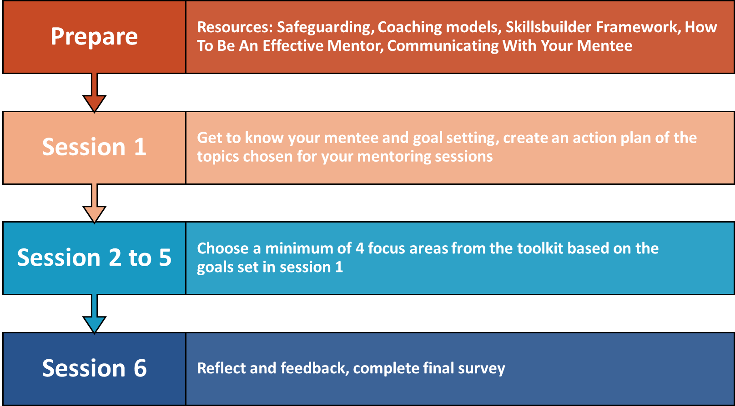
Your Mentoring Journey

Slide 4

Your first mentoring session
In your first mentoring session, your goal will be to understand your mentee better and create an action plan
  Get to know your mentee with some icebreaker activities
  Discuss strengths and weaknesses
  Build and practice goal setting skills
  Discuss their ideal outcomes and goals for their mentorship: What do they want to achieve?
  END OF SESSION GOAL: Create your action plan together: select a minimum of four focus areas for their next sessions
You do not have to complete ALL of the following activities, select a few to support your mentee in achieving the session goal (creating an action plan)

Slide 5

‘Get to know you’ activities
Here are some 'get to know you' activities you can use to open your first session, to break the ice and help things flow better for the rest of the session. Feel free to use these or your own similar activities. We recommend spending 15 minutes or so (for a 1hr session) on this 'get to know you' stage.
Activity 1: This or that
Activity 2: If I were...
Activity 3: Fact or Fiction
Activity 4: Now me, Now you

Slide 6
Activity 1: This or That
This is a fast-paced game where players pick their favourite of two choices. The answers reveal participants’ preferences, can show similarities between players and can spark natural conversation. Here are some examples, but you can also come up with your own if you wish
  Mountains or beaches? ​
  Mcdonalds or Dominoes? ​
  Money or free time? ​
  Football or basketball? ​
  Cats or dogs?
  Movies or TV shows?
  Sandwiches or tacos?
  Outside or inside?
  Sleep late or wake up early?
  Ice cream or cake?
  Books or music?
  Horror or comedy movie?
  Concert or match?
  Car or motorcycle?
  Sweet or salty?

Slide 7
Activity 2: If I were....
‘If I Were’ is a game that encourages players to imagine themselves in different situations. It will divulge a little more about the mentee's personality, and how they perceive themselves. To play the game, read out the prompts and take it in turns to think of a response.
Example prompts:
  If I were a celebrity, I’d be…
  If I were a food, I’d be…
  If I were a book, I’d be…
  If I were a movie, I'd be
  If I were a superhero, I’d be…
  If I were an animal, I’d be…
  If I were a mythical beast, I’d be…

Slide 8
Activity 3: Fact or Fiction?
Also know as two truths and a lie, in this game you can learn something new about each other's lives.
Each person comes up with three statements about themselves, two are FACT (or truths) and one is FICTION (lie).
The other person must figure out which statement is the fiction. You may ask probing questions to discover more information.

Slide 9
Activity 4: Now me, Now you
Take it turn to quiz each other with our 'get to know you' questions. Swap between 'fun' questions and more career-based questions (Or start with a few fun, before moving onto career based).
We recommend cover as many as these career questions as you can as it will help you in the goals setting stage of the session .
Example fun questions:
  If you could have any superpower, what would it be?
  If you won the lottery, what would you do?
  What is your favourite movie/TV show?
  What is your favourite food?
  Do you have any hobbies?
  What is on your bucket list?
  What is your favourite memory?
  What is your favourite place you have travelled?
  Who is your favourite person in the world?
  What is your most prized possession?

Slide 10
Activity 4: Now me, Now you
Career questions for the mentee to ask
  What were your perceptions of a career when you were at school?
  Did you know what you wanted to do or did you have no idea?
  When you left school, what did you do? Did you go straight into work/university?
  How did you decide about whether to go to work? or university?
  What was your experience of university or work?
  How did you progress after university? Or how did you progress in your career?
  Have you always had the same job in the same area, or many different jobs?
  What have you learnt about work/about yourself as your career progresses?
Career questions for the mentor to ask
  Do you know what you want to do when you finish education, or do you have any idea?
  Did you think you want to go straight into work, or university?
  Have you done any work experience or had any jobs? What where they, what did you like, what didn't you like?
  What subjects do you enjoy the most?
  What do you like about school/college, what do you dislike?
  What work/career do family members have?

Slide 11
Goal Setting
Work with your mentee to identify their strengths and weakness, and discuss their ideal outcomes and goals for their mentorship
Activity: SWOT Analysis
Instructions​
SWOT analysis is a simple but useful framework for analysing your Strengths, Weaknesses, Opportunities, and Threats. ​
Support your mentee to fill in the SWOT grid by asking them prompt questions and helping them to articulate and synopsise their ideas. ​
Additional questions could include:​
What do you enjoy doing? What makes you proud?
What do you need to improve to be able to get and keep a good job?
How would your friends describe you? How would your family describe you?​
Time - 10mins

Slide 12
Activity: SWOT Analysis
Strengths
Weaknesses
What are you good at? What do you enjoy?
What do you need to improve? What do you need help with?
Opportunities
Threats
What help do you have? What currently makes it easier for you to study or get a job?
What obstacles do you face? What currently makes it harder for you to study or get a job?

Slide 13
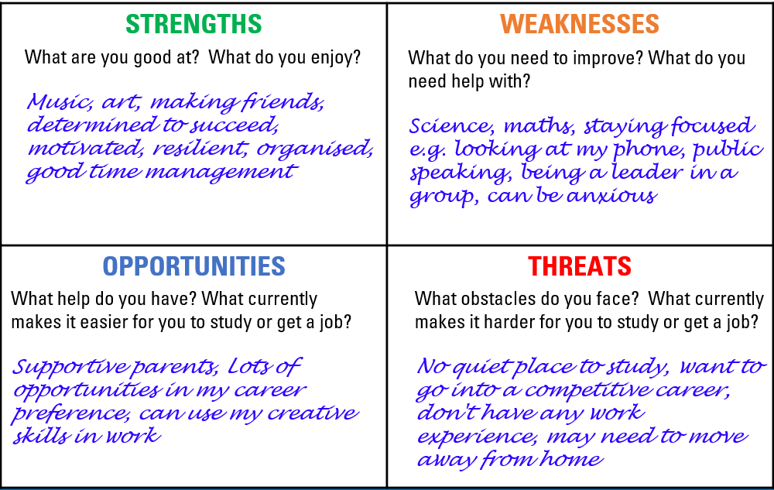
SWOT Analysis Completed Version

Slide 14
Activity - Wheel of Life
Introduction
The Wheel of Life is a great exercise and tool for helping to create more balance and success in life. It can help mentees identify areas that need support and improvement and can be used as a foundation exercise for goal-setting.
Goal
Guide your mentee to identifying areas of their life that might need more focus, in preparation for setting goals
Time: 10 - 15 mins

Slide 15
Activity - Wheel of Life
Instructions
Step 1: Share your screen, so both you and your mentee can use the template together. Or ask you mentee to draw a circle and divide it into 8 equal segments
Step 2: Support your mentee to score their satisfaction levels (0 –5) against each of the different categories you on the wheel. Once all 8 categories have been scored, link them up to create the personal 'wheel'. You may also use the blank template, if you and your mentee wish to choose more relevant categories
Step 3: Ask some prompt questions to encourage deeper thinking. These could include:
  Why did you score yourself in each category the way you did?
  What is your ideal score for each category to achieve in the next month, 3 months, 6 months, one year?
  Where are your biggest gaps in satisfaction levels?
  Which area of your life do you primarily want to focus on to enhance your satisfaction levels?

Slide 16
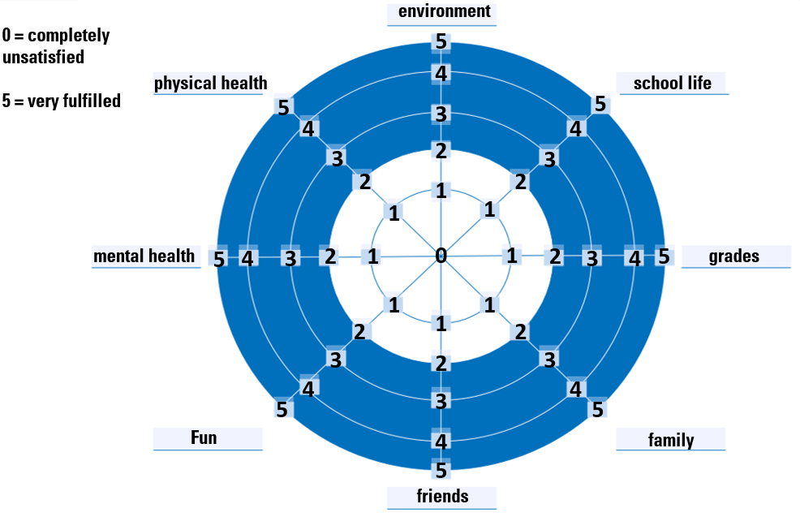
Wheel of Life template

Slide 17
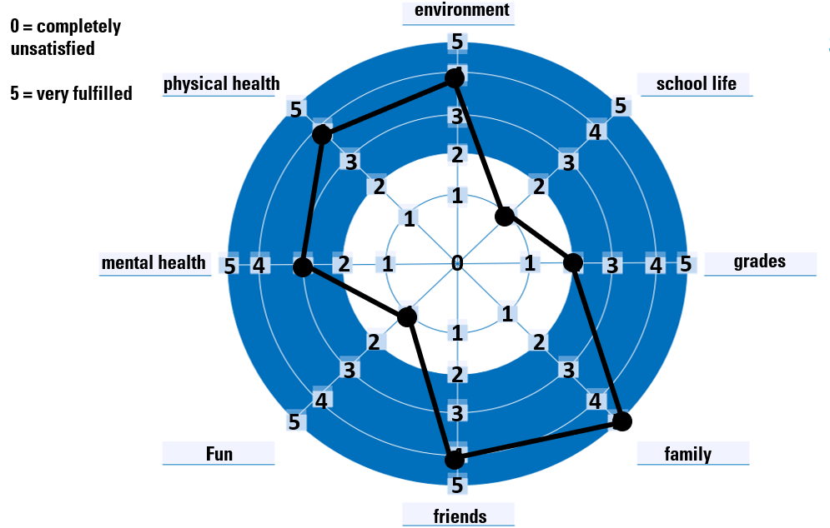
Completed example

Slide 18
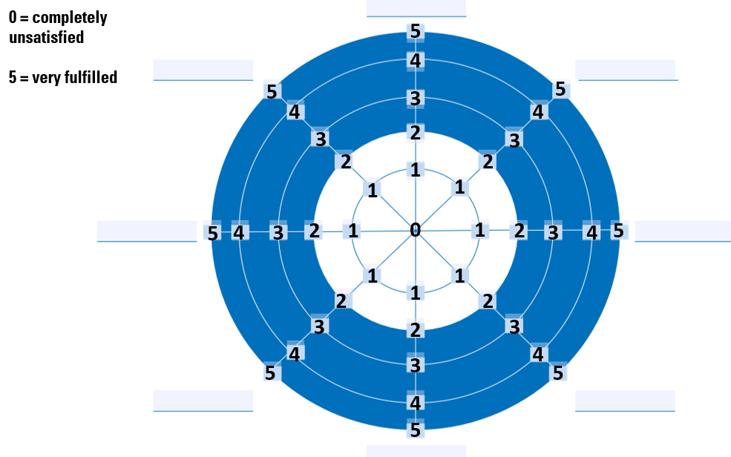
Blank category template

Slide 19
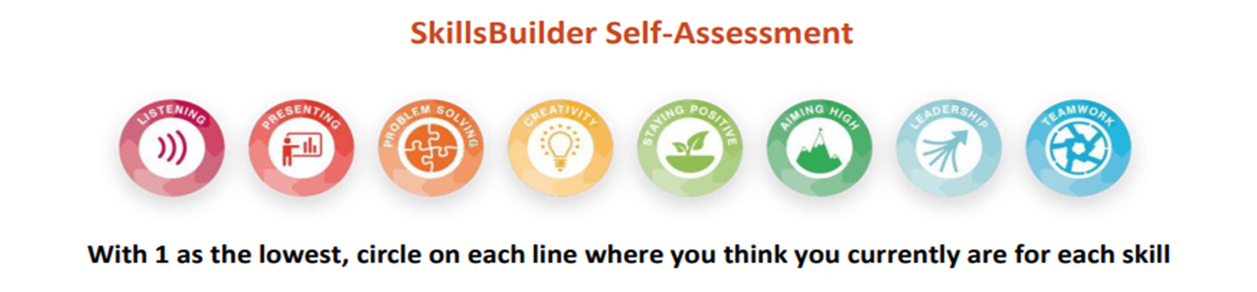
Activity - SkillsBuilder Self Assessment
Work with your mentee to complete the Skills Builder self-assessment. This will help them identify key areas that may require focus and improvement

Slide 20
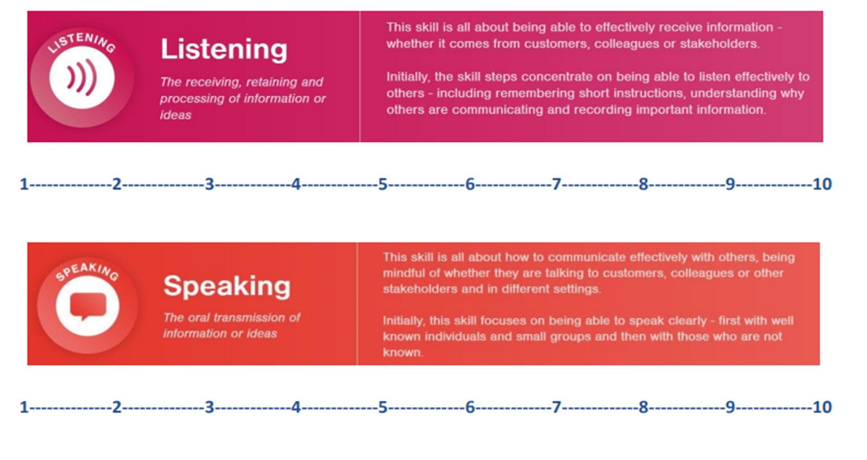
Activity - SkillsBuilder Self Assessment
Communication Skills

Slide 21
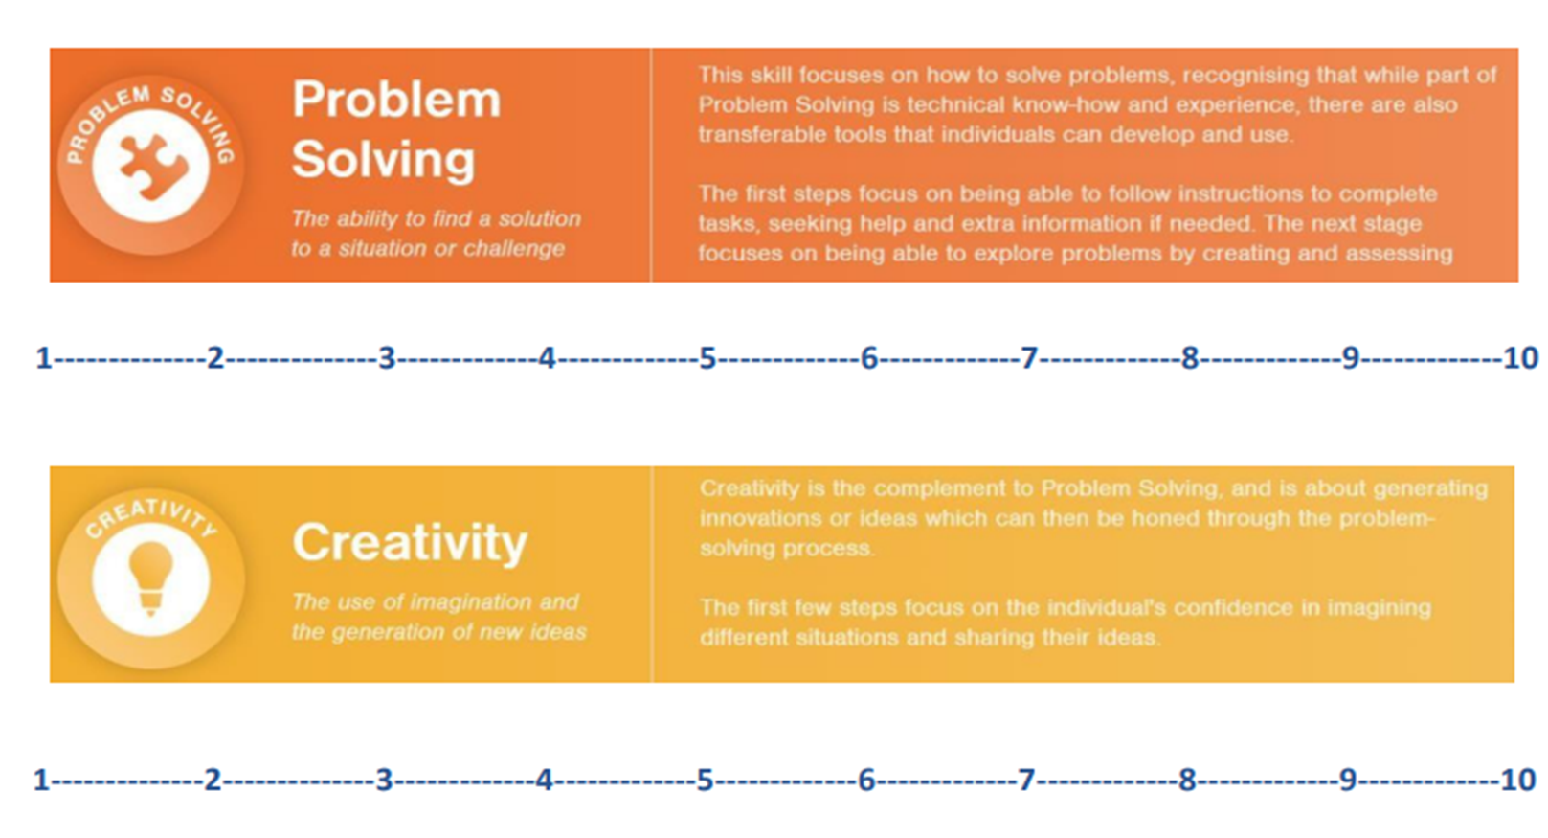
Activity - SkillsBuilder Self Assessment
Critical Thinking

Slide 22
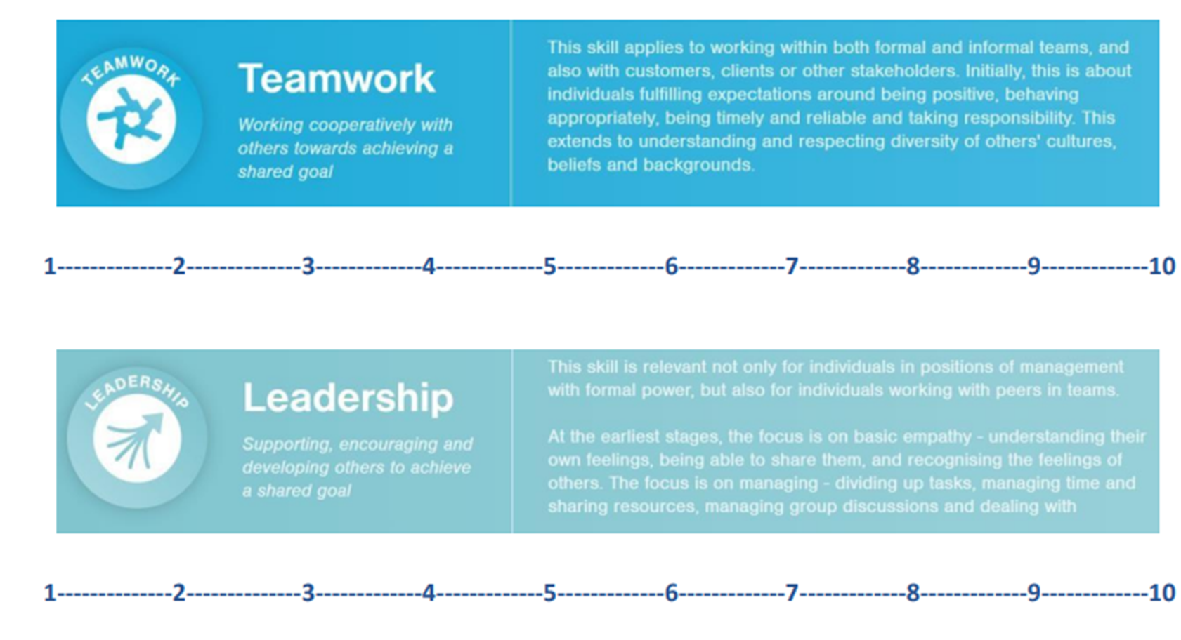
Activity - SkillsBuilder Self Assessment
People Skills

Slide 23
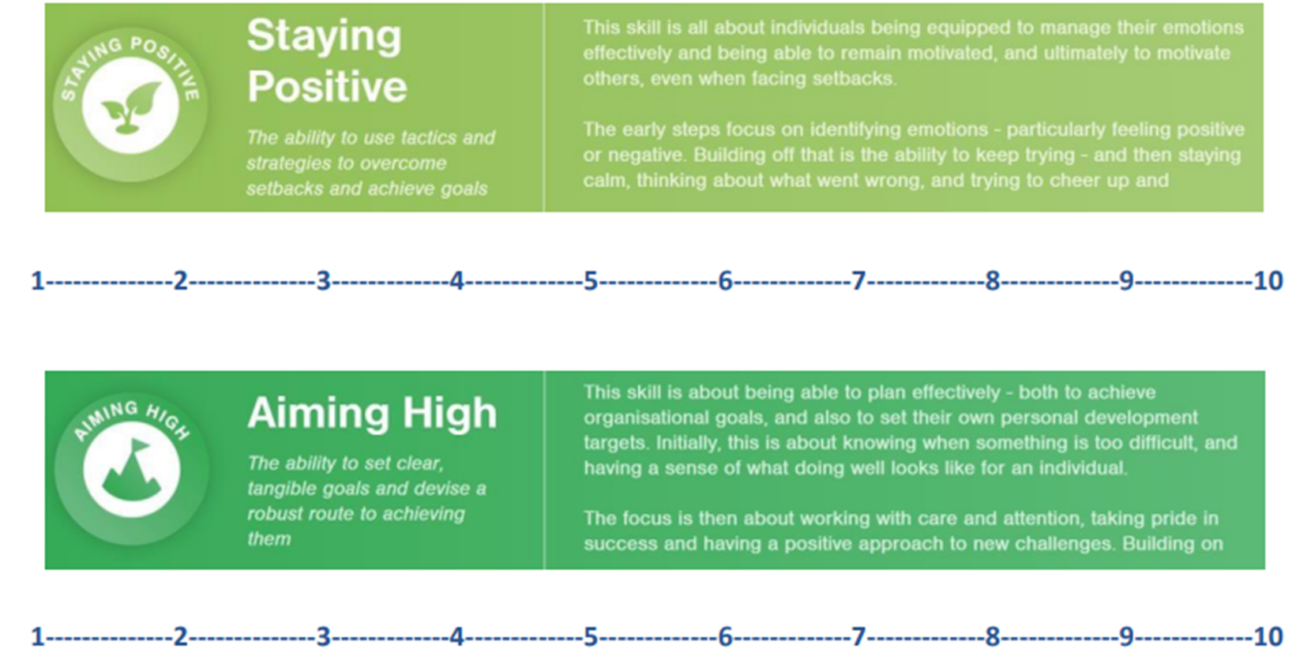
Activity - SkillsBuilder Self Assessment
Self-Management

Slide 24
Thinking about career goals
Discuss the following questions and note down your ideas:
  What do you think is the most important skill for your chosen career area?
  By the end of this mentorship, where do you see yourself?
  Where do you see yourself in 1 year?
  Where do you see yourself in 5 years?
  What skills do you need to get yourself to these places? What tasks will you need to do?
  What employability skills would you like to improve most?

Slide 25
Long and short term goals
Decide on 3 short term goals and 2 long term goal (you can decide on more if it feels appropriate and achievable)
Short term goals | Long term goals
1.. 2.. 3.. | 1.. 2.. 3..

Slide 26
Creating your mentorship action plan
Take a look at our list of suggested focus areas for sessions 2 – 5. Which of these areas does your mentee needs to work on to allow them to achieve their goals? Together choose a minimum of 4.
Building resilience
Managing stress
Time management
Public speaking
Teamwork
Conflict resolution
Money management
Revision support
Building your vocabulary as an EAL student
Exploring your career options
Interview skills
Writing a CV
Writing a personal statement
Professional writing skills
Leadership skills
Communication skills
Building motivation
UCAS and applying for Uni

Slide 27
Action plan template
Please see editable word doc, available in the toolkit. Don’t forget to send your completed version to the Spark! Mentoring Team
Session | Session focus topic | Goal this will help to achieve
1
2
3
4
5
6

