Slide 1


Mentor Toolkit
Session 6

Slide 2


Using the Mentor Toolkit
  Please download a copy of this presentation onto your own computer
  Feel to free to edit and adapt these resources to suit your mentoring style
  You do not have to (and should not!) use all the activities in this pack, choose the resources that you think will work best for you and your mentee
  If using for an online session, screen share and complete the activities together
  The times given are an estimate - you may find they take less or more time, depending on you and your mentee.

Slide 3

Personalise your session
By now, you should know your mentee pretty well. You should have a good idea about the kinds of activities that work for them, and what they are hoping to get out of their sessions.
So, in this final session, you have the freedom to focus on whatever feels right. You may choose to do something more interactive and fun. This would also be a good time to do a workplace visit, and as part of that you could choose some activities that would give them more of insight into your job/career.
Whatever you choose to do, we do just ask that you can find some time to for you to reflect and feedback on your mentoring experience, and to complete the final survey

Slide 4

Activity 1: Reflect and feedback
Goal
Spend some time reflecting on your time with your mentee, thinking about what went well and what could be improved upon
Instructions
Answer the questions on the table. Discuss the questions together and try to honestly share your experiences with each other.
You might want to revisit your action plan from Session 1 to aid reflection on your journey
Time 10 mins

Slide 5
Activity 1: reflect and feedback
The most successful parts of the mentoring programme were… #1 #2 | My main takeaway will be……
Things that could have been improved upon were… #1 #2 | Would you recommend the mentoring programme to a friend? Why/why not?

Slide 6
Activity 2: Creating an after-mentoring action plan
Goal:
Aid your mentee in future thinking – help them to plan what steps will they take to further help them reach their goals
Instructions:
Part 1: Revisit your action plan from Session 1. Discuss with your mentee how far they have come to reaching their goals they set.
Any there any goals they feel they have achieved?
Which goals still need further work?
Part 2: Now help them with future thinking:
If there are goals that are not met yet, what can they do to help reach these after your mentorship is over? Do they have any new goals? If so, that steps can they take to work towards them?
Part 3: Structure your thinking with the ‘after mentoring’ action plan on the next page

Slide 7
Activity 2: Creating an after-mentoring action plan
1.Short term goal Something I can achieve in the coming weeks | Actions I can take to help achieve this goal: 1. 2. 3.
2. Middle term goal Something I can achieve over the next few months | Actions I can take to help achieve this goal: 1. 2. 3.
3. Long term goal Something I would like to achieve in the future | Actions I can take to help achieve this goal: 1. 2. 3.

Slide 8
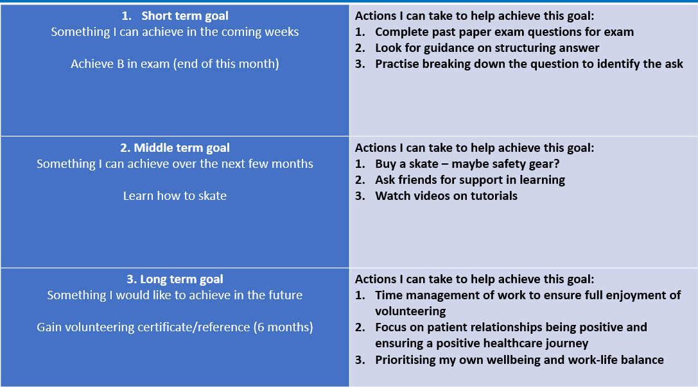
Action plan completed version

Slide 9
Activity 3: Completed end-of- mentoring survey
Please find 5 minutes to complete the mandatory final feedback survey with your mentee. You will both need to complete one. In these surveys, we will ask for you give us your honest feedback on what went well and comments on what can be improved upon.
Surveys are vital for us at Spark! to measure our impact and to continually improve upon our programmes.
Please contact the Spark! Team for an up-to-date link to the survey, if you have not already been sent via email.

Slide 10
Ending your mentoring relationship
We hope that you had a great experience with your mentee and have formed a long-lasting professional relationship. We do encourage you to stay in touch, as a big part of effective mentoring is having access to a career network. However, due to safeguarding reasons, there are some dos and don’ts to follow for your contact going forward.
DO:
  Stay in touch via email and online meetings only. Encourage your mentee to keep their emails professional.
  Let a member of Spark! staff know of your intentions to stay in touch, and continue to follow safeguarding policies.
DON’T:
  Add or accept your mentee on social media (Facebook, Instagram etc). Depending on the advice from your organisation, once your mentee has turned 18, you may add them as a connection on LinkedIn.
  Meet in person or contact via text or Whatsapp. Please delete your mentee’s number from your phone, and encourage them to do the same for yours

