Slide 1
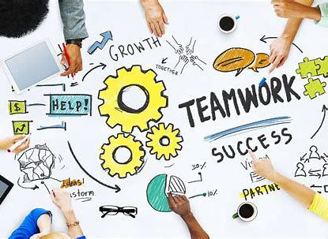

Mentor Toolkit

Slide 2


Using the Mentor Toolkit
  Please download a copy of this presentation onto your own computer
  Feel to free to edit and adapt these resources to suit your mentoring style
  You do not have to (and should not!) use all the activities in this pack, choose the resources that you think will work best for you and your mentee
  If using for an online session, screen share and complete the activities together
  The times given are an estimate - you may find they take less or more time, depending on you and your mentee.

Slide 3

Why is teamwork important?
Teamwork…
1.Improves listening skills and communication
2.Allows you to share the workload
3.Generates more ideas as a group
4.Can support in any conflict resolution
5.Allows you to showcase your strengths and personal skills
6.Improves your confidence
7.Increases creativity

Slide 4

How to develop your teamwork skills
Share information
•As a team, remember, the success of your project depends on the success of every member of your team. If you have any information that could benefit the work of another team member, you must share the information with your fellow teammates
Timely Submissions
•As a team, you must remember that every member’s contribution is important. Keeping the time in mind, make your contributions worthwhile
Be a part of the team
•When you are part of the team, show that you are interested to be part of the team. Take active part in team activities and show your enthusiasm
•Celebrate wins and achievements together
•If credit has been given to the team for the goal achieved, be sure to accept the credit as a member of the team and not individually

Slide 5
Examples of poor teamwork
Withholding information
This can have a detrimental effect on team performance
Lack of communication
Open communication and coordination helps everyone understand what their specific objectives are and what to expect from their team members
Personality conflicts
Everyone has their own preferences and personalities but it is important to not let this effect morale or teamwork

Slide 6
Activity 1: How collaboration put man on the moon
Teamwork Matters
The three Apollo 11 astronauts were not close friends. They had different personalities. But they made it work; they interacted successfully under the most extreme circumstances. They needed to be accepting and respectful of who their teammates are and the individual contributions they offer.
Task:
Ask your mentee to draw on a real-life example of where teamwork has gone well or hasn’t gone so well.
Can you also share an example with them from your career journey?

Slide 7
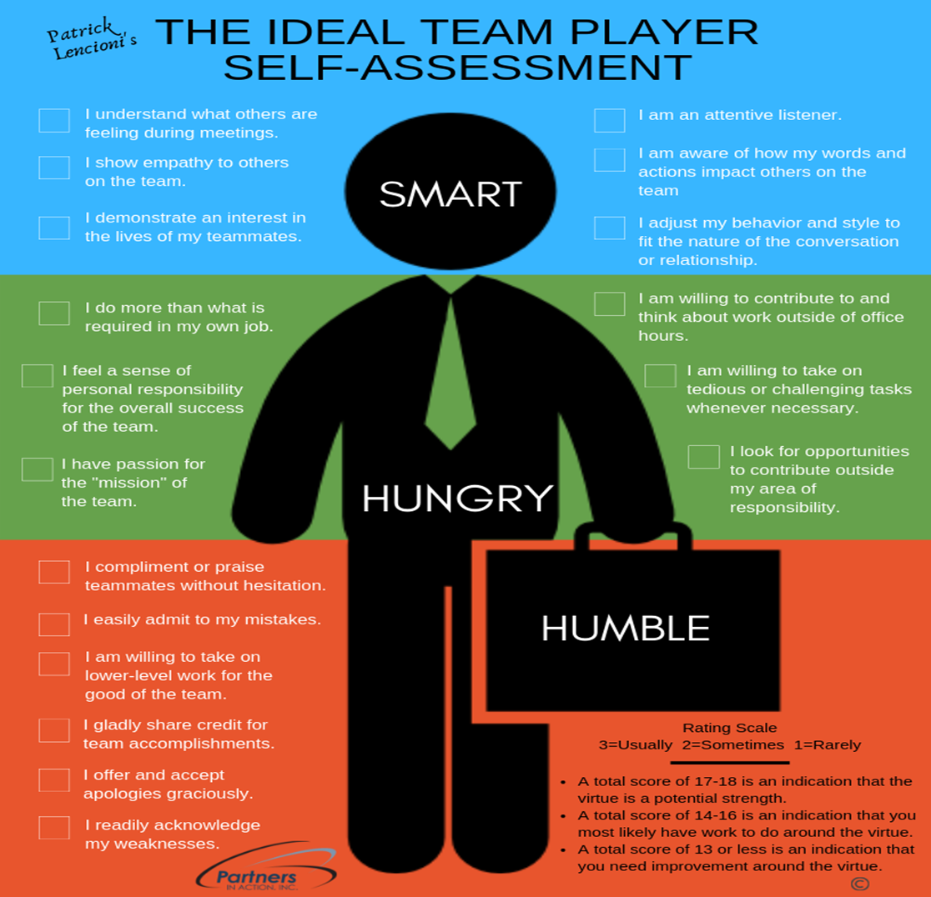
Ask your mentee to complete this self-assessment task. Tell them to be honest with their answers!
Where are they on the rating scale?
Is there room for improvement?

Slide 8
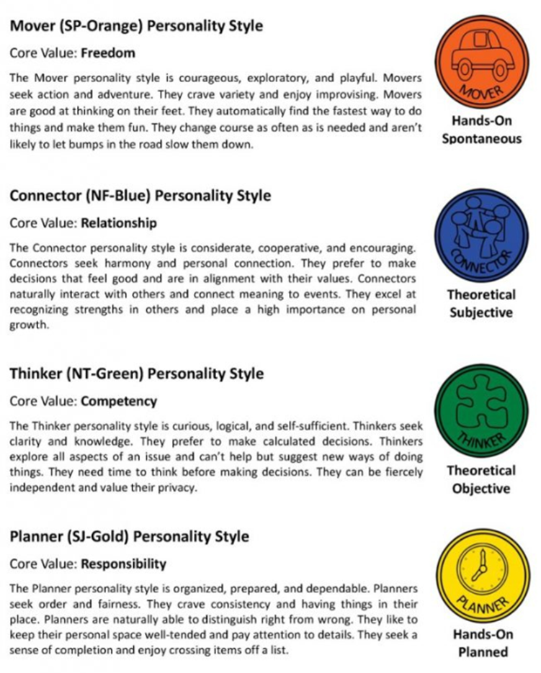
Go through the personality styles and ask your mentee which one they most identify with and why.
Open up a discussion on whether one personality type is more dominant when it comes to working in a team or if it is important to have a mix of the different personality types.

