Slide 1
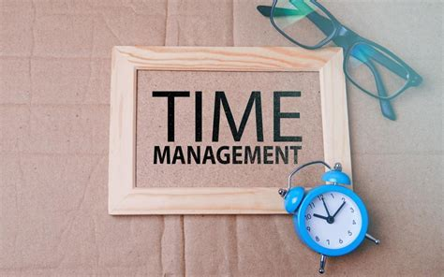

Mentor Toolkit

Slide 2


Using the Mentor Toolkit
  Please download a copy of this presentation onto your own computer
  Feel to free to edit and adapt these resources to suit your mentoring style
  You do not have to (and should not!) use all the activities in this pack, choose the resources that you think will work best for you and your mentee
  If using for an online session, screen share and complete the activities together
  The times given are an estimate - you may find they take less or more time, depending on you and your mentee.

Slide 3

Activity 1: Why is time management important?
Time management is the ability to effectively prioritise your work. It is essential for staying productive and ensuring you are meeting your overall objectives. Those with strong time management skills tend to meet deadlines and have a good idea of how long a task will take and are able to plan accordingly. Likewise, they are realistic of time constraints and avoid overbooking themselves.
1.It speeds up the completion of your goals
2.It helps you prioritise your workload
3.You get more done in less time
4.It reduces tension
5.It prevents procrastination
6.It increases concentration power
7.It helps you make better decisions
8.It provides steps to success
9.It helps to increase our productivity

Slide 4

Decision-making
Knowing how to spend your time takes a lot of decision making. You need to have the skills to choose which work is most important to do.
You also need to have the ability to decide when to agree to a project or professionally decline.
Planning
Knowing how to plan out your day is a key component of having good time management. Planning consists of scheduling your meetings, appointments and daily tasks.
Another part of the planning process is having tools and resources that keep you on task. Those who know how to manage their time can plan the length of a project or task.

Slide 5
Organisation
Staying organised is a major part of being on top of your work.
By having your desk in order and your calendar up to date, you stay calm and collected while figuring out what you need to do.
Being organised can help you prioritise your tasks, get to meetings on time and hand in quality work.
Prioritising
Being able to assess which tasks are the most important is a big part of knowing how to spend your time at school or work.
Some people choose to complete their fast tasks first so that they have the rest of their week to work on more challenging tasks.
Likewise, some people prefer to do the opposite and it is about finding the balance and what works well for you.
The main thing is knowing your working style and what is going to help you get everything done on time.

Slide 6
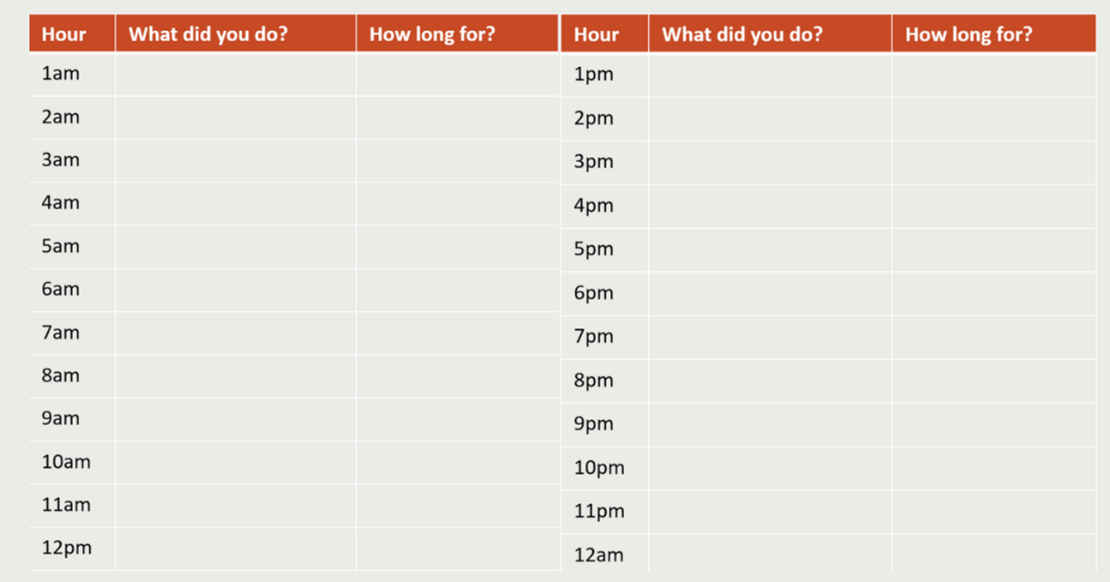
Activity 2: How do you spend your day?
We each have approximately 112 waking hours a week, is your mentee using them effectively to achieve their goals? Support them to fill out a timeline, like the one below, of their previous (or typical) 24 hours. Fill out your own as well. Facilitate a conversation by comparing notes, and exploring if your mentee could spend their time more effectively.

Slide 7
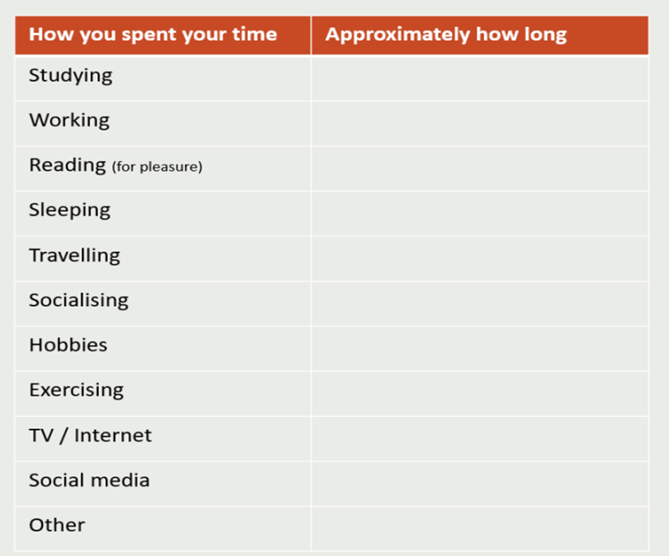
Activity 2: How do you spend your day?
Based on the audit, approximately how much time does your mentee spend on each category below? Does your mentee think they spend too long, or too little on any particular activities? What can they do to create a better balance?

Slide 8
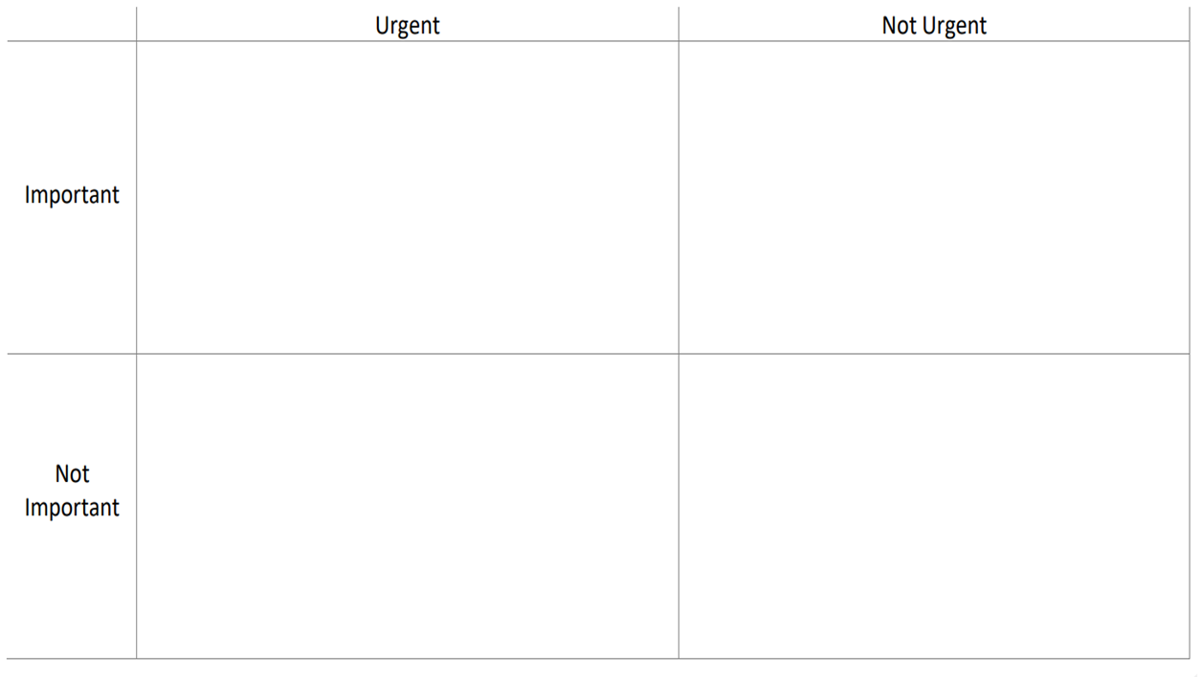
Activity 3: Important vs urgent matrix
Based on everything you have discussed with your mentee, you can spend some time going through the Important vs Urgent matrix.
Add daily tasks into each box and facilitate a conversation around their specific choices.

Slide 9
Top tips for good time management
Top and tail
•Identify a start time and end time for your school/working day. When you reach your end time, try to switch off and get away from your studies or work until the next day.
Make space
•Find a study space that works for you and allows you to have an appropriate work-life balance. That may be as simple as creating a desk that is your workstation in your room or finding a quiet space that works for you around the house.
Reward yourself
•Make plans for evenings and weekends that you can use as an incentive to get your work done in good time.
Be realistic
•Recognise that you won't finish everything that you set out to do every day or week. Use a to-do list to make sure that the higher-priority tasks are completed first and roll over the tasks that are less urgent.

